Slide 1
Safe Multi-Agent Reinforcement Learning with Bi-level Optimization in Autonomous Driving
Zhi Zheng
30.6.2023

Slide 2
Introduction
Motivation
Contribution
Convergence Analysis
Experiments and Results
Q & A

Slide 3
Introduction
Safe reinforcement learning
Stackelberg model
Bi-level optimization

Slide 4
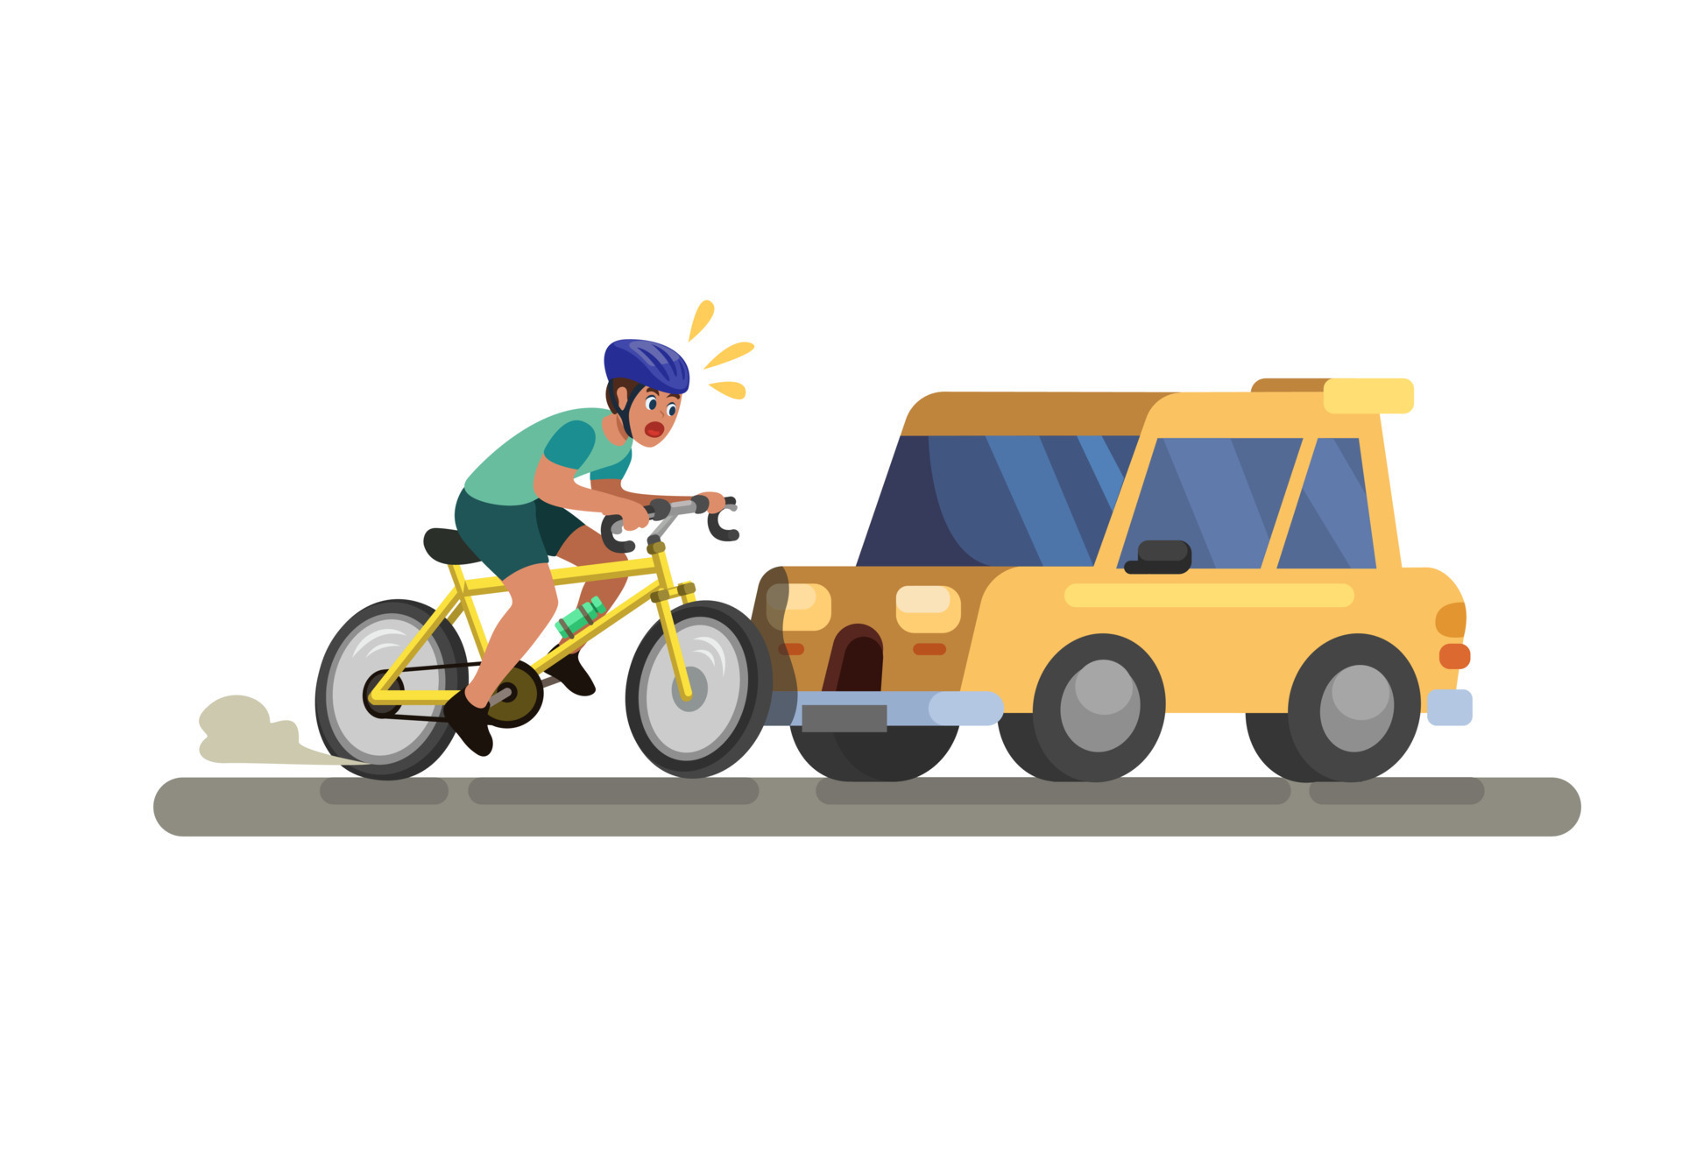
Safe reinforcement learning
Balancing Performance and Safety

Slide 5
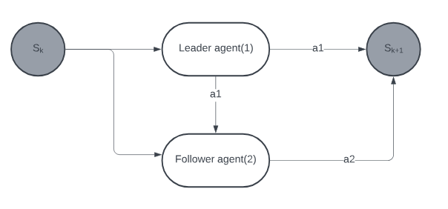
Stackelberg model
Hierarchical decision-making order

Slide 6
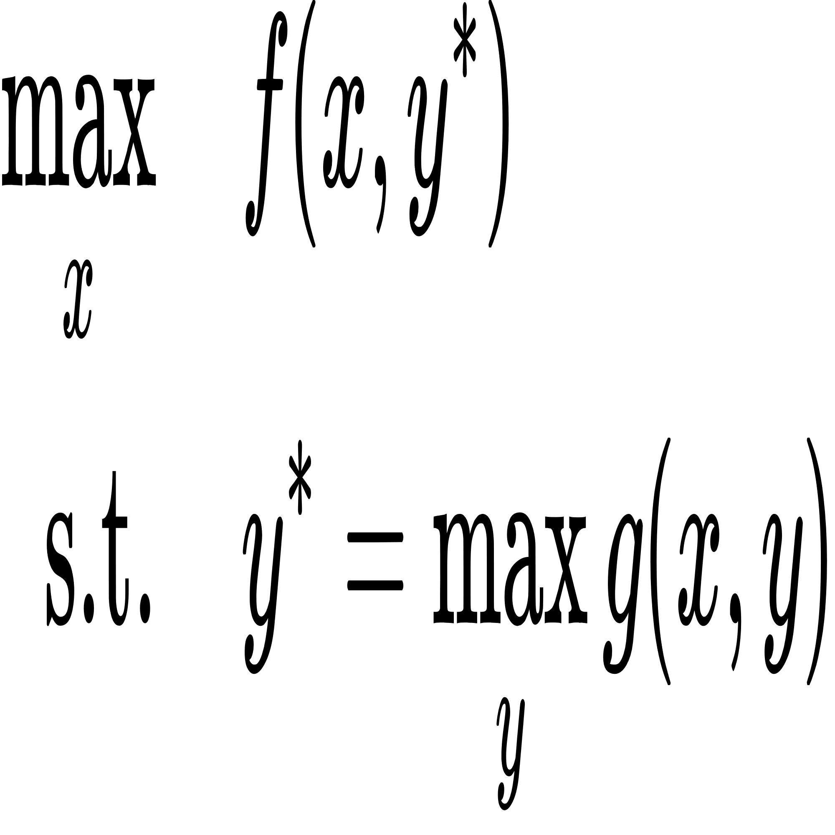
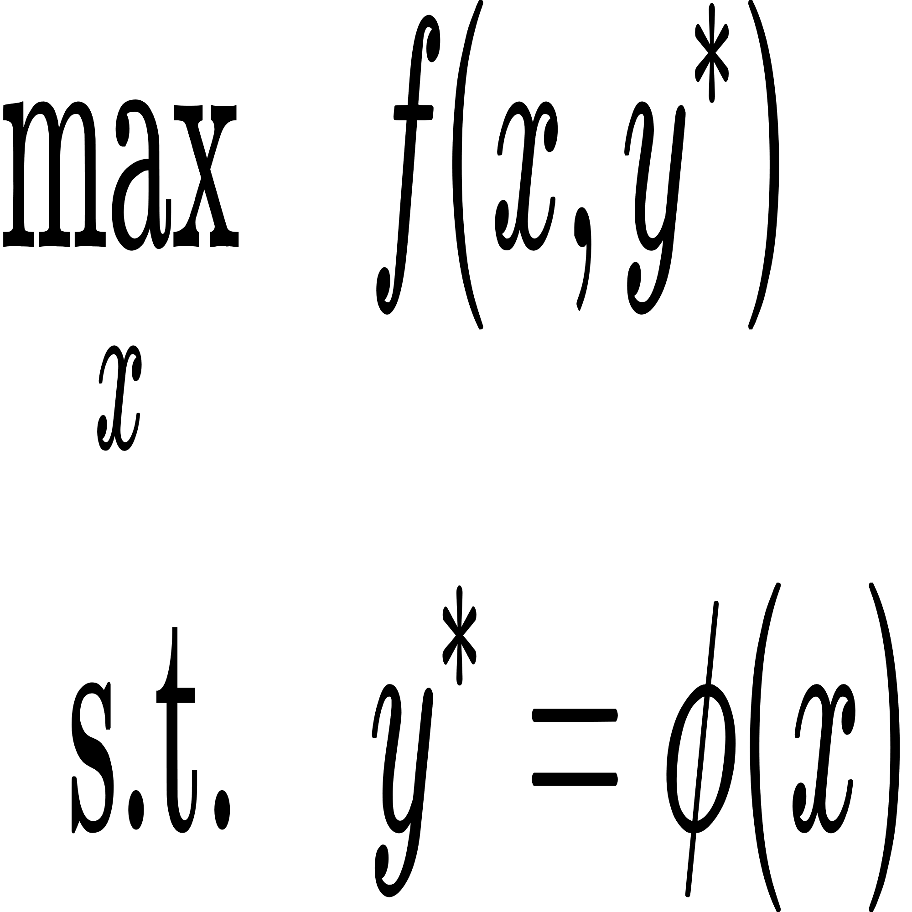
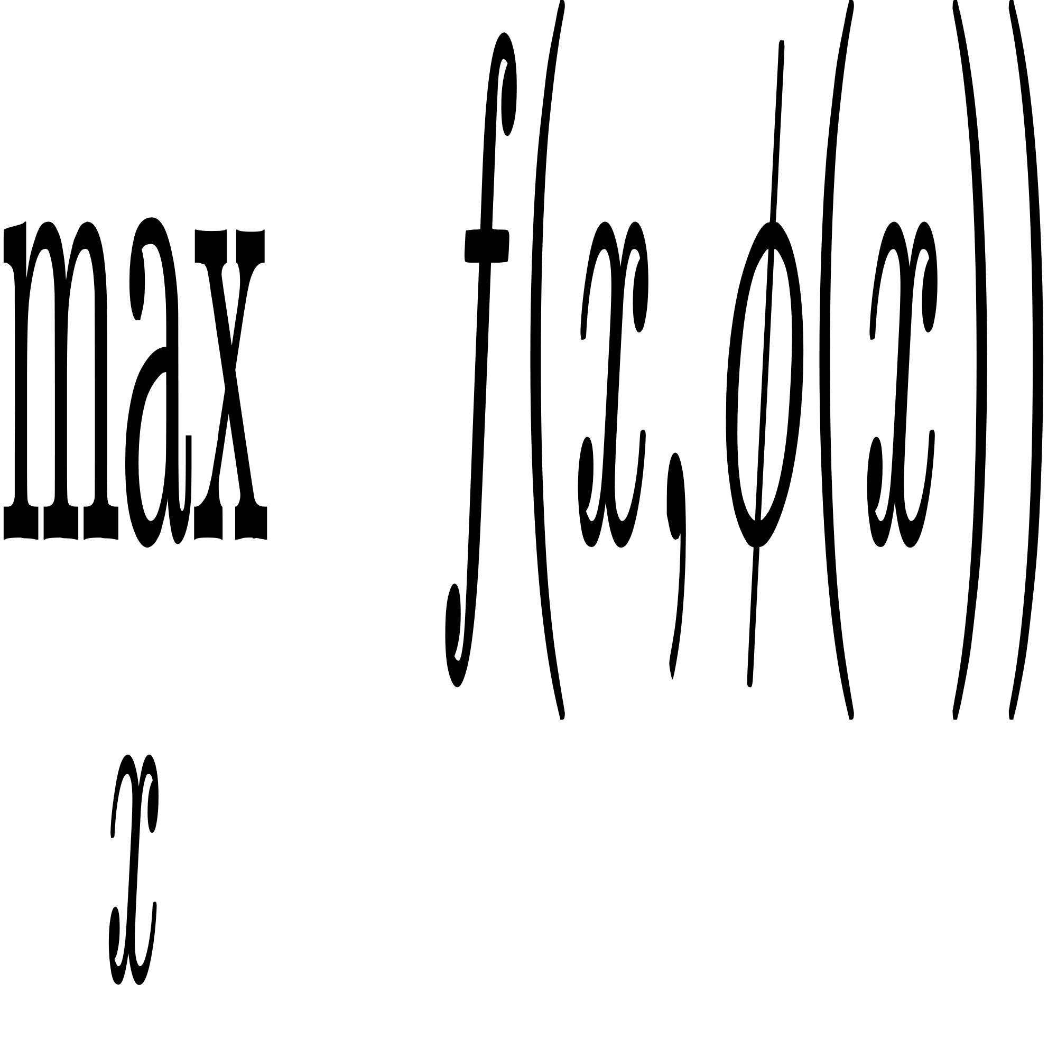
Bi-level optimization
leader \ upper-level problem
follower \ lower-level problm

Slide 7
Motivation
Bi-level Actor-Critic for Multi-agent Coordination
Multiple Nash equilibria result in uncertainty and suboptimality
Stackelberg model is potentially a better solution
Add safety constraints

Slide 8
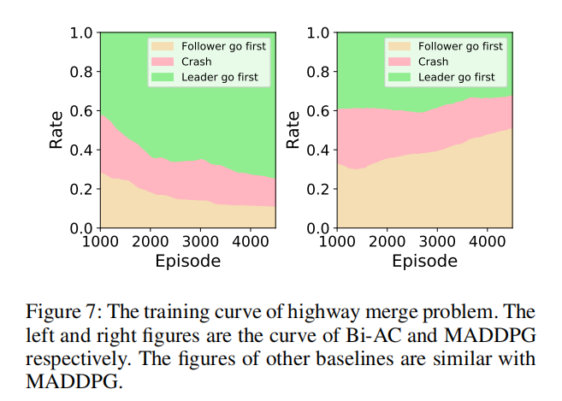

Slide 9
Contribution
Extend Bi-AC algorithm to continuous action space
Propose Constrained Stackelberg Q-learning
Propose Constrained Stackelberg MADDPG
Demenstrate their effectiveness by experiments

Slide 10
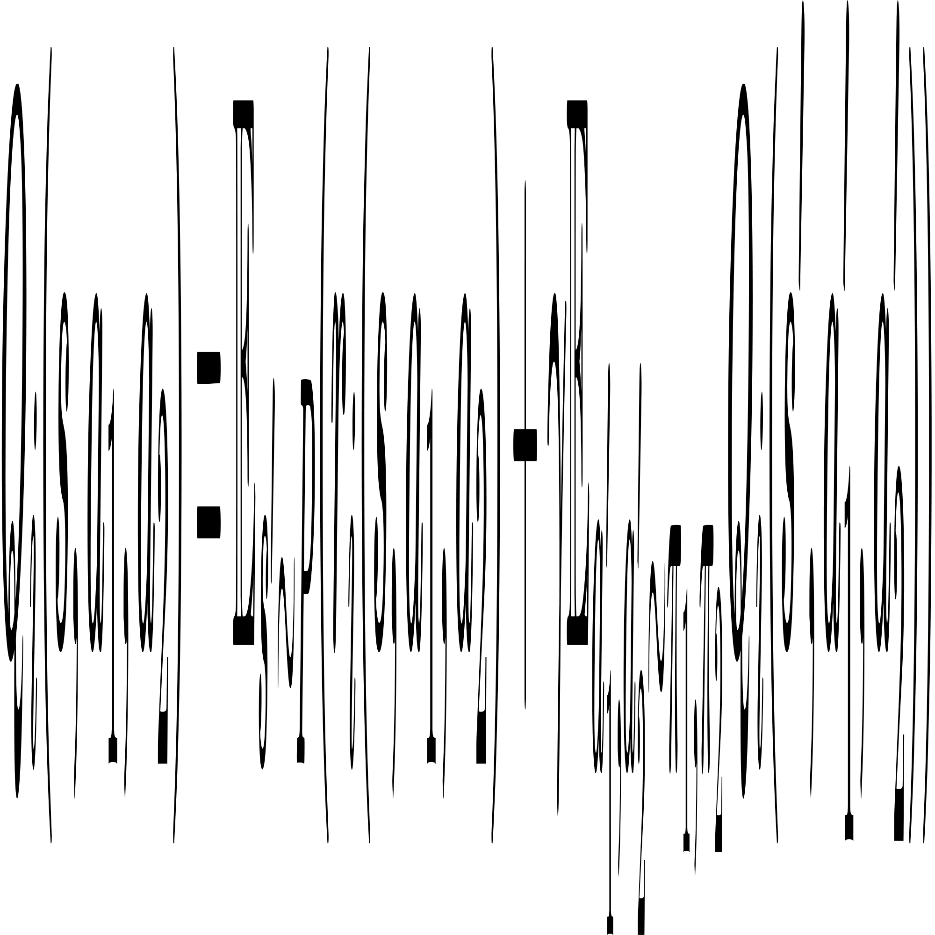
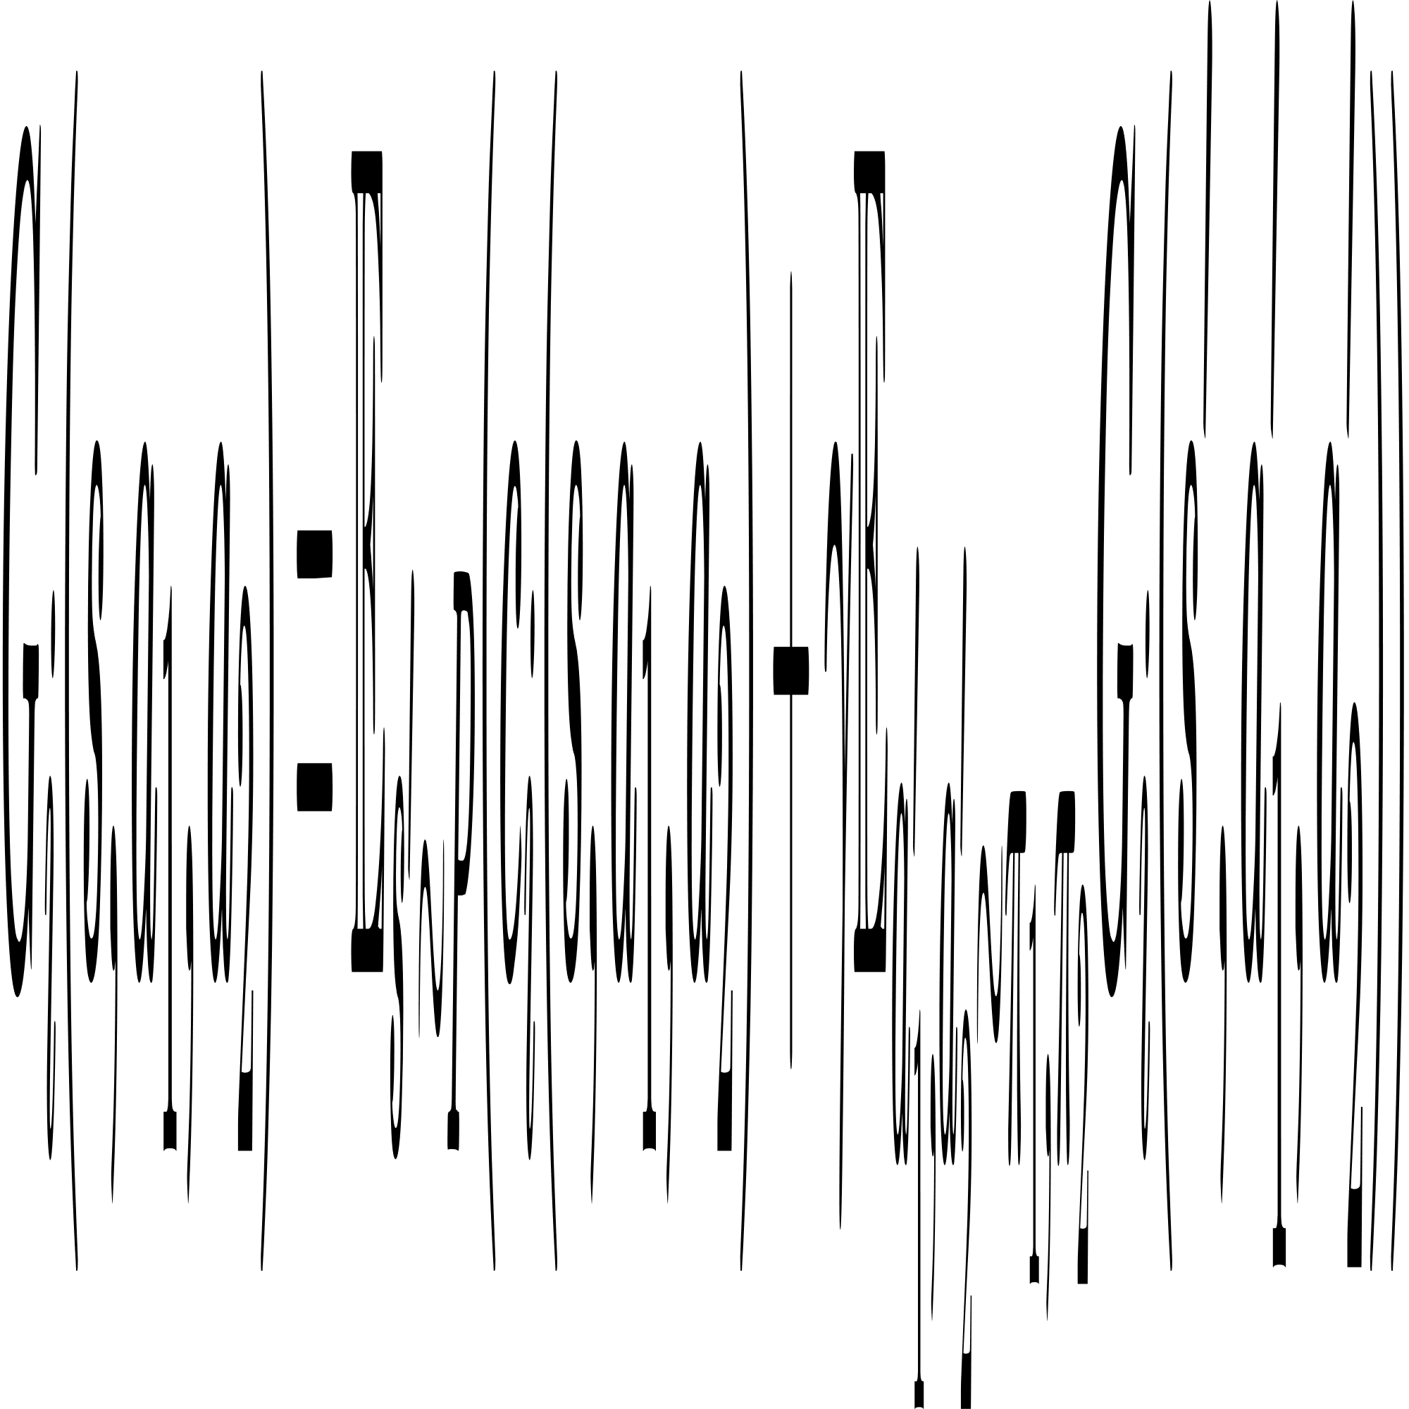
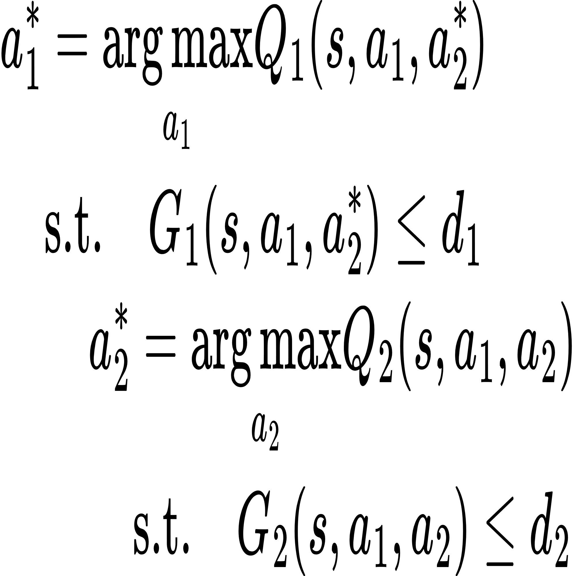
Constrained Stackelberg Q-learning
reward state value function
cost state value function
1. interact with the env
(a₁*, a₂*)
2. update Qi, Gi

Slide 11
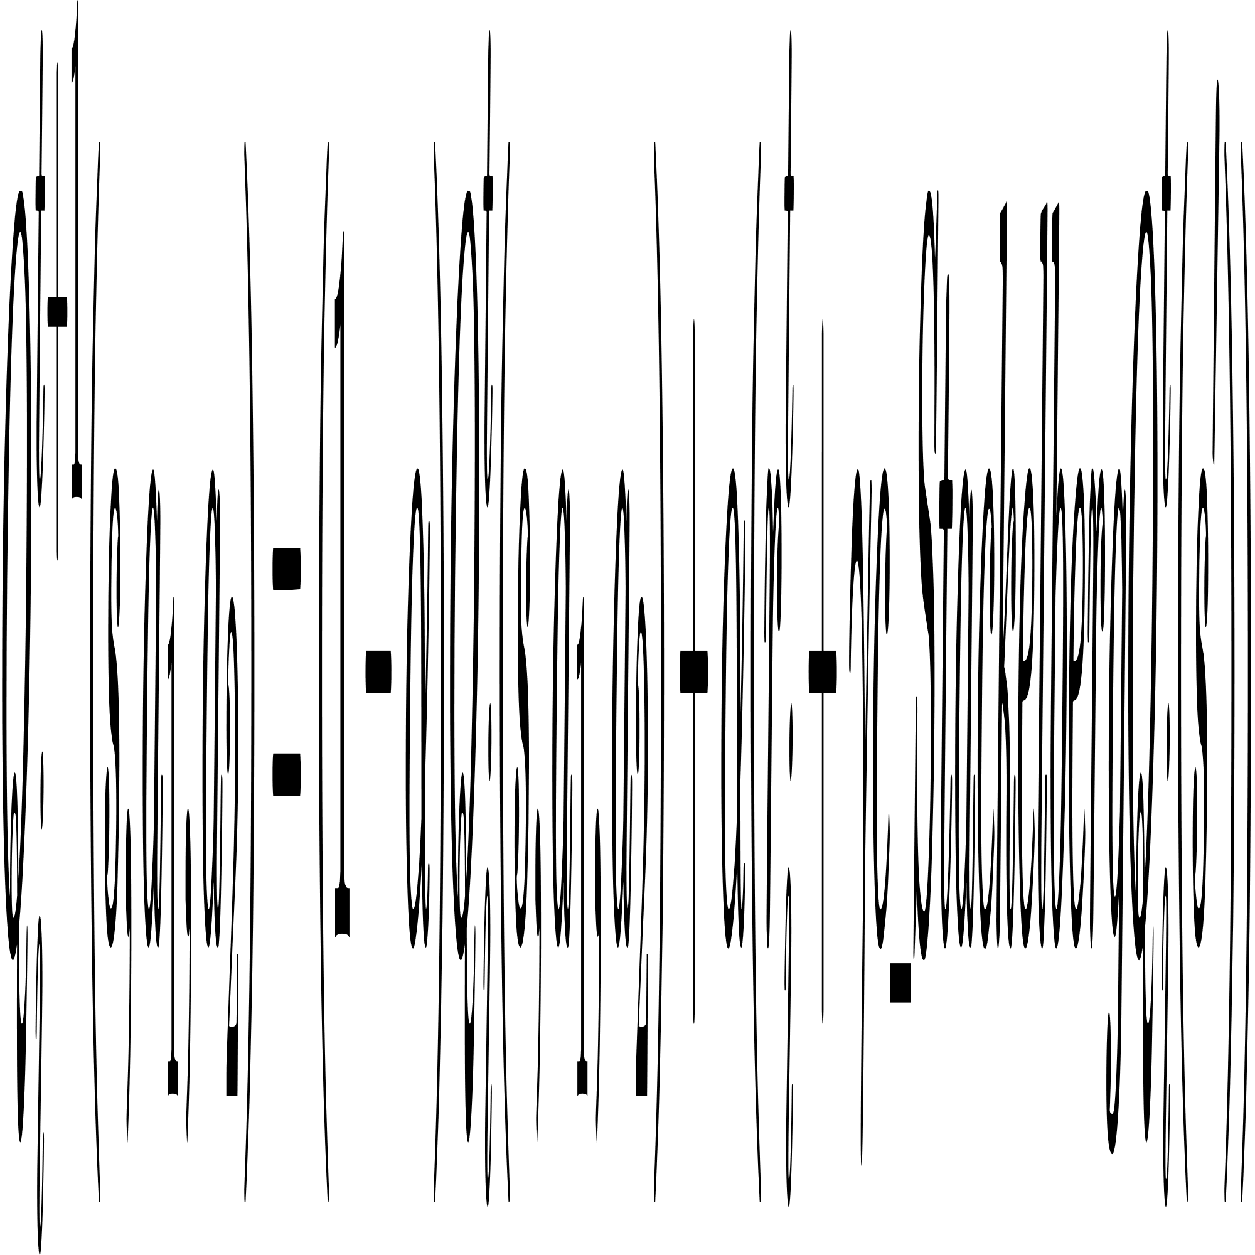
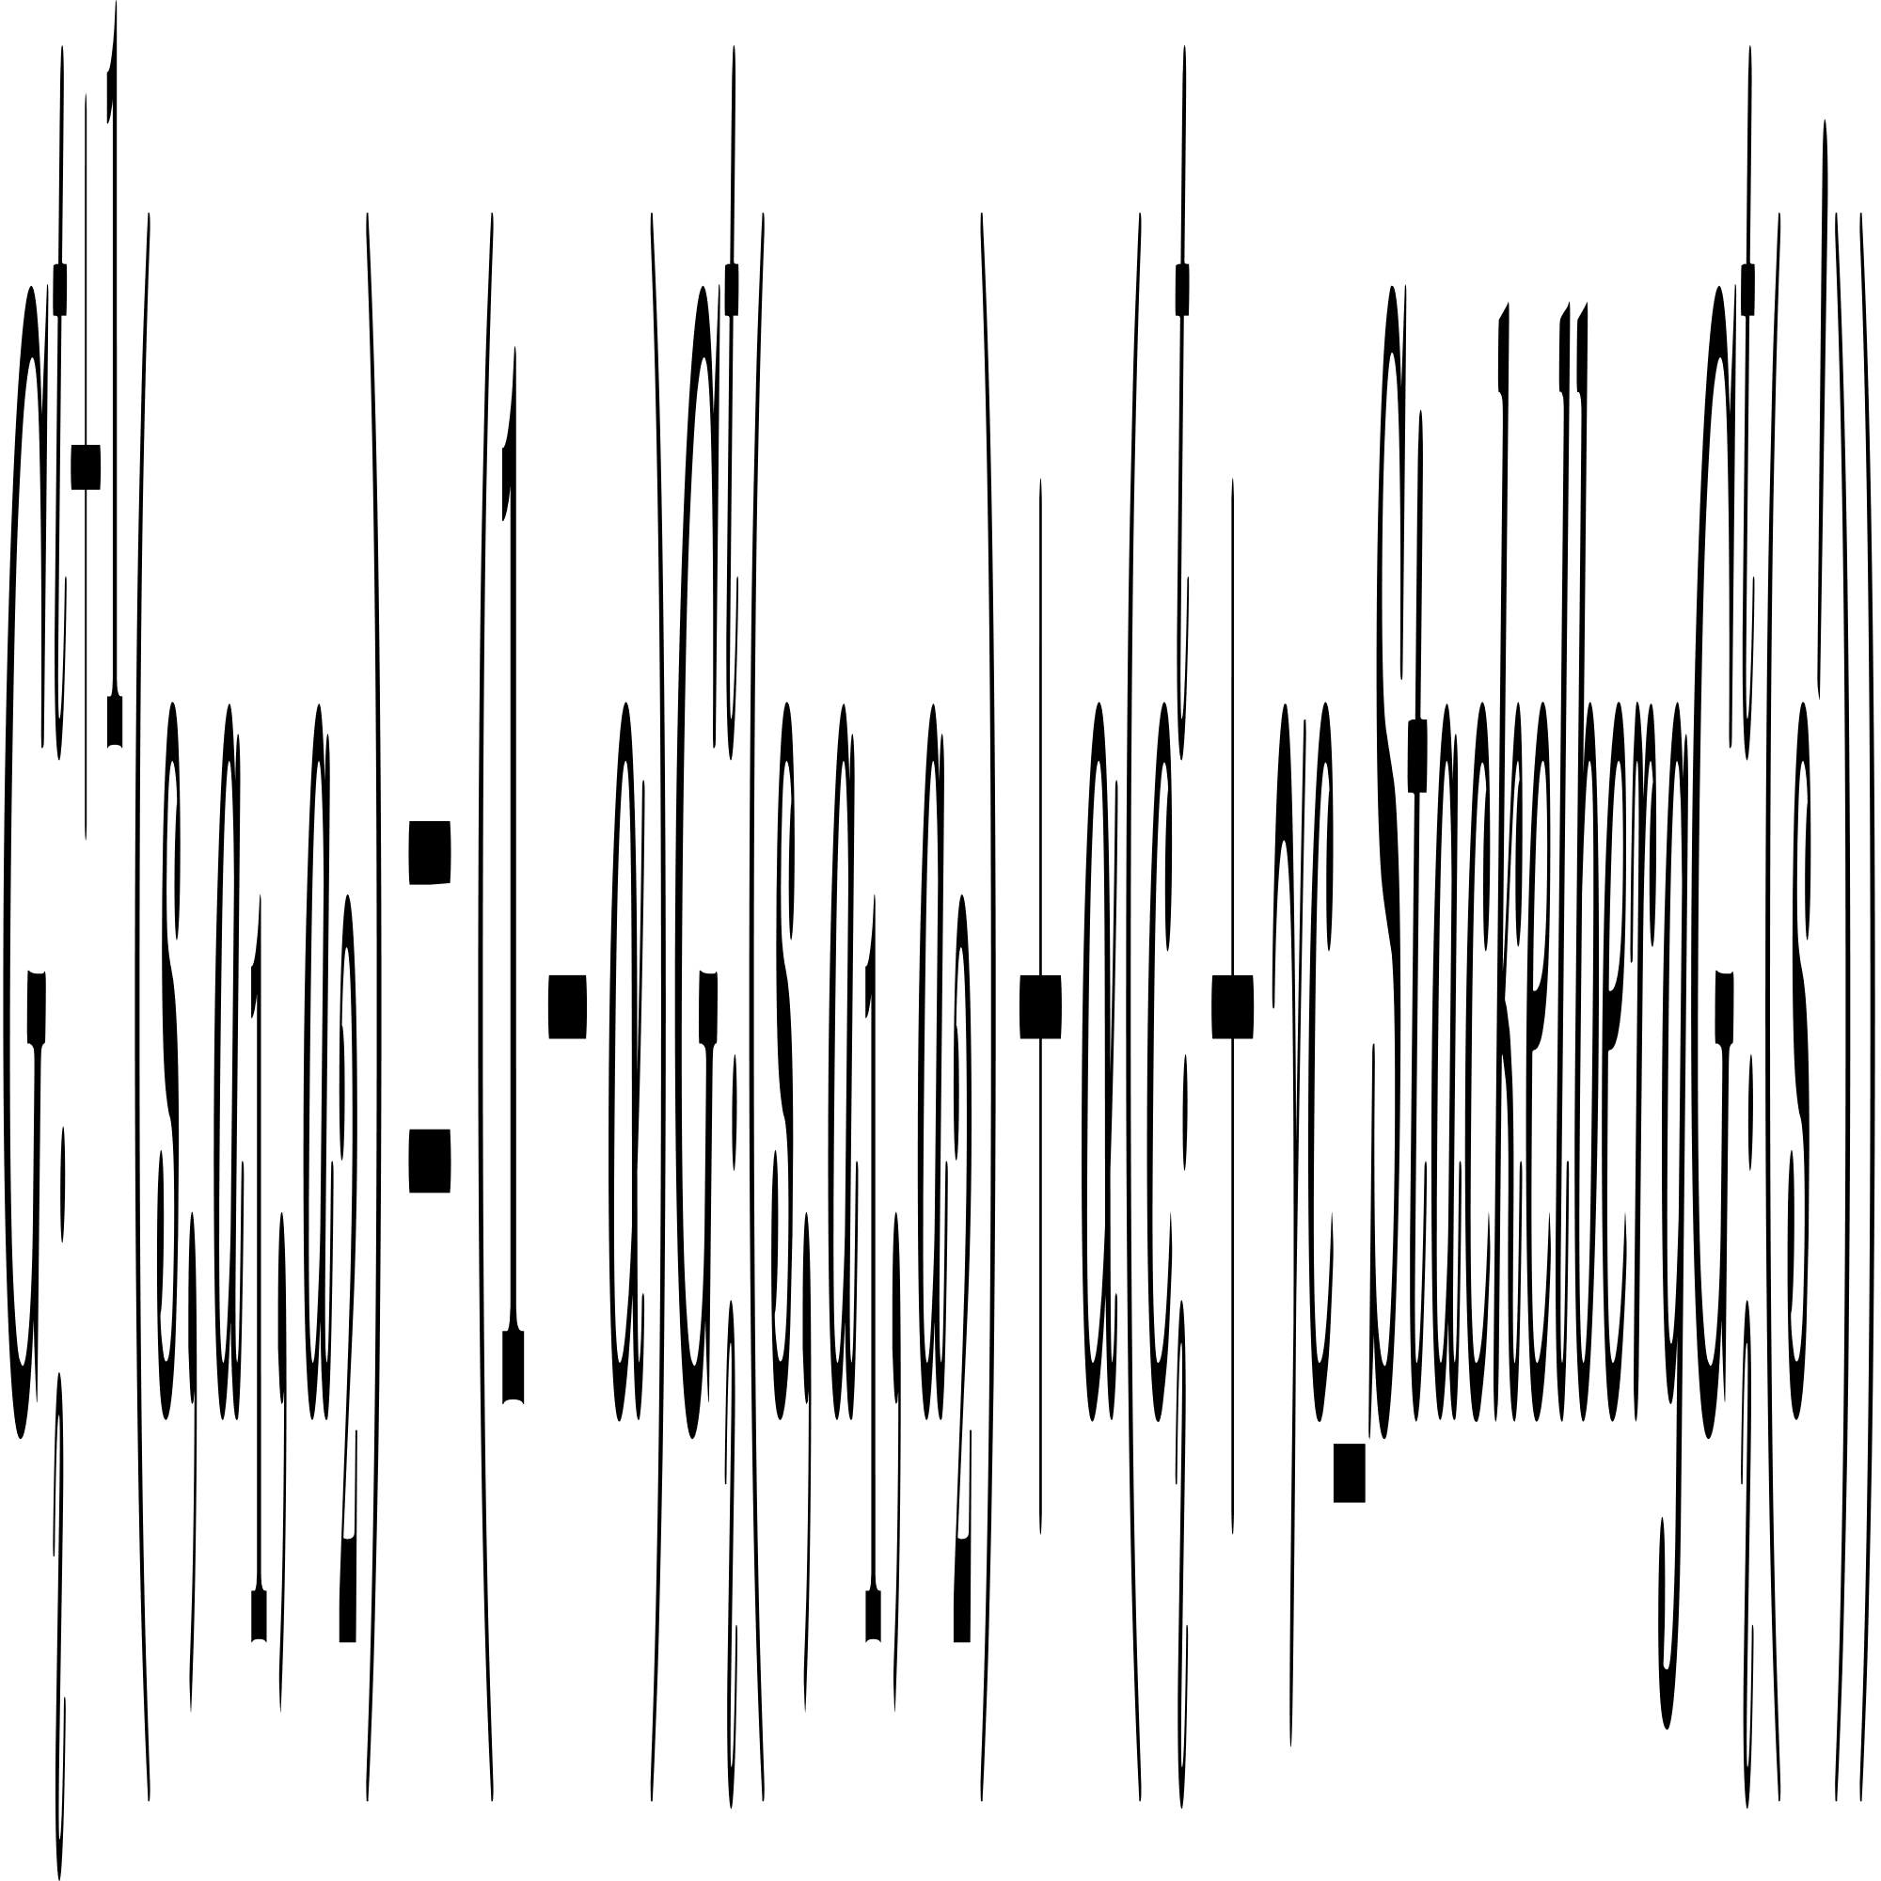
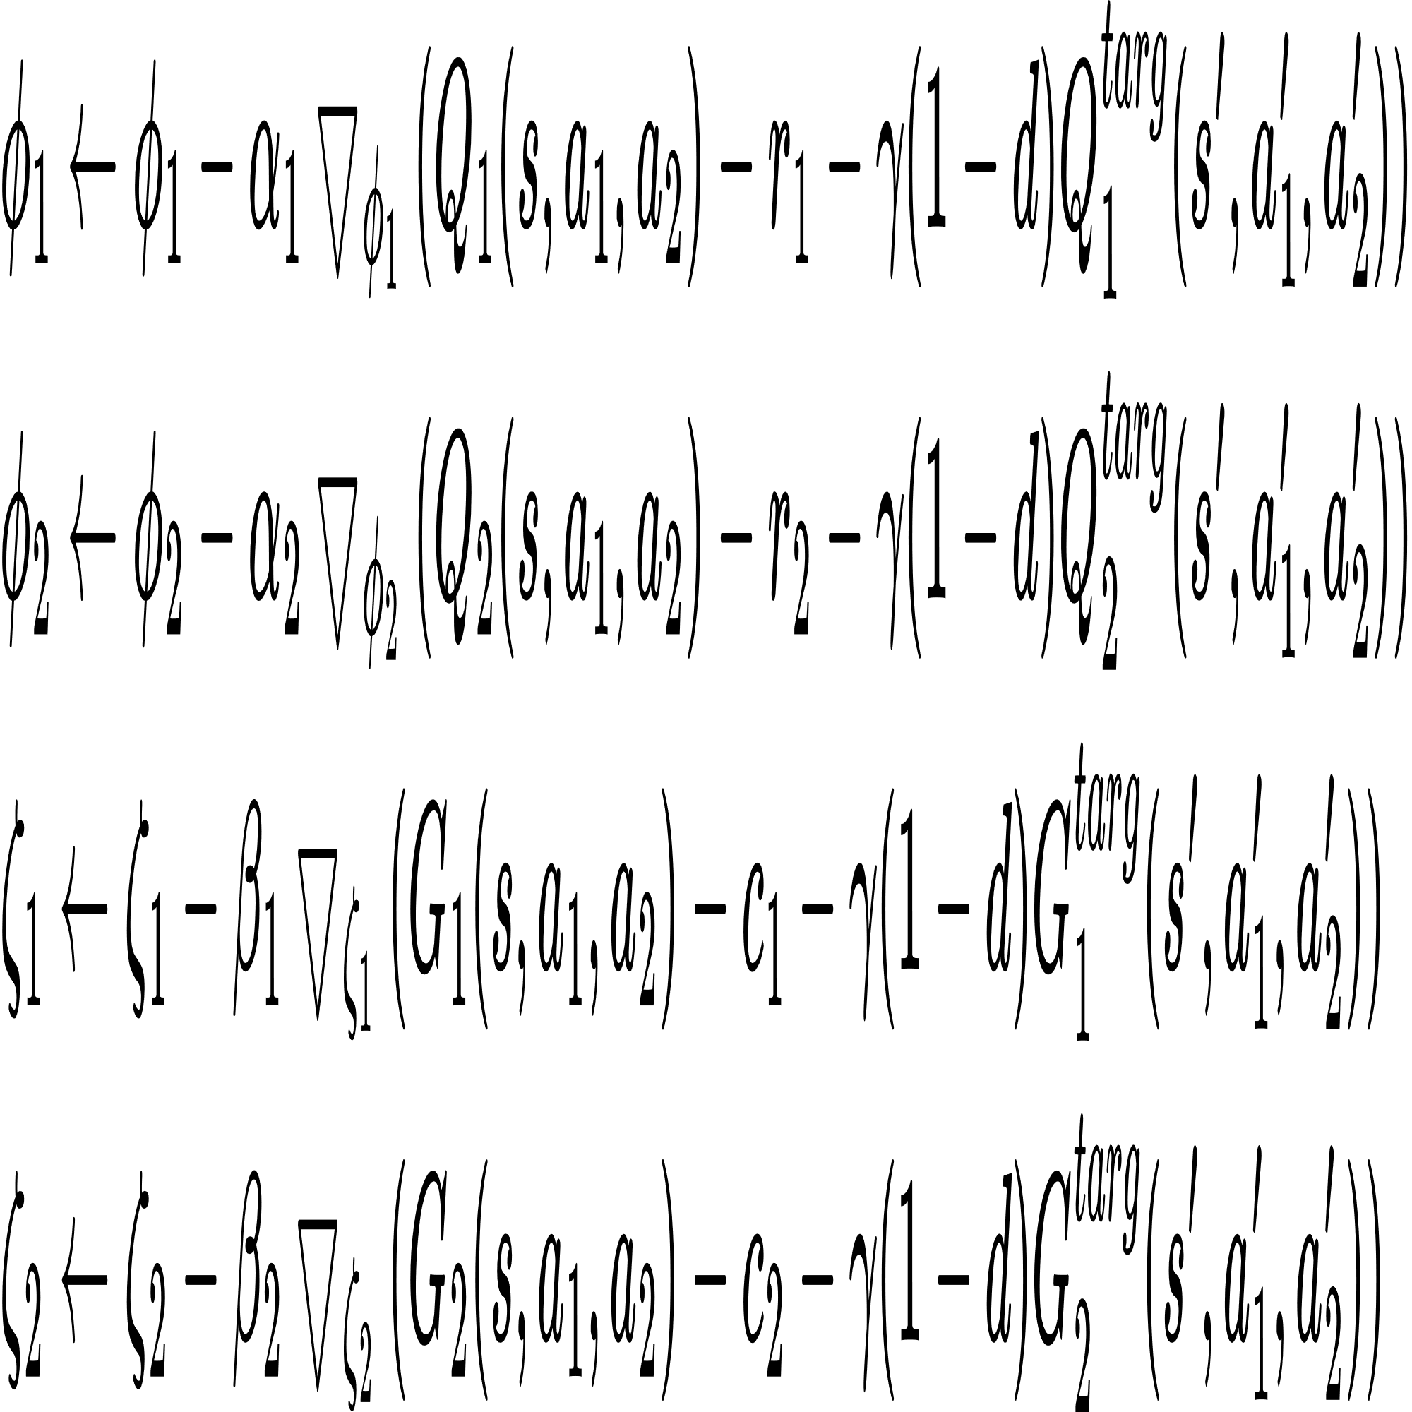
Constrained Stackelberg Q-learning
equilibrium point
minimizing TD-error

Slide 12
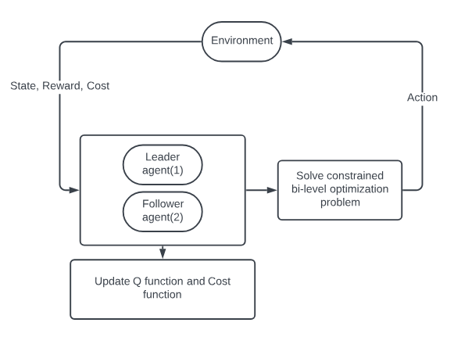
Constrained Stackelberg Q-learning
limit: 1. discrete action space,
2. time complexity O(n^2)

Slide 13
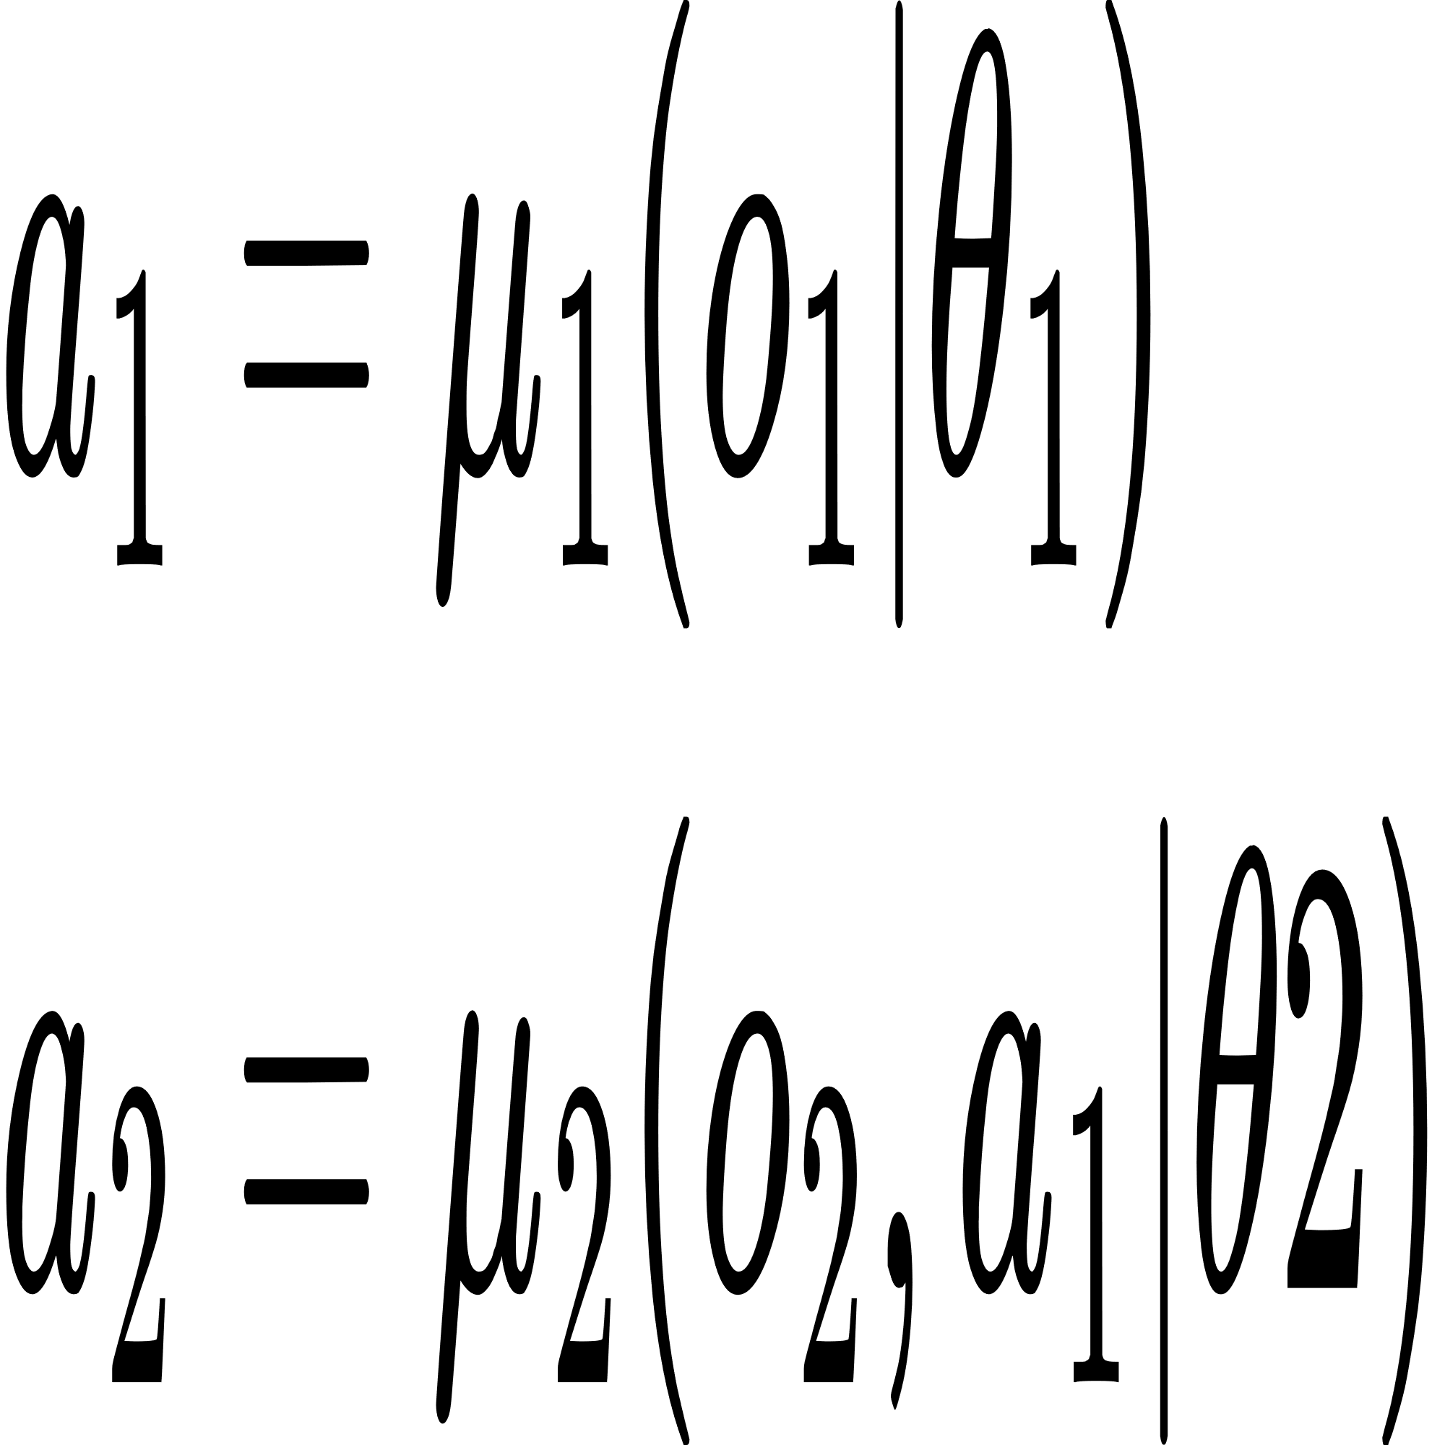
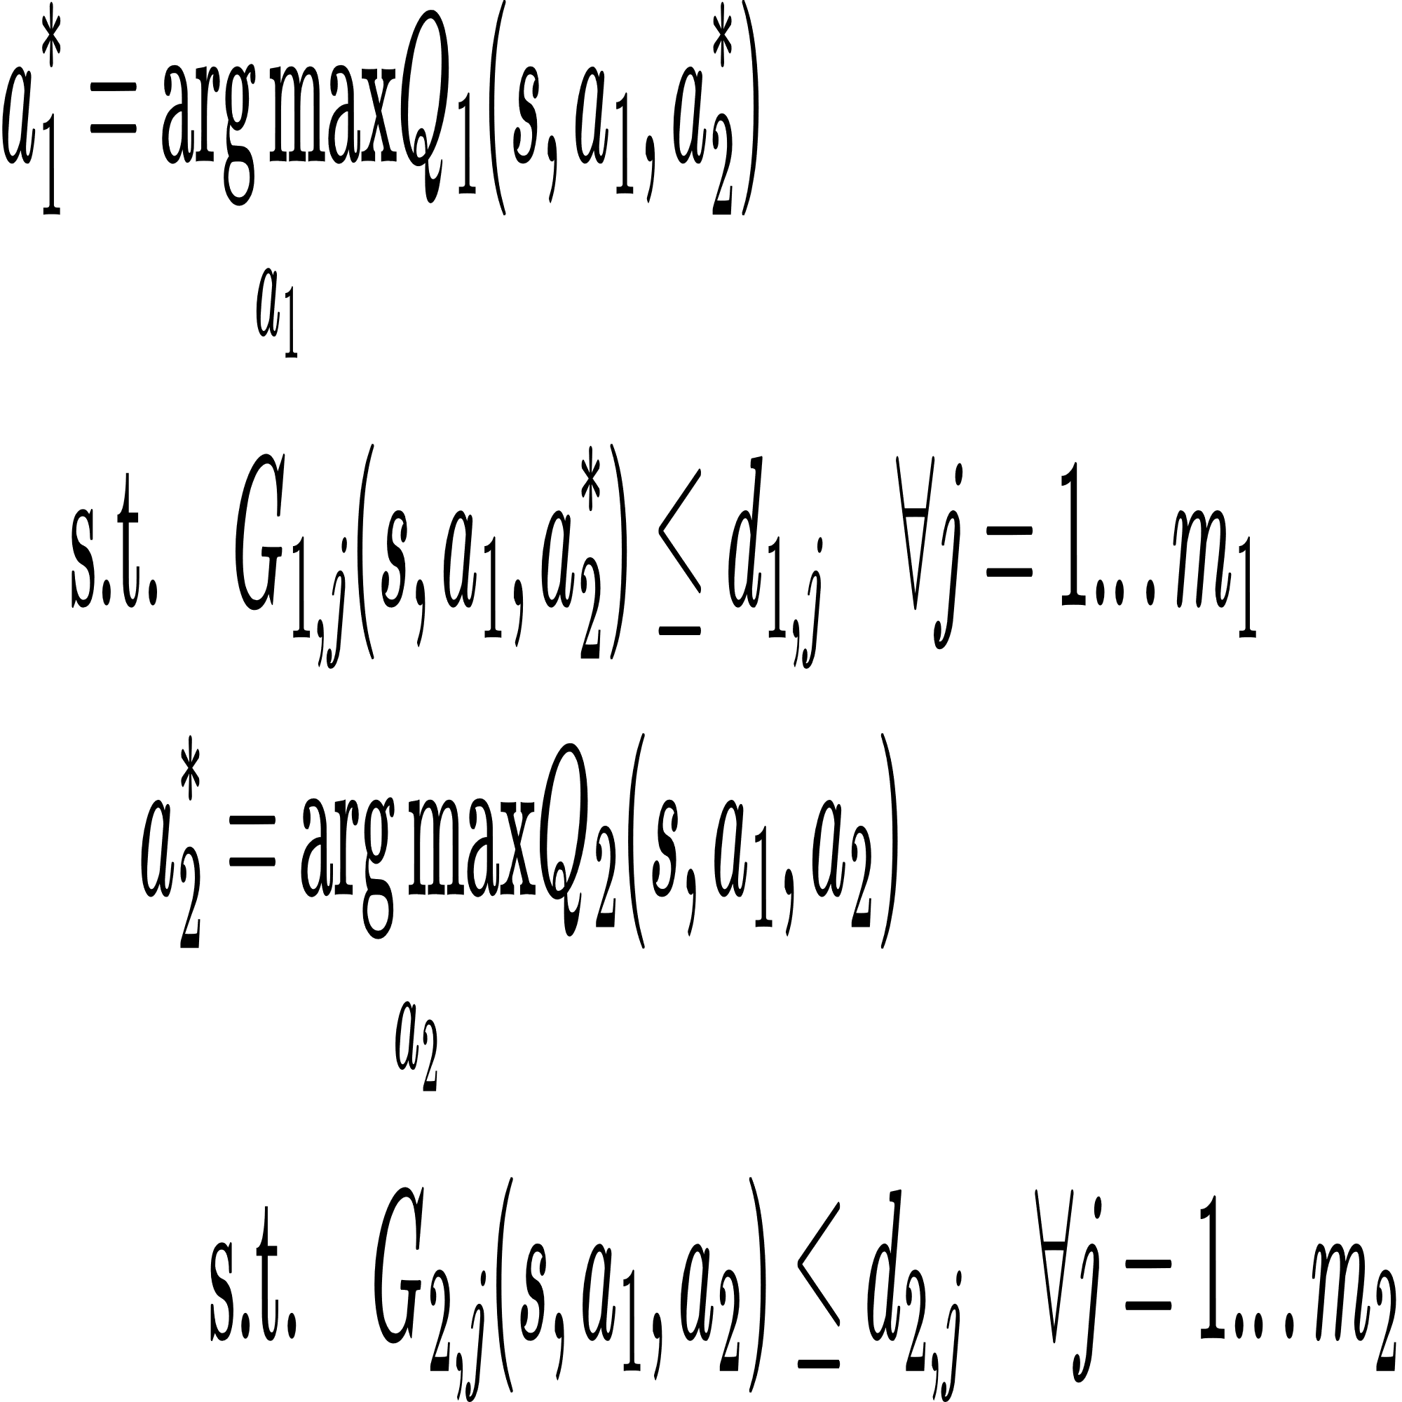
Constrained Stackelberg MADDPG
local observation

Slide 14
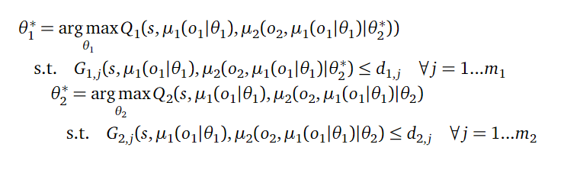
Constrained Stackelberg MADDPG
replace a_{i} with actor parameters θ_{i}

Slide 15
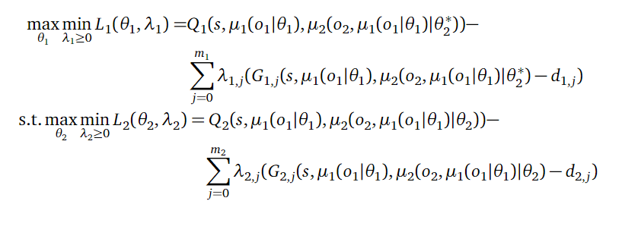
Constrained Stackelberg MADDPG
Lagrangian multiplier
best response function

Slide 16
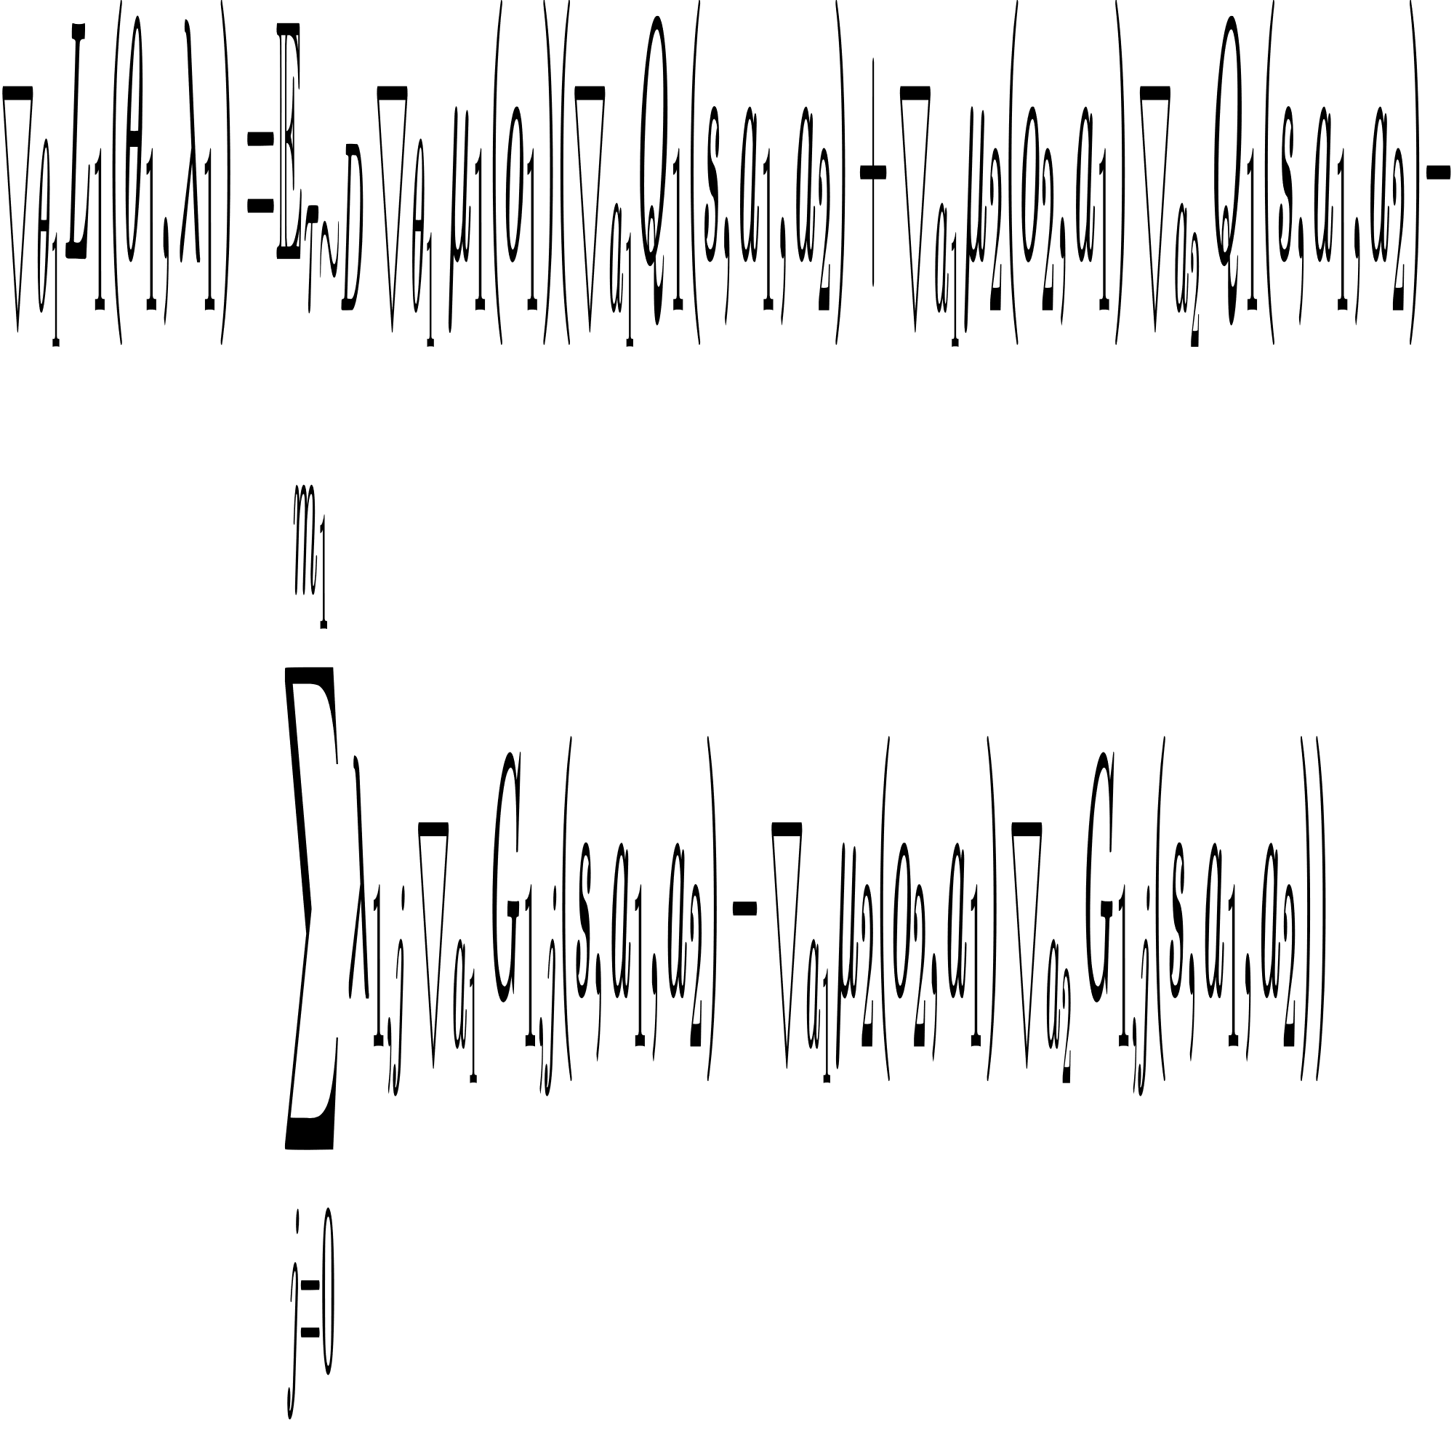
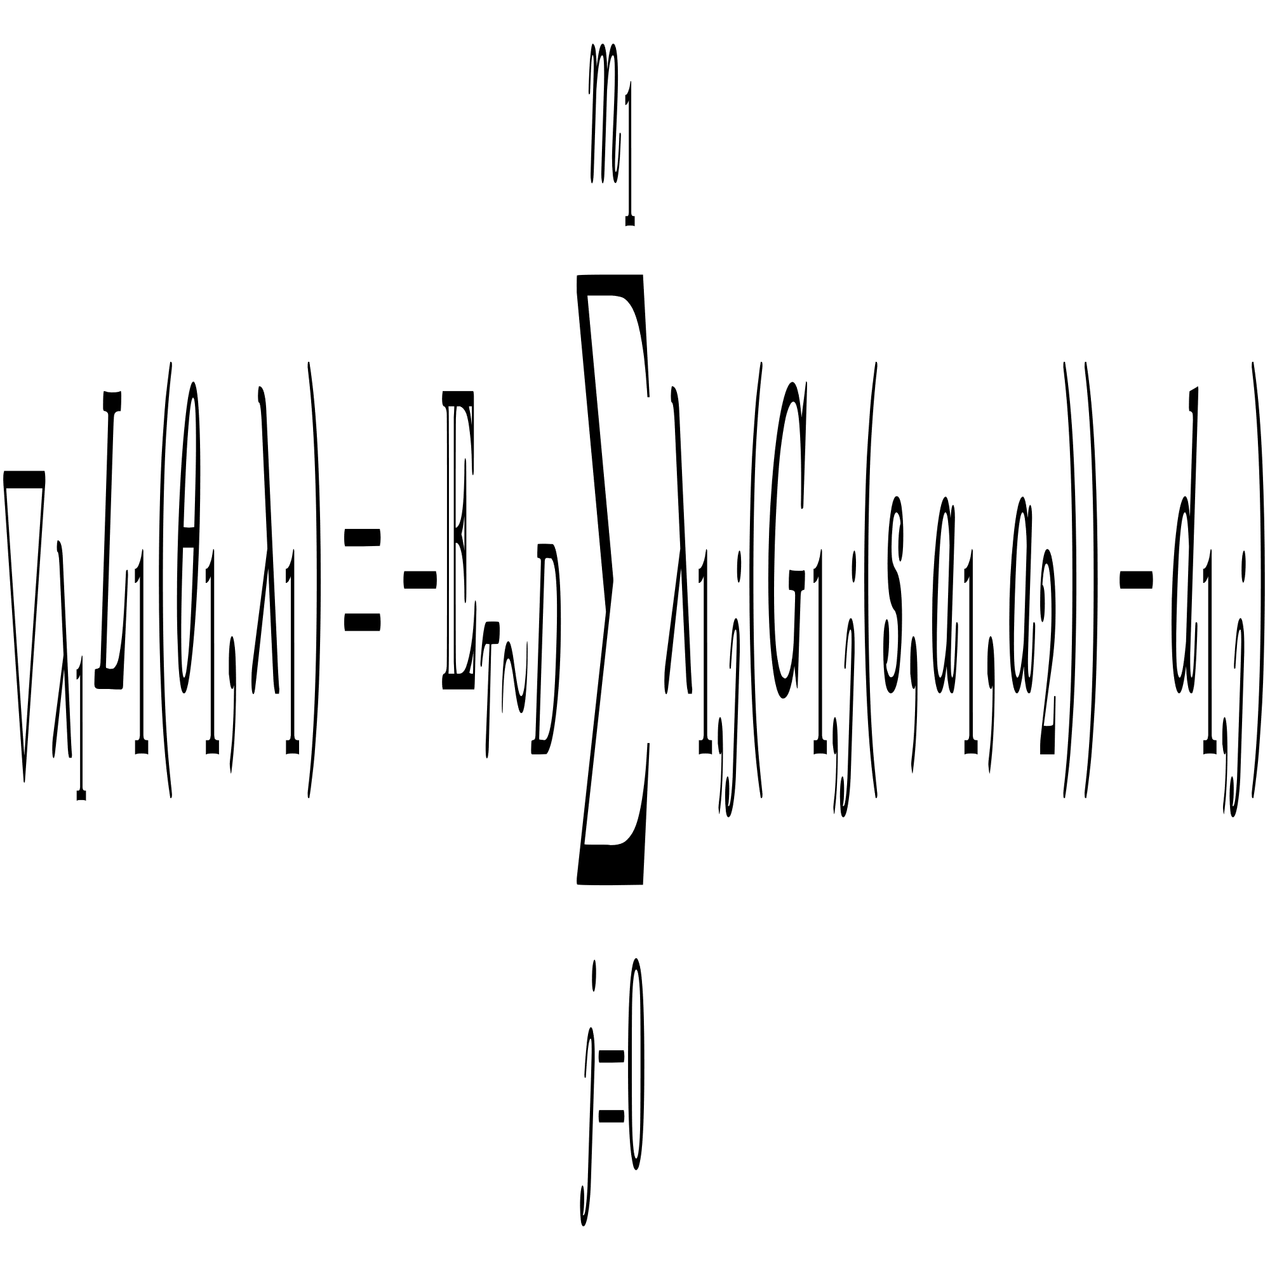
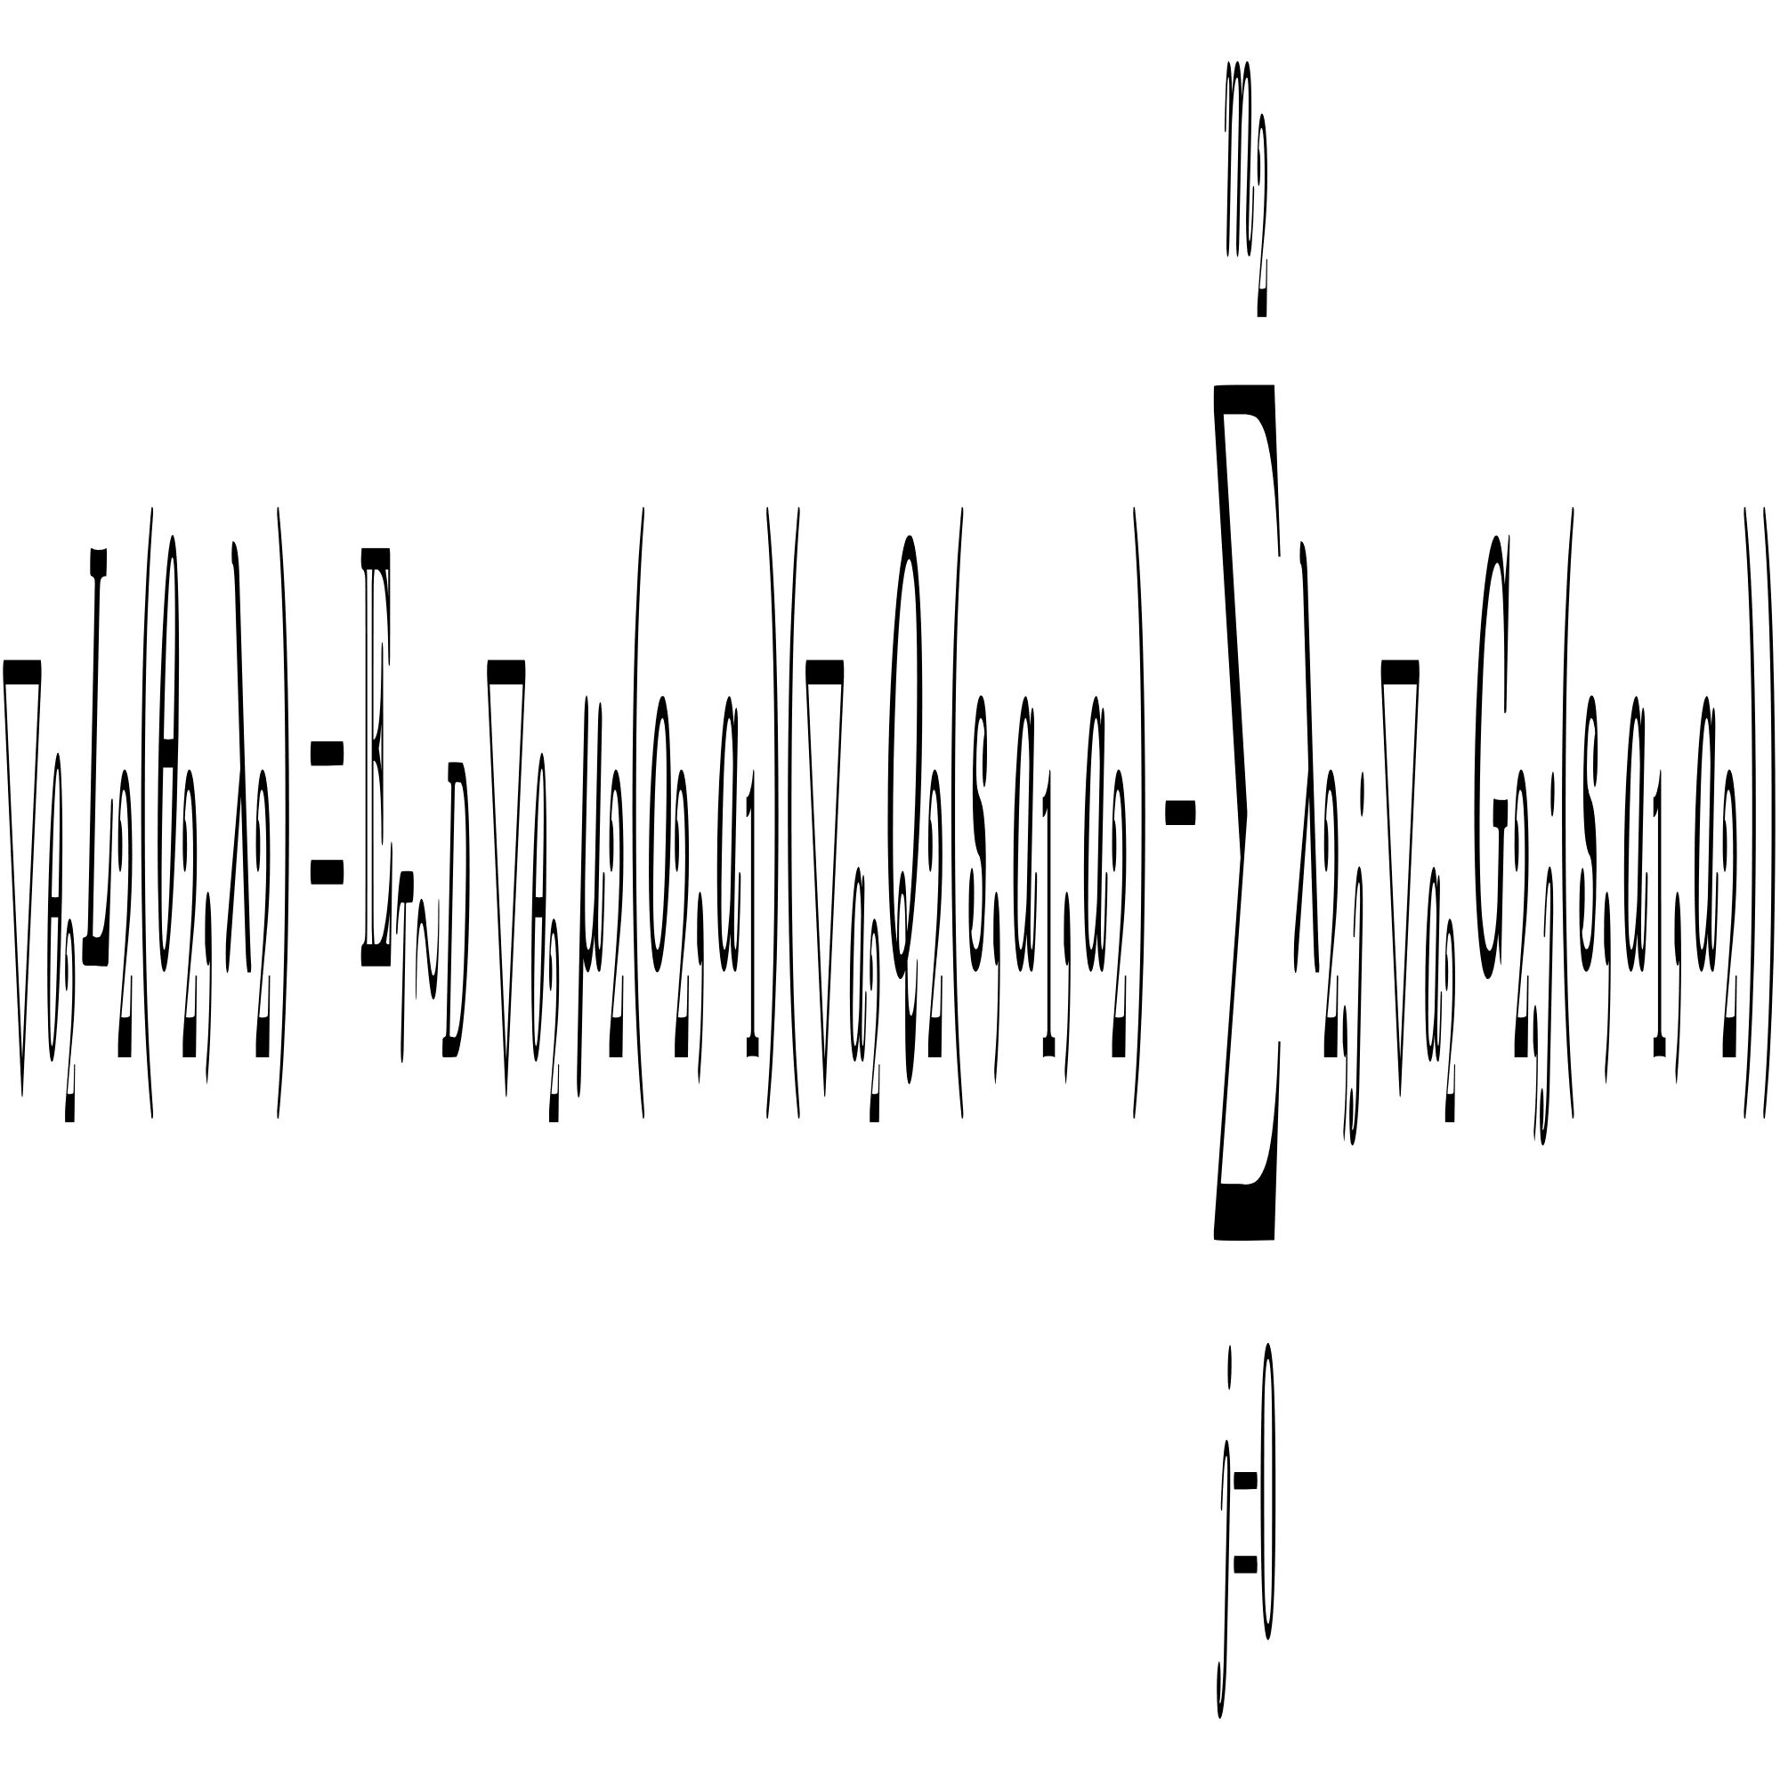
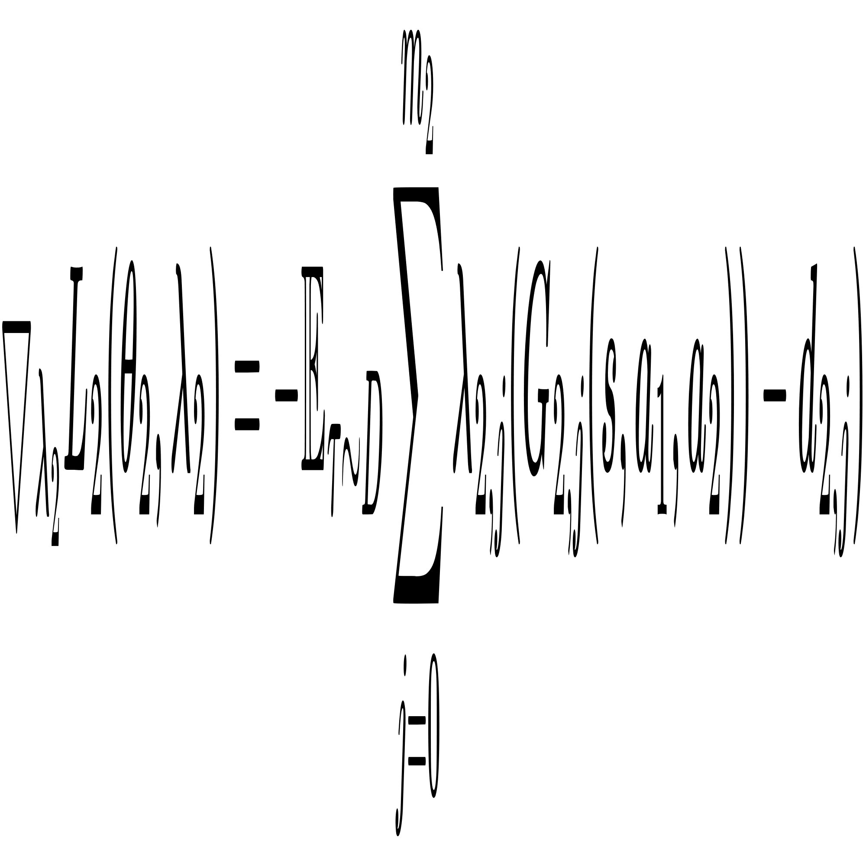
Constrained Stackelberg MADDPG
Leader policy gradient
Follower policy gradient

Slide 17
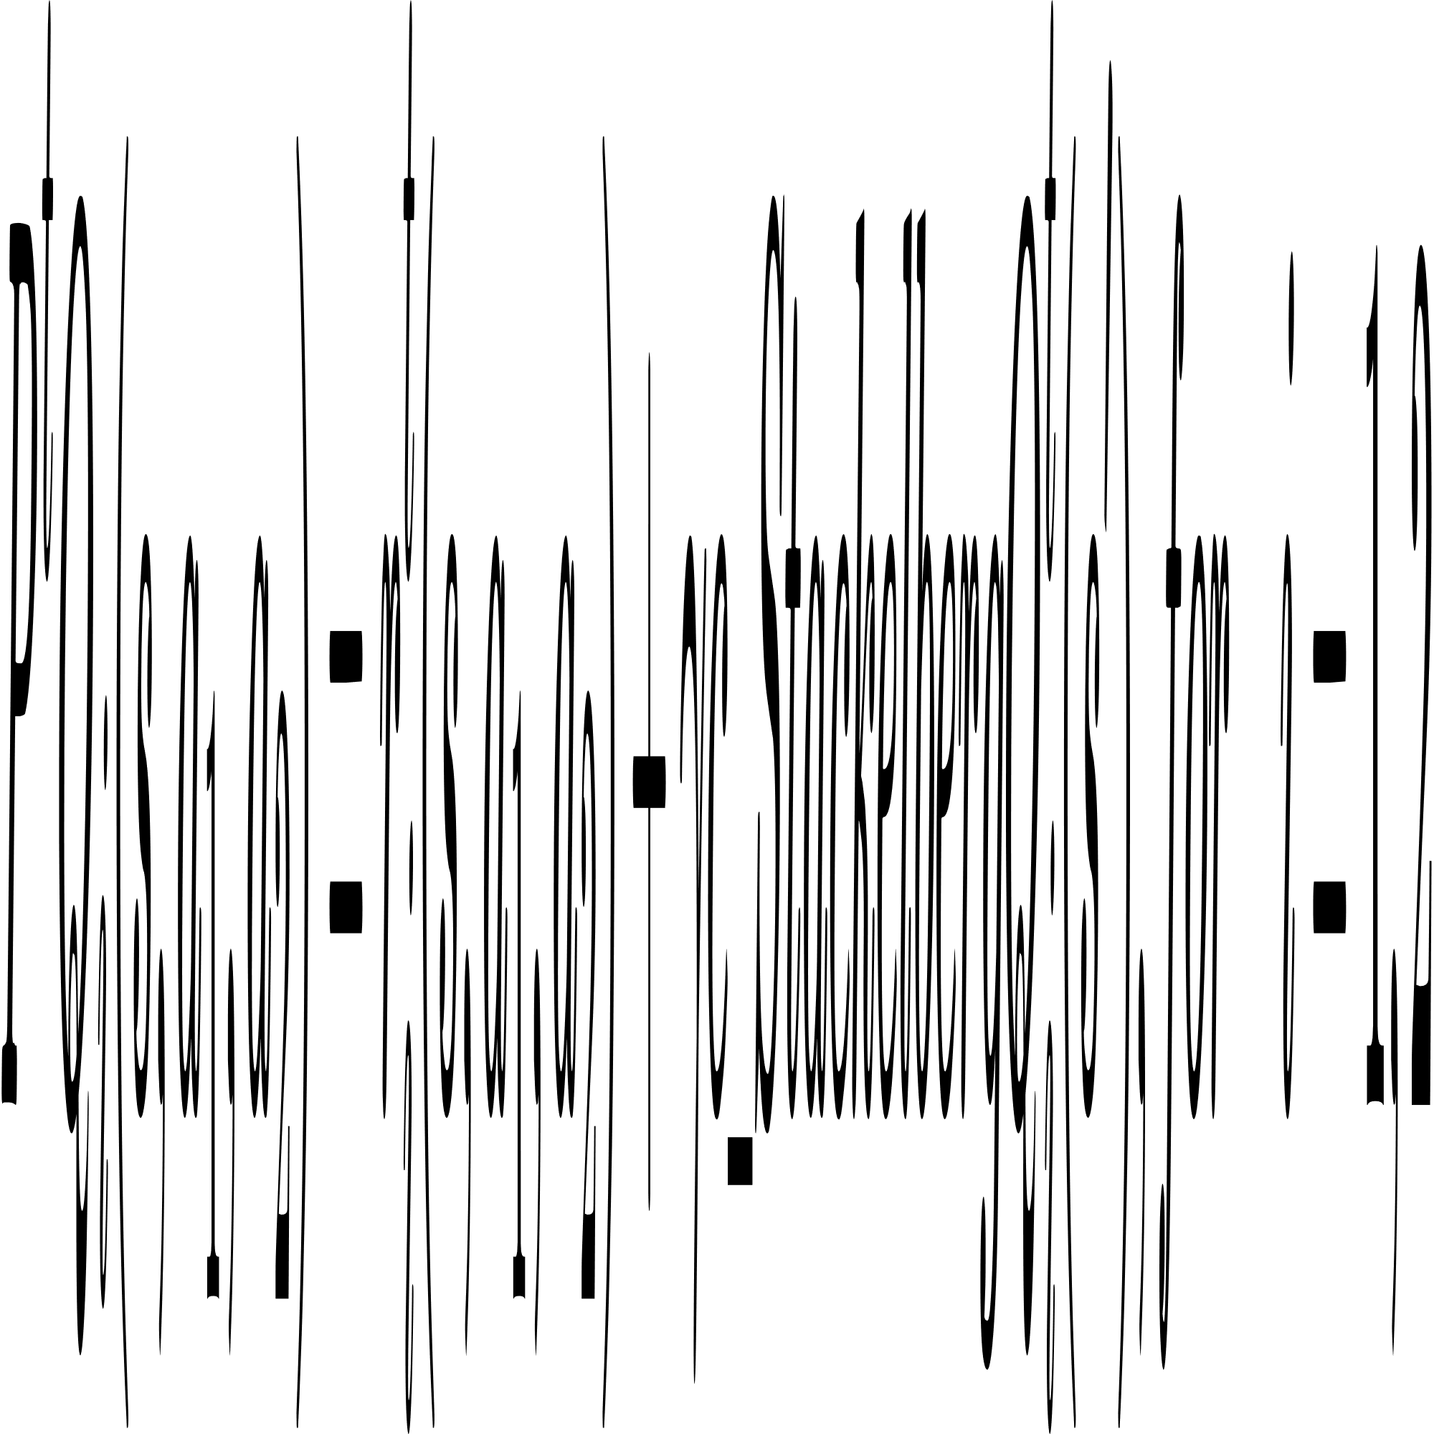
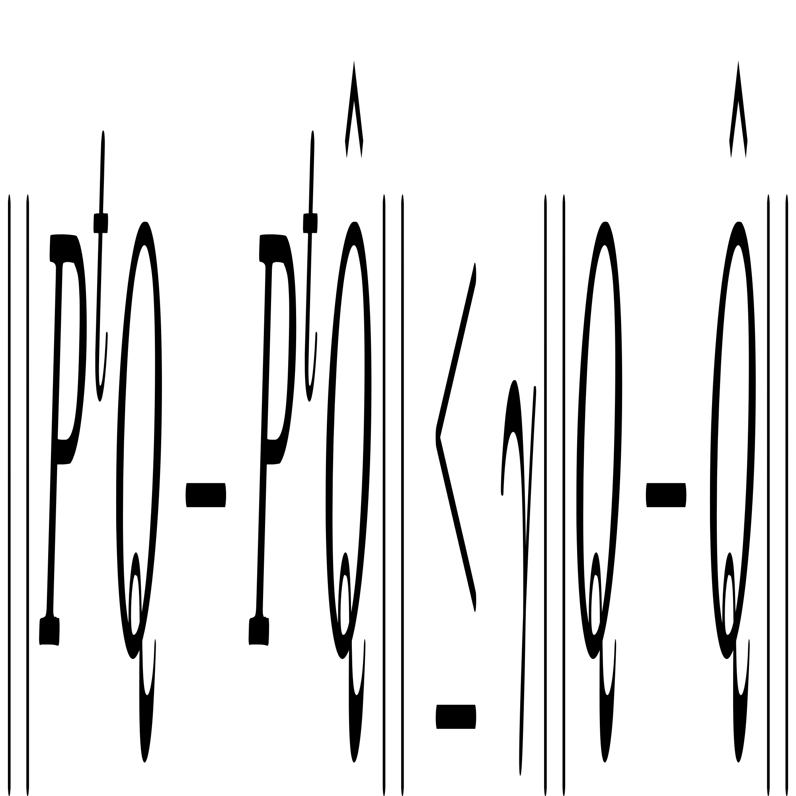
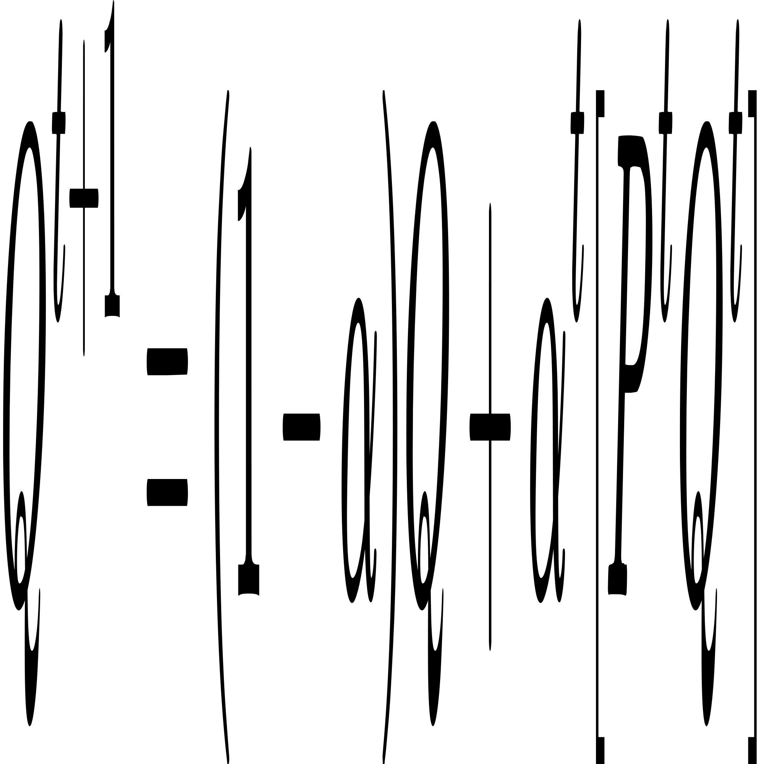
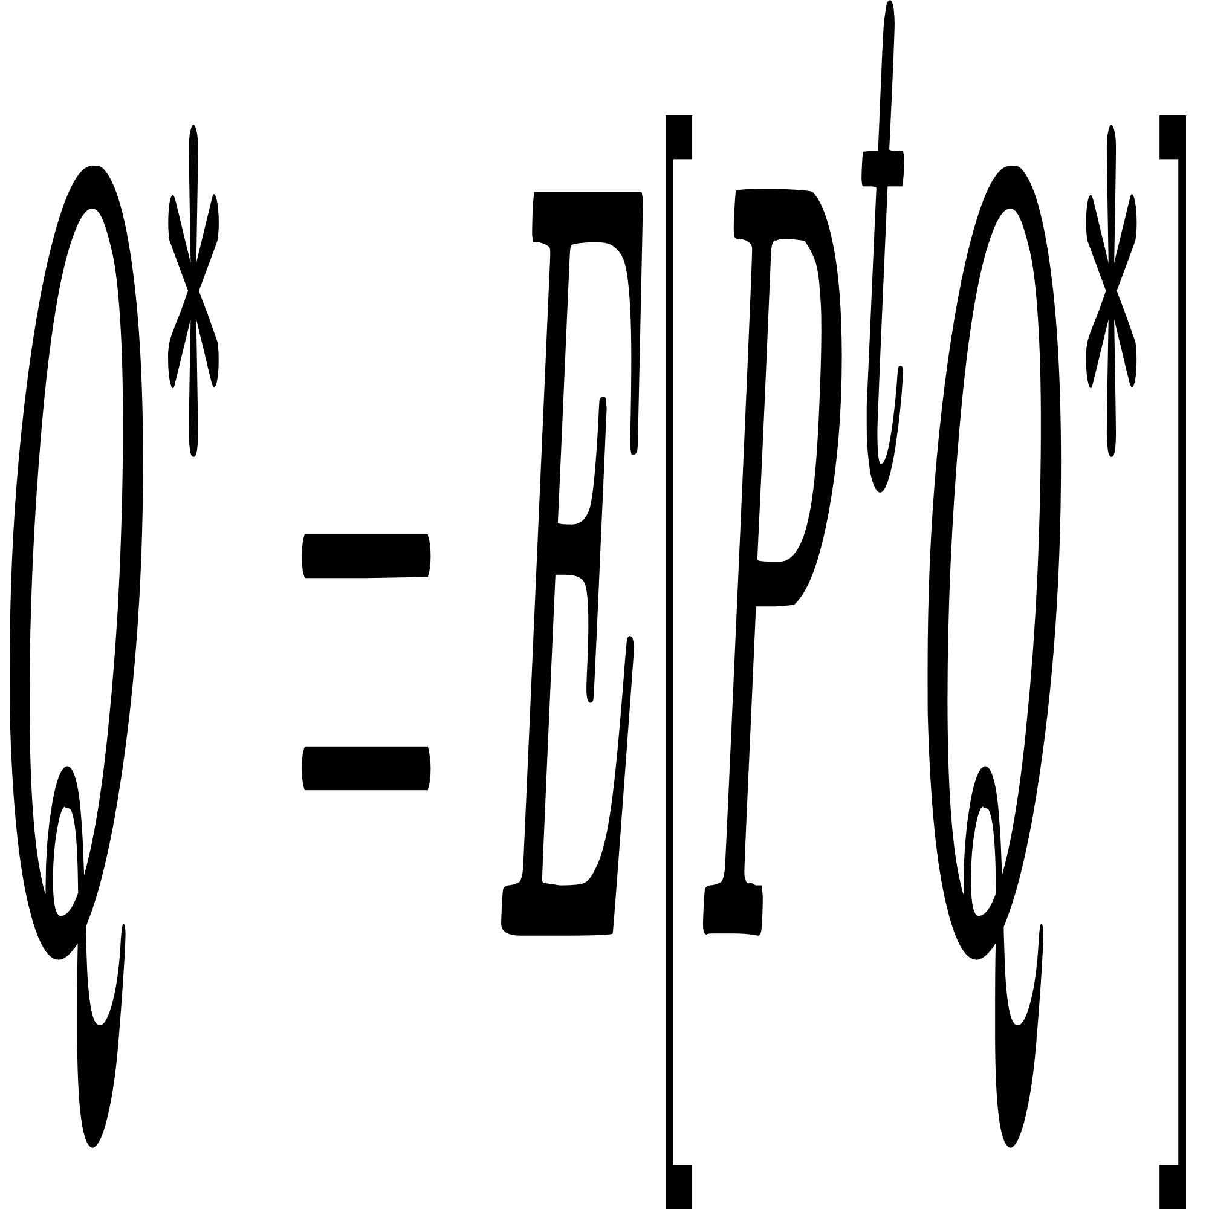
Convergence
Definition of P^{t}
Fixed Point thereom
condition 1
iteration rule
convergence
condition 2

Slide 18
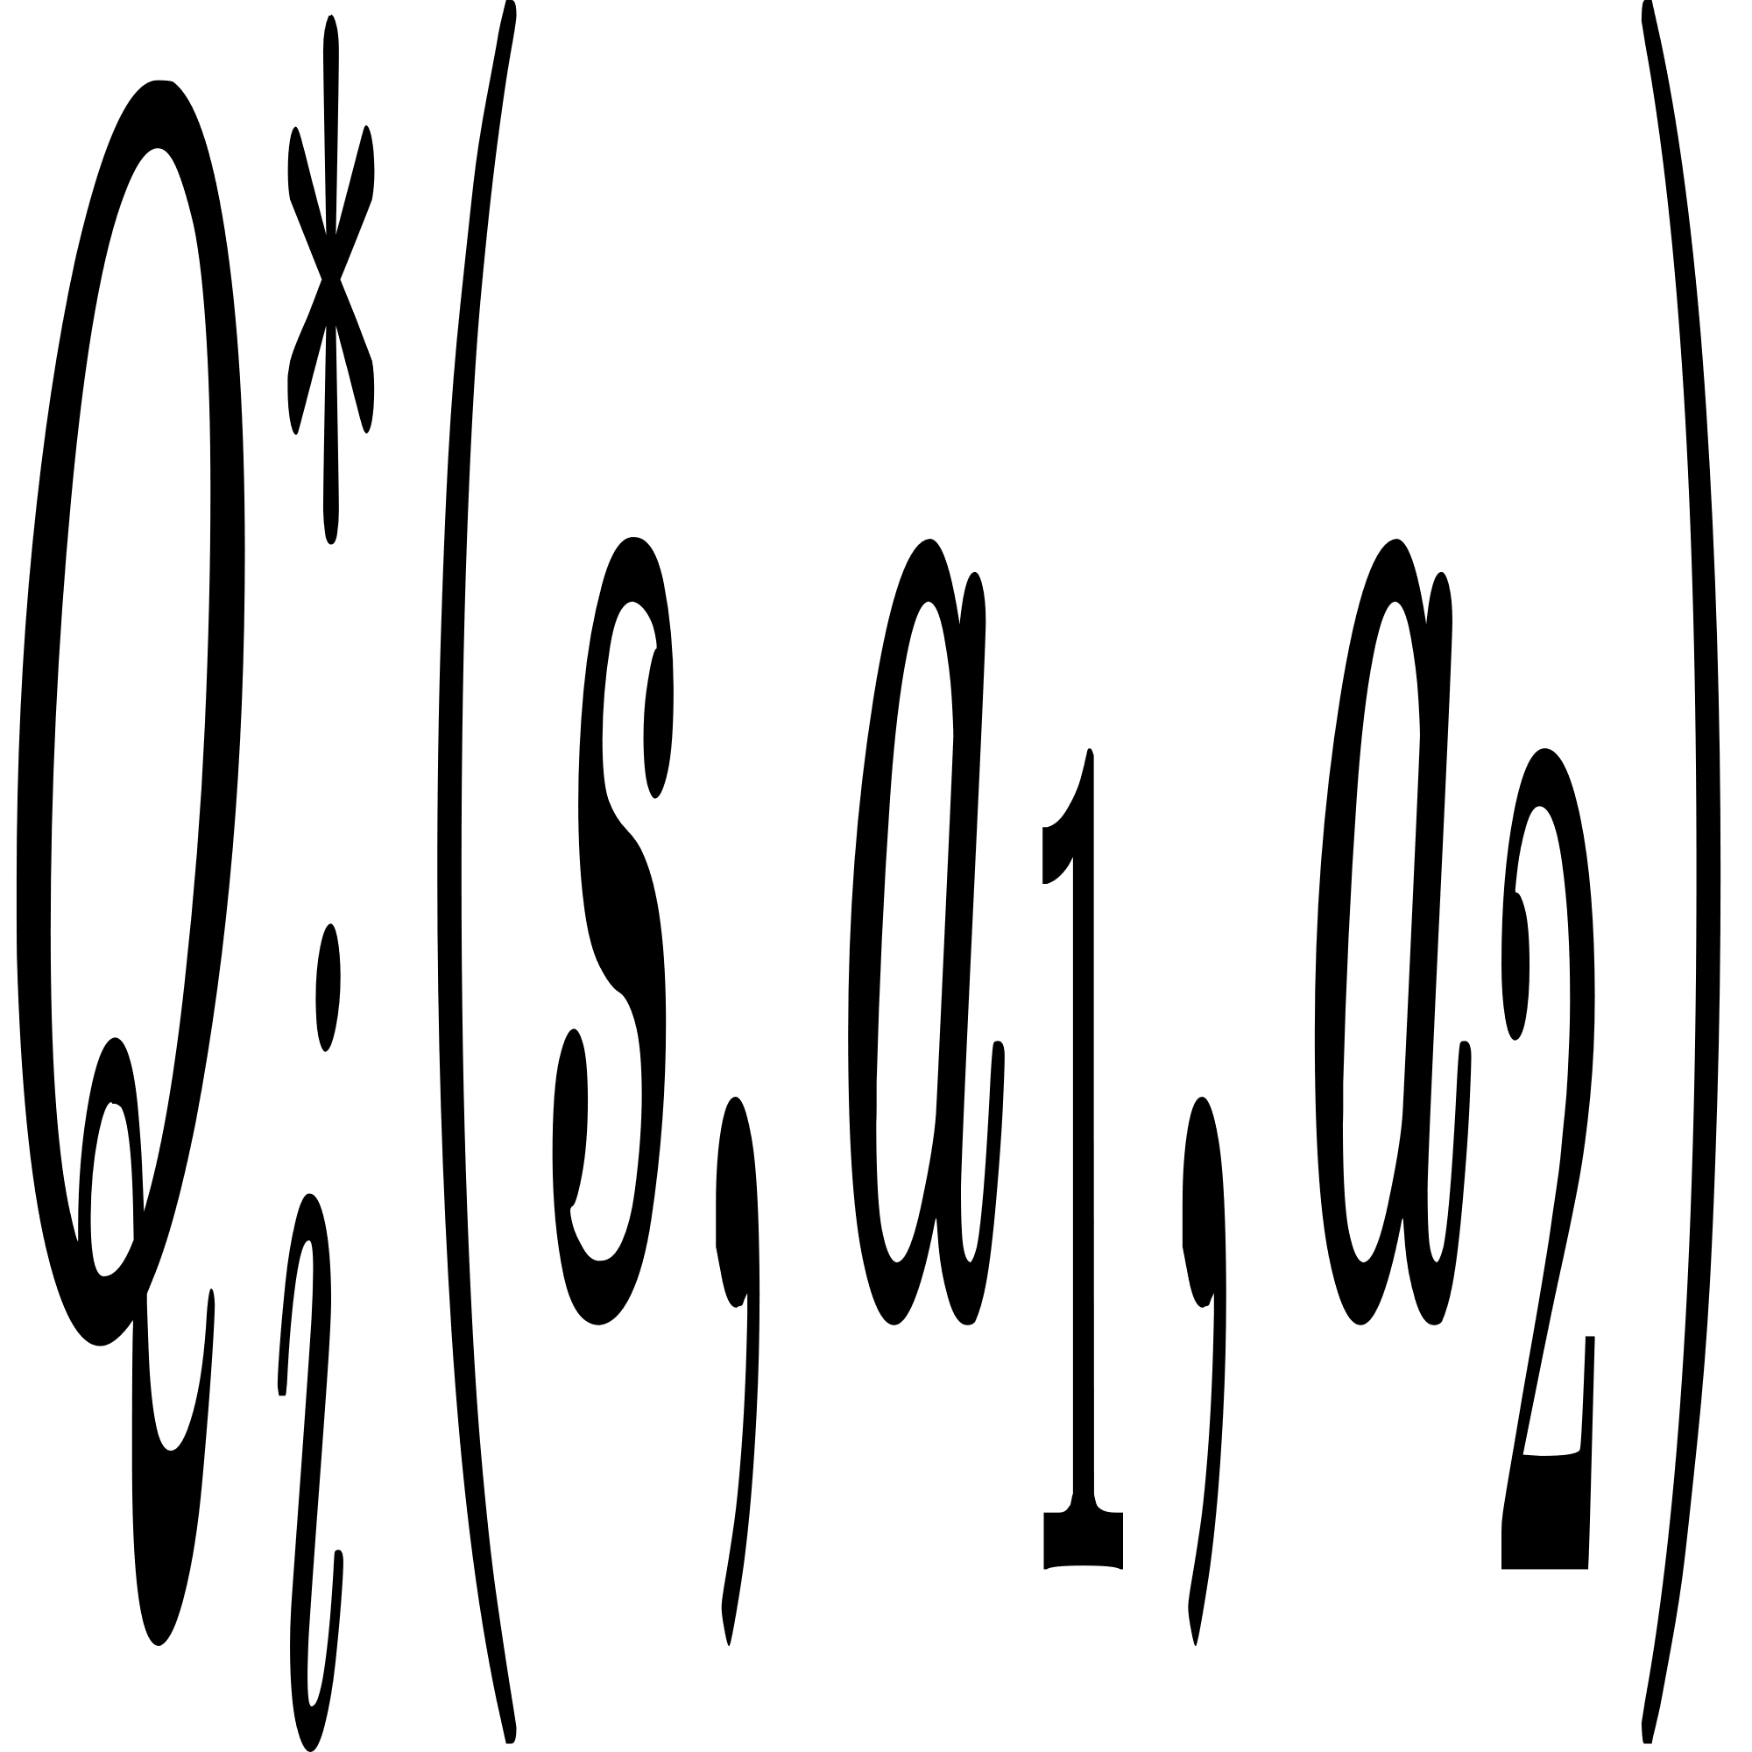
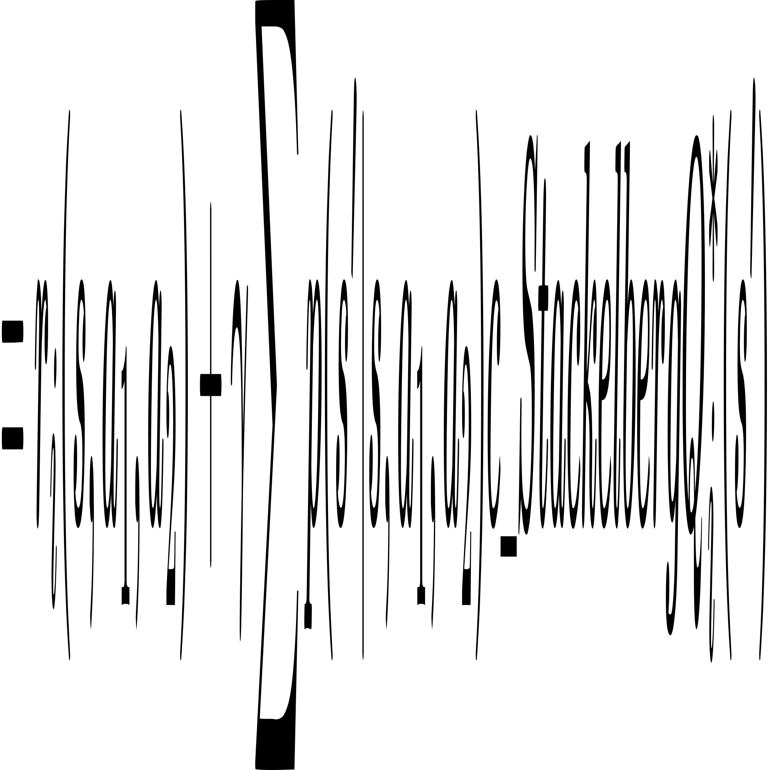

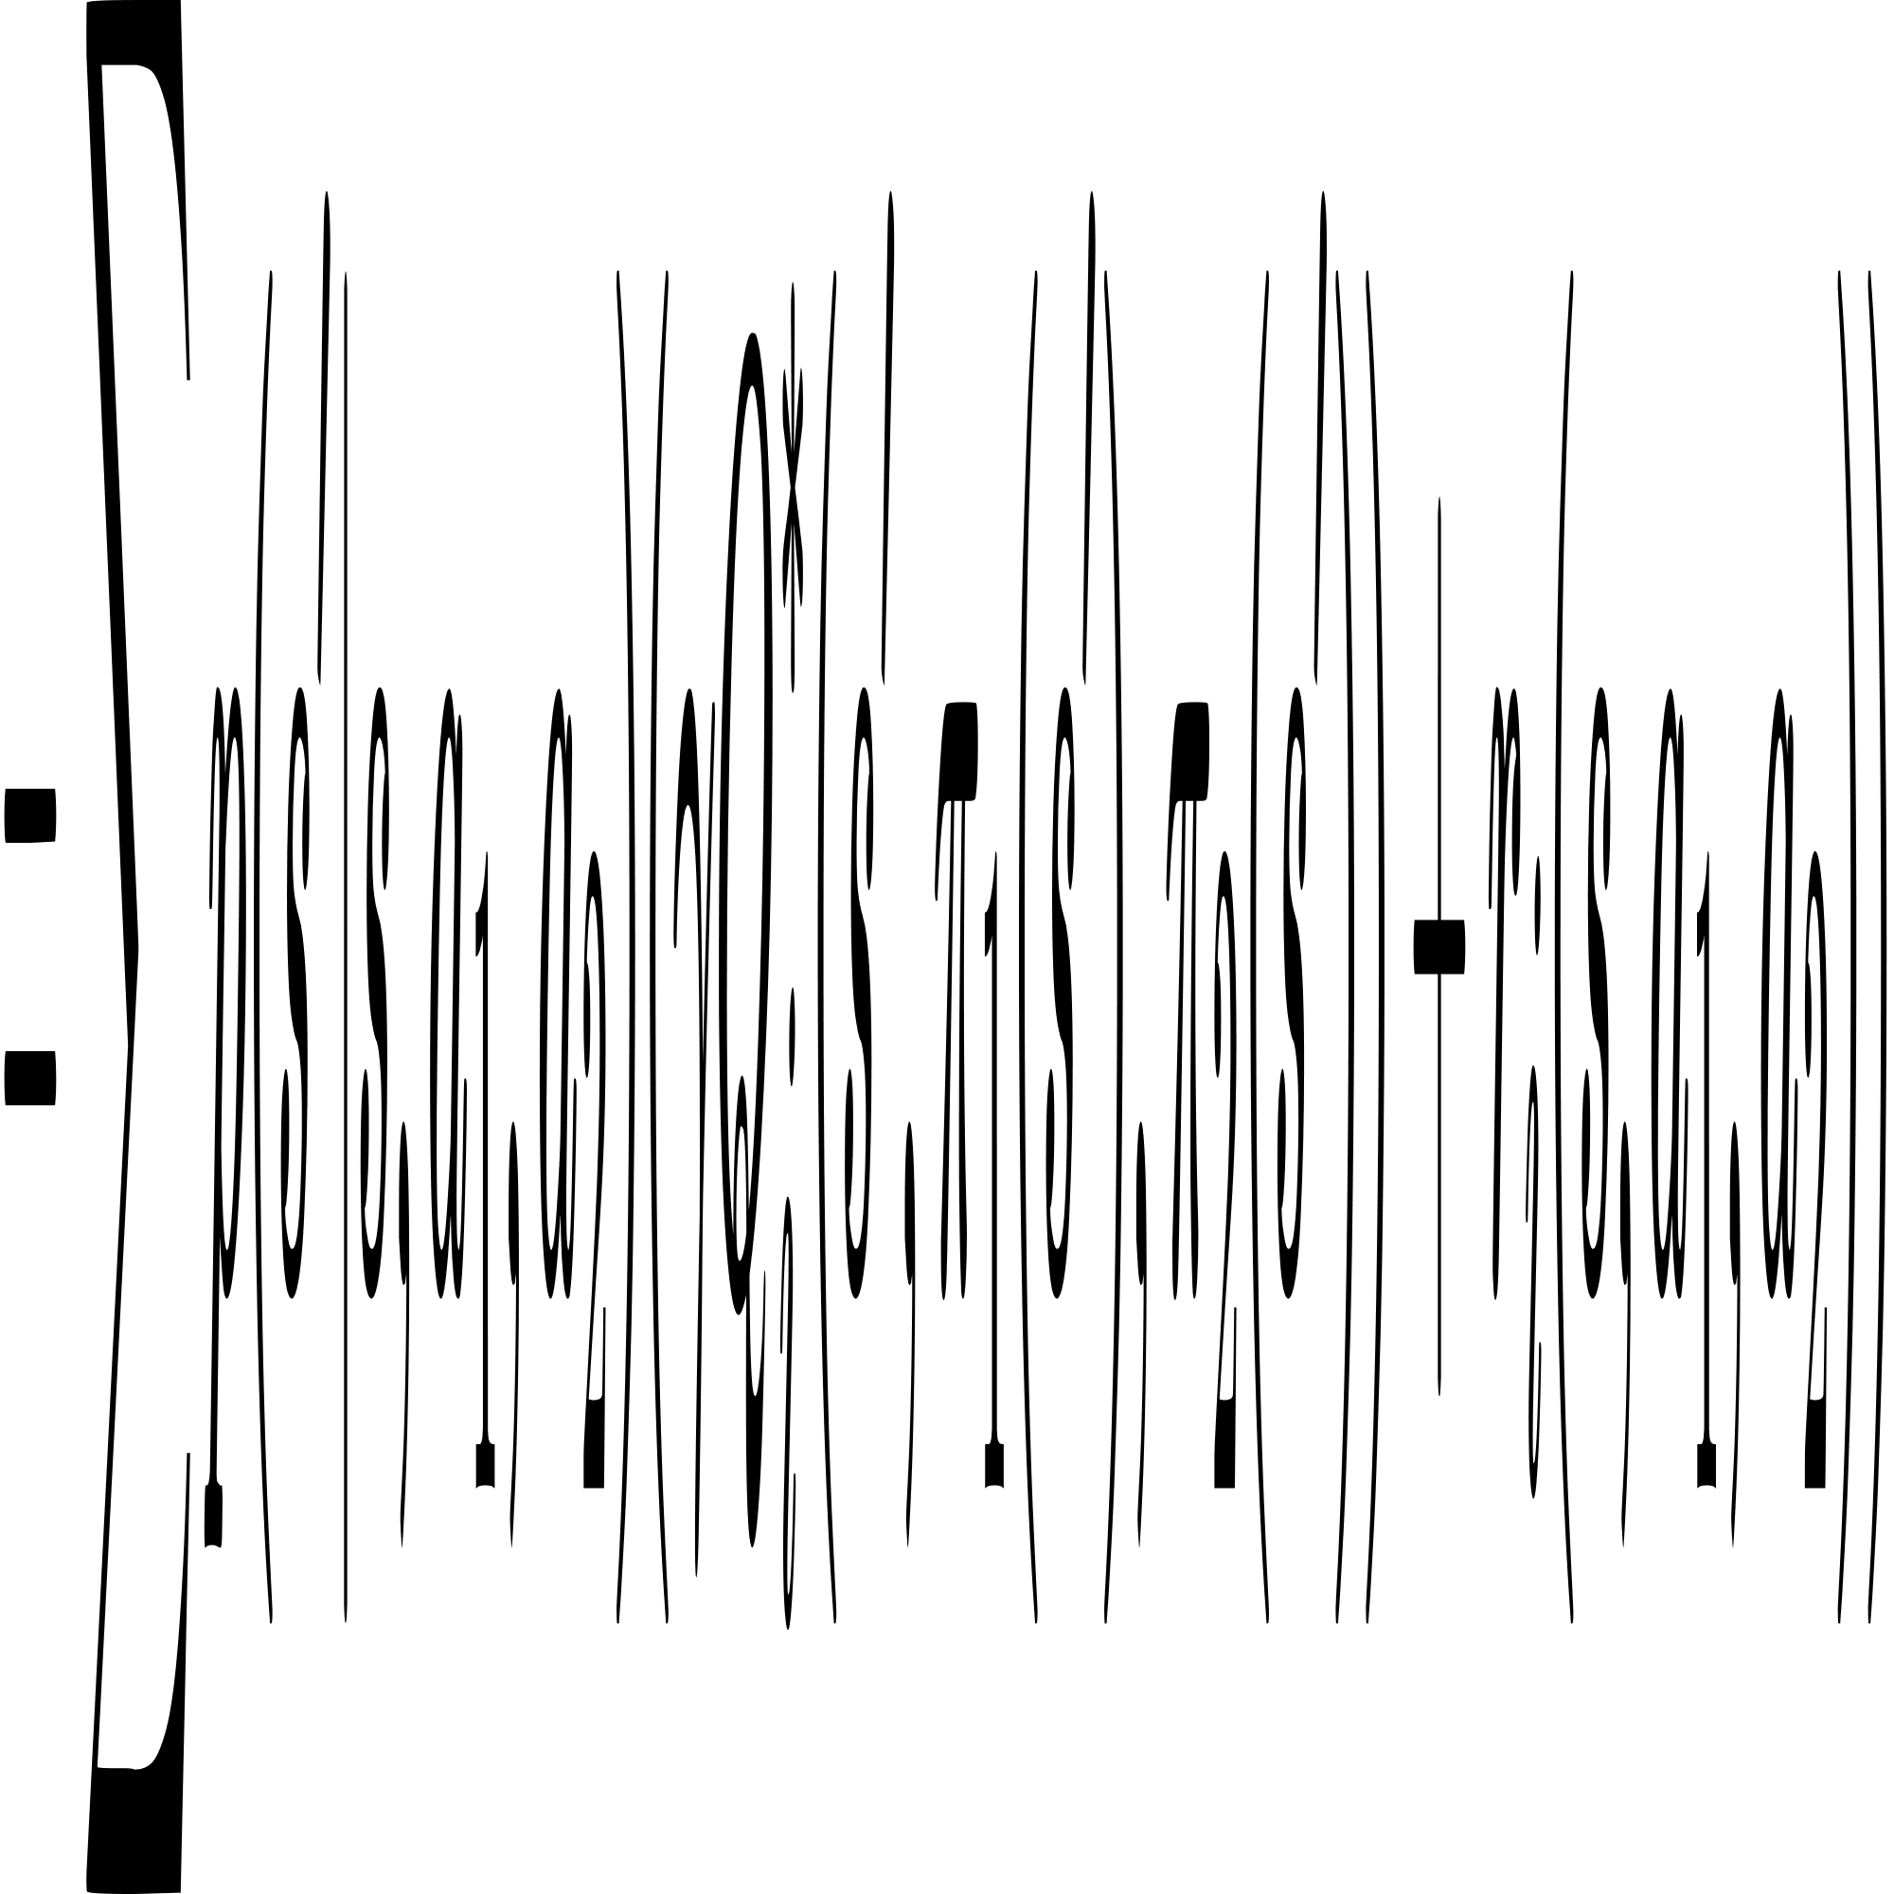
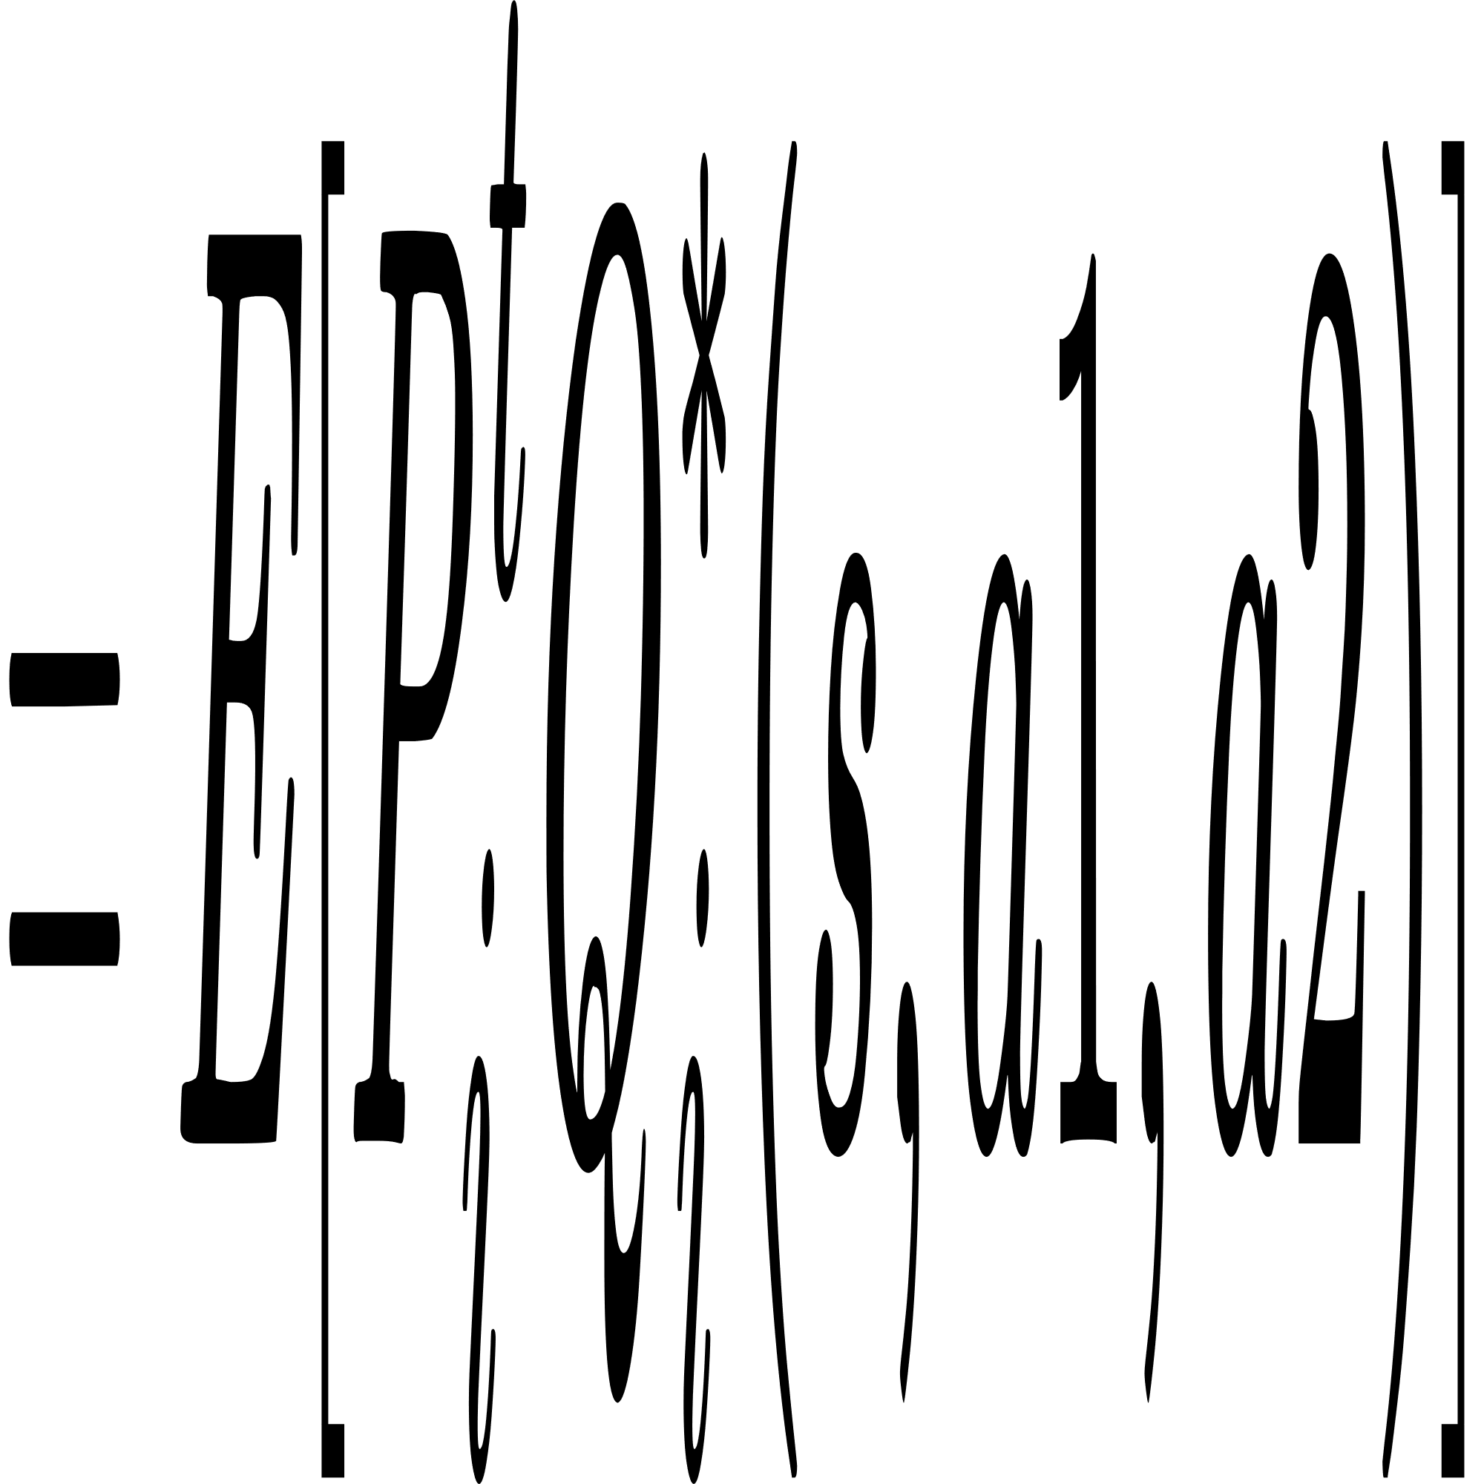
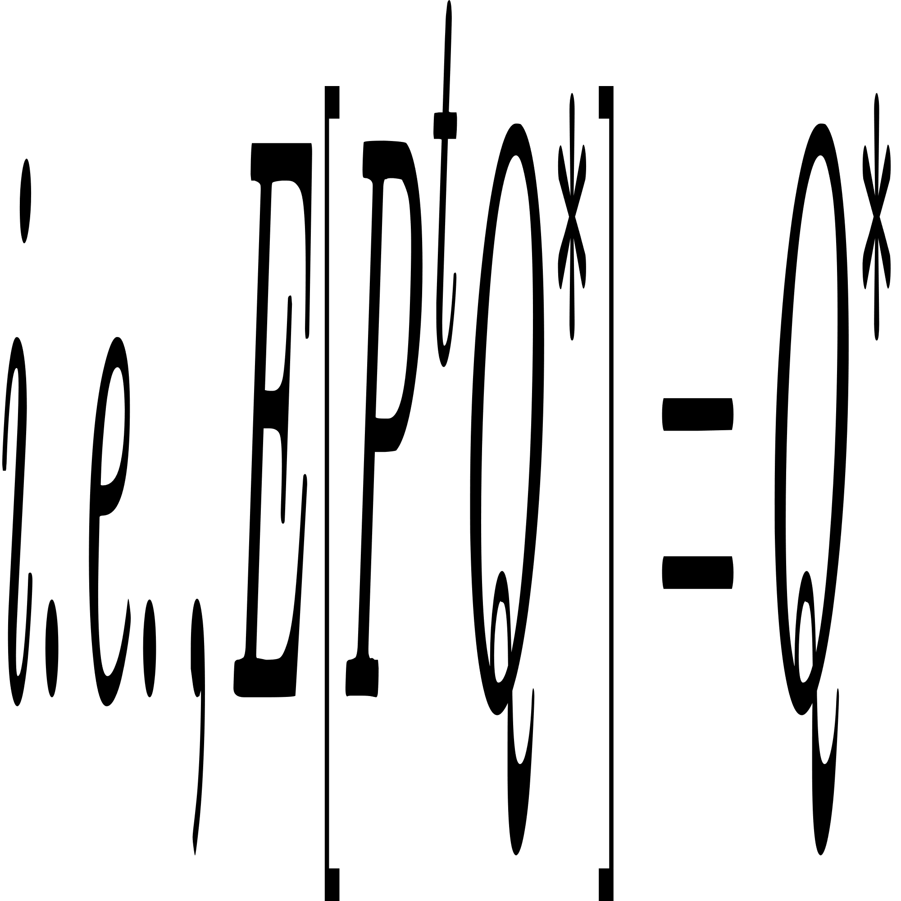
Proof of condition 2
state transition probability

Slide 19
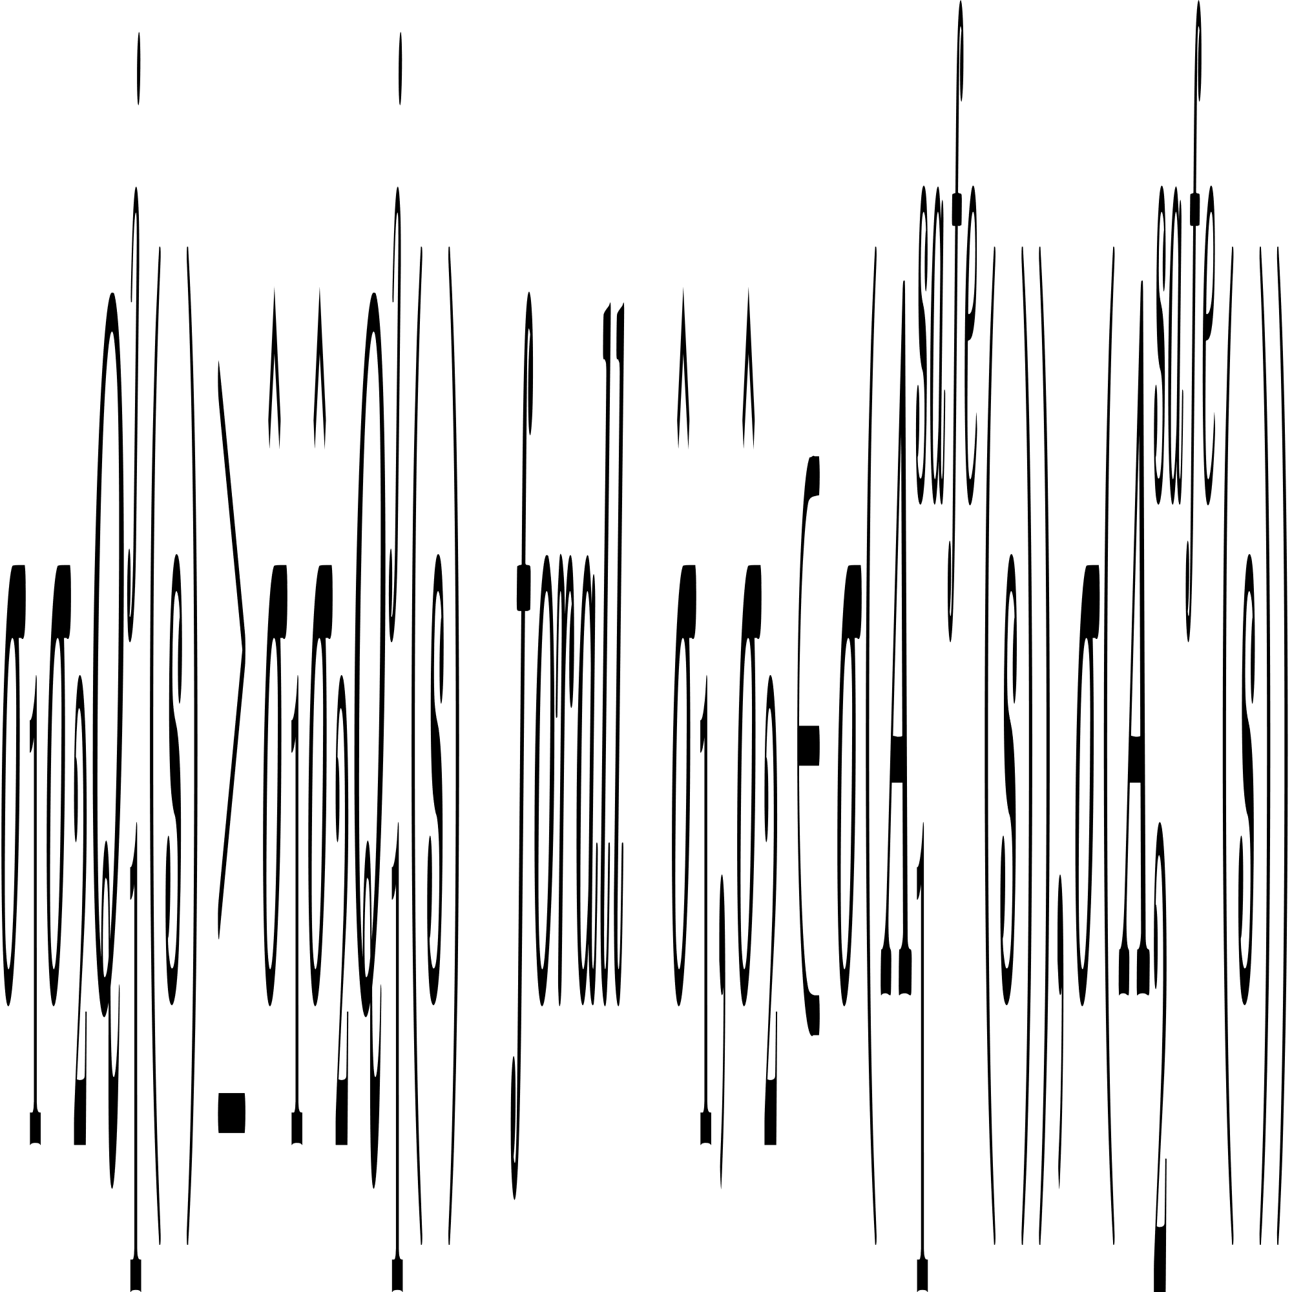

Features of the constrained Stackelberg equilibrium point
Leader
Follower

Slide 20
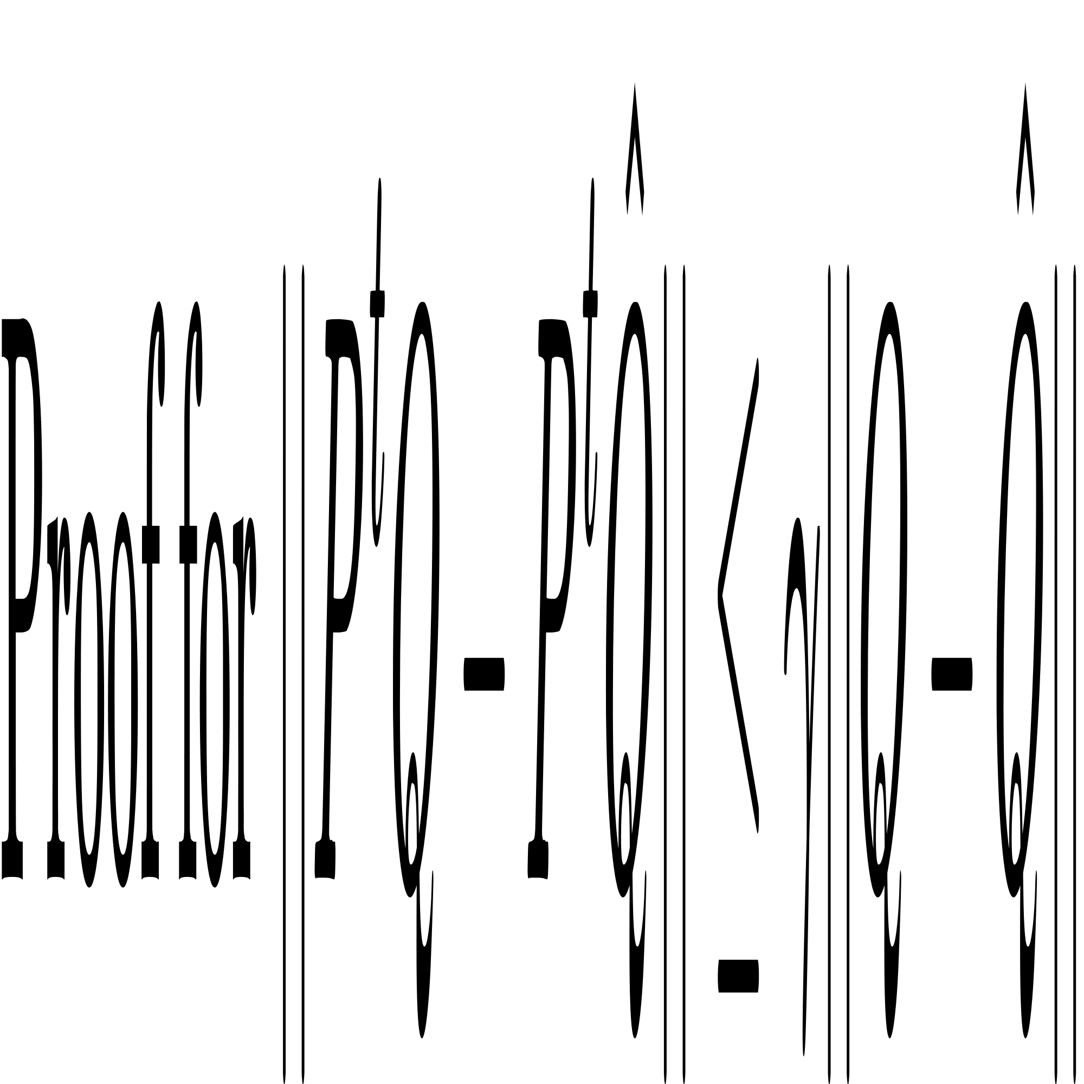
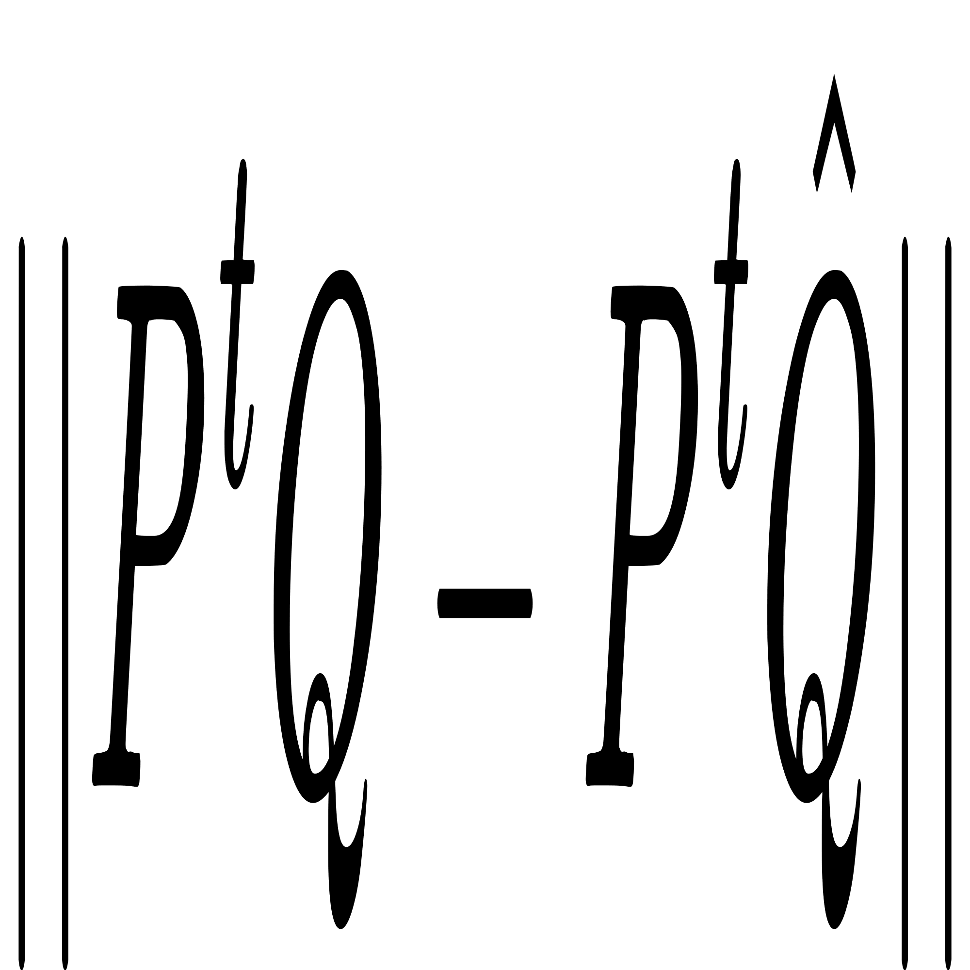
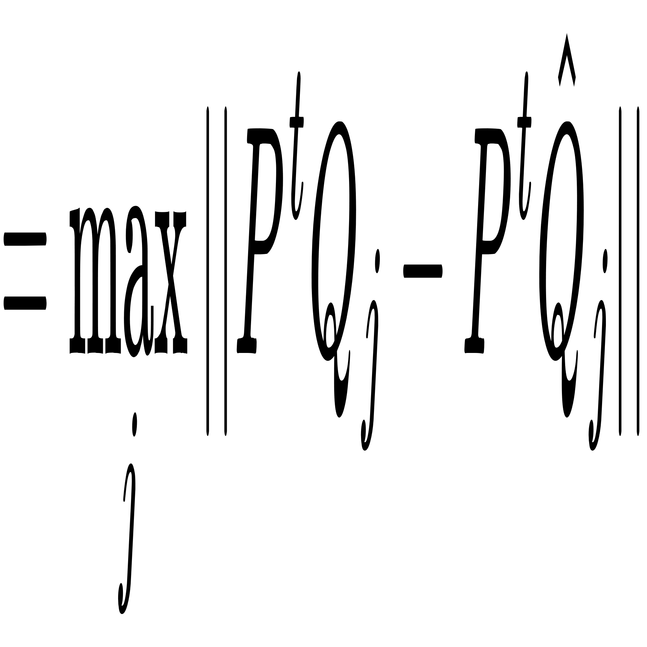
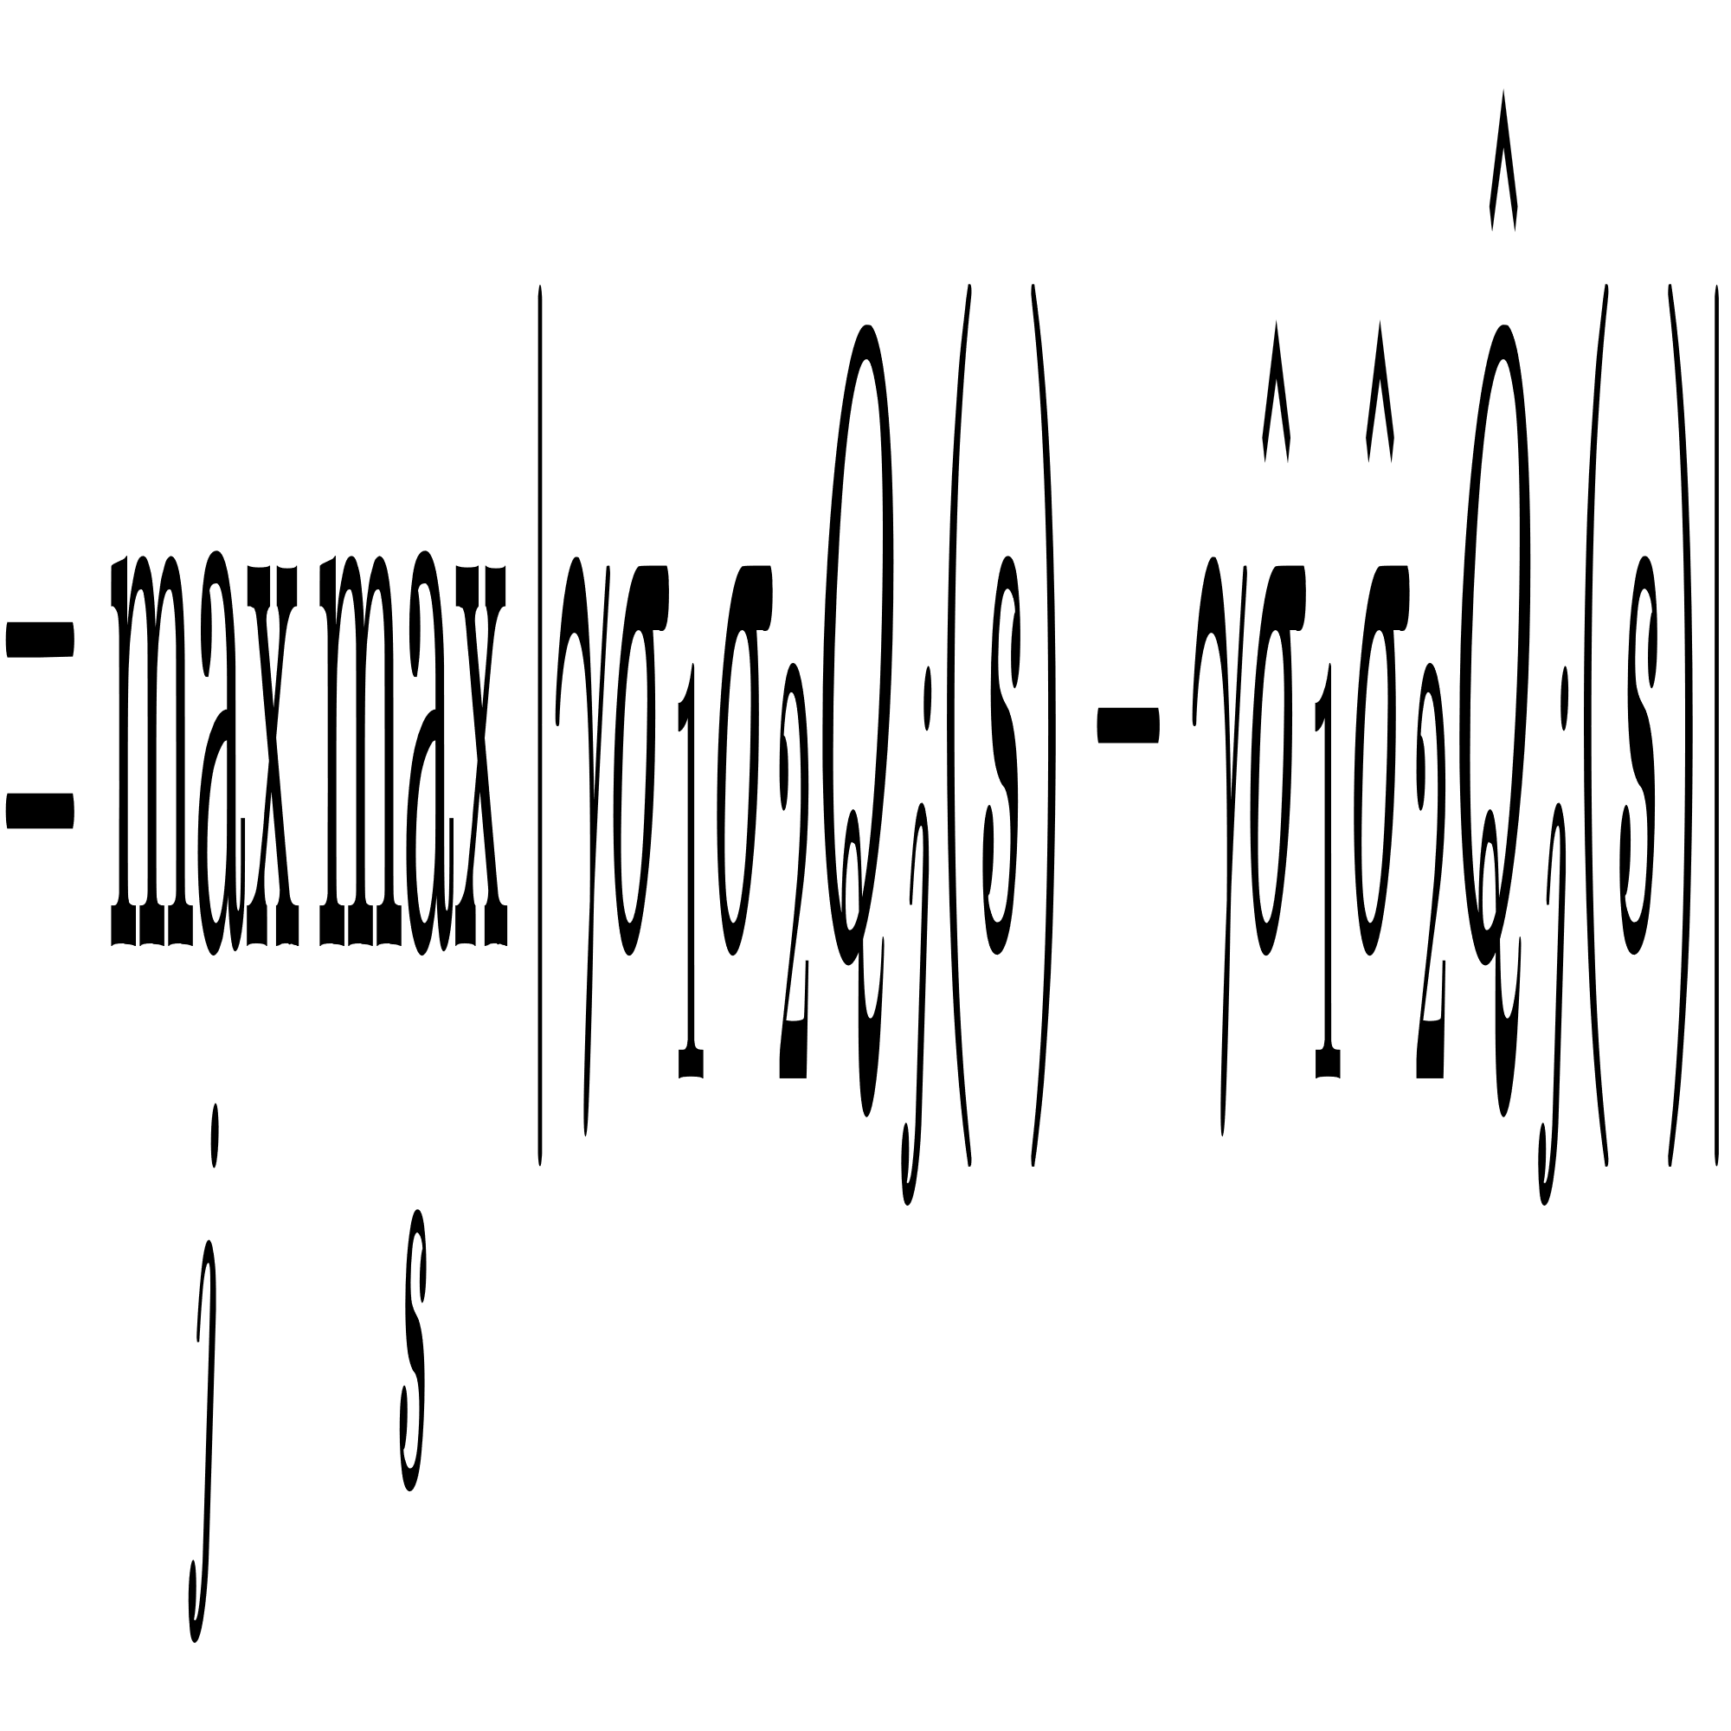
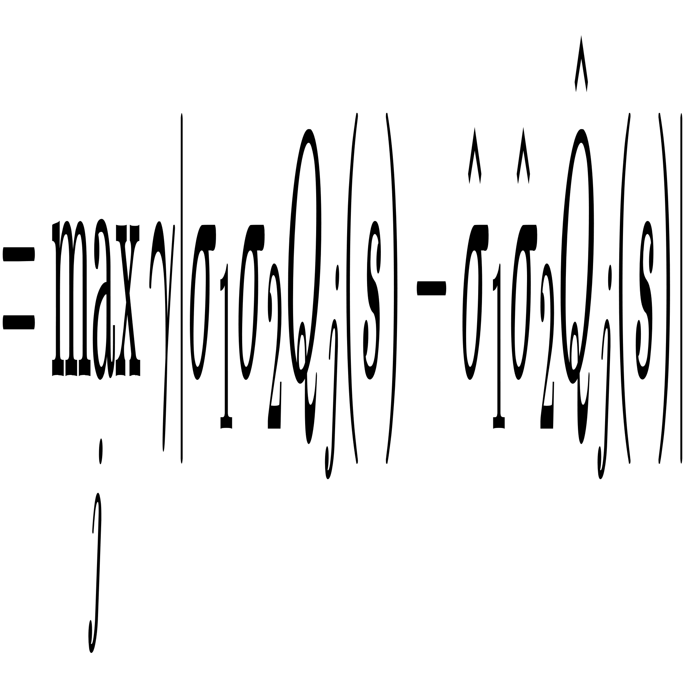
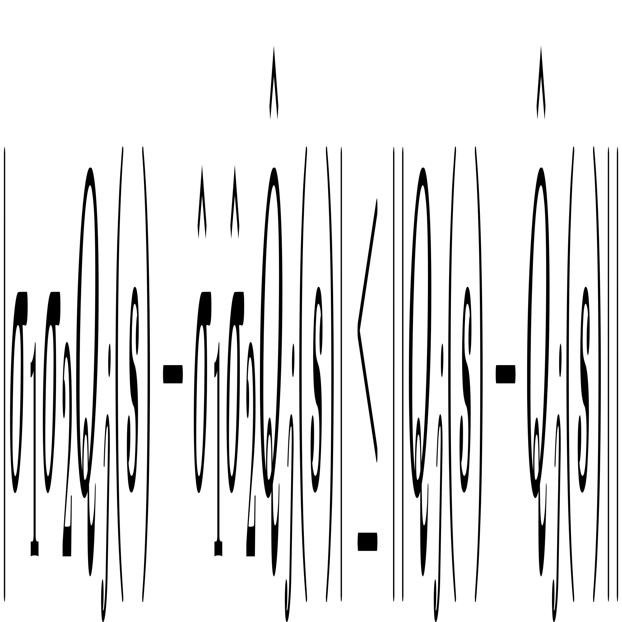
optimal strategy
for j = 1,2

Slide 21
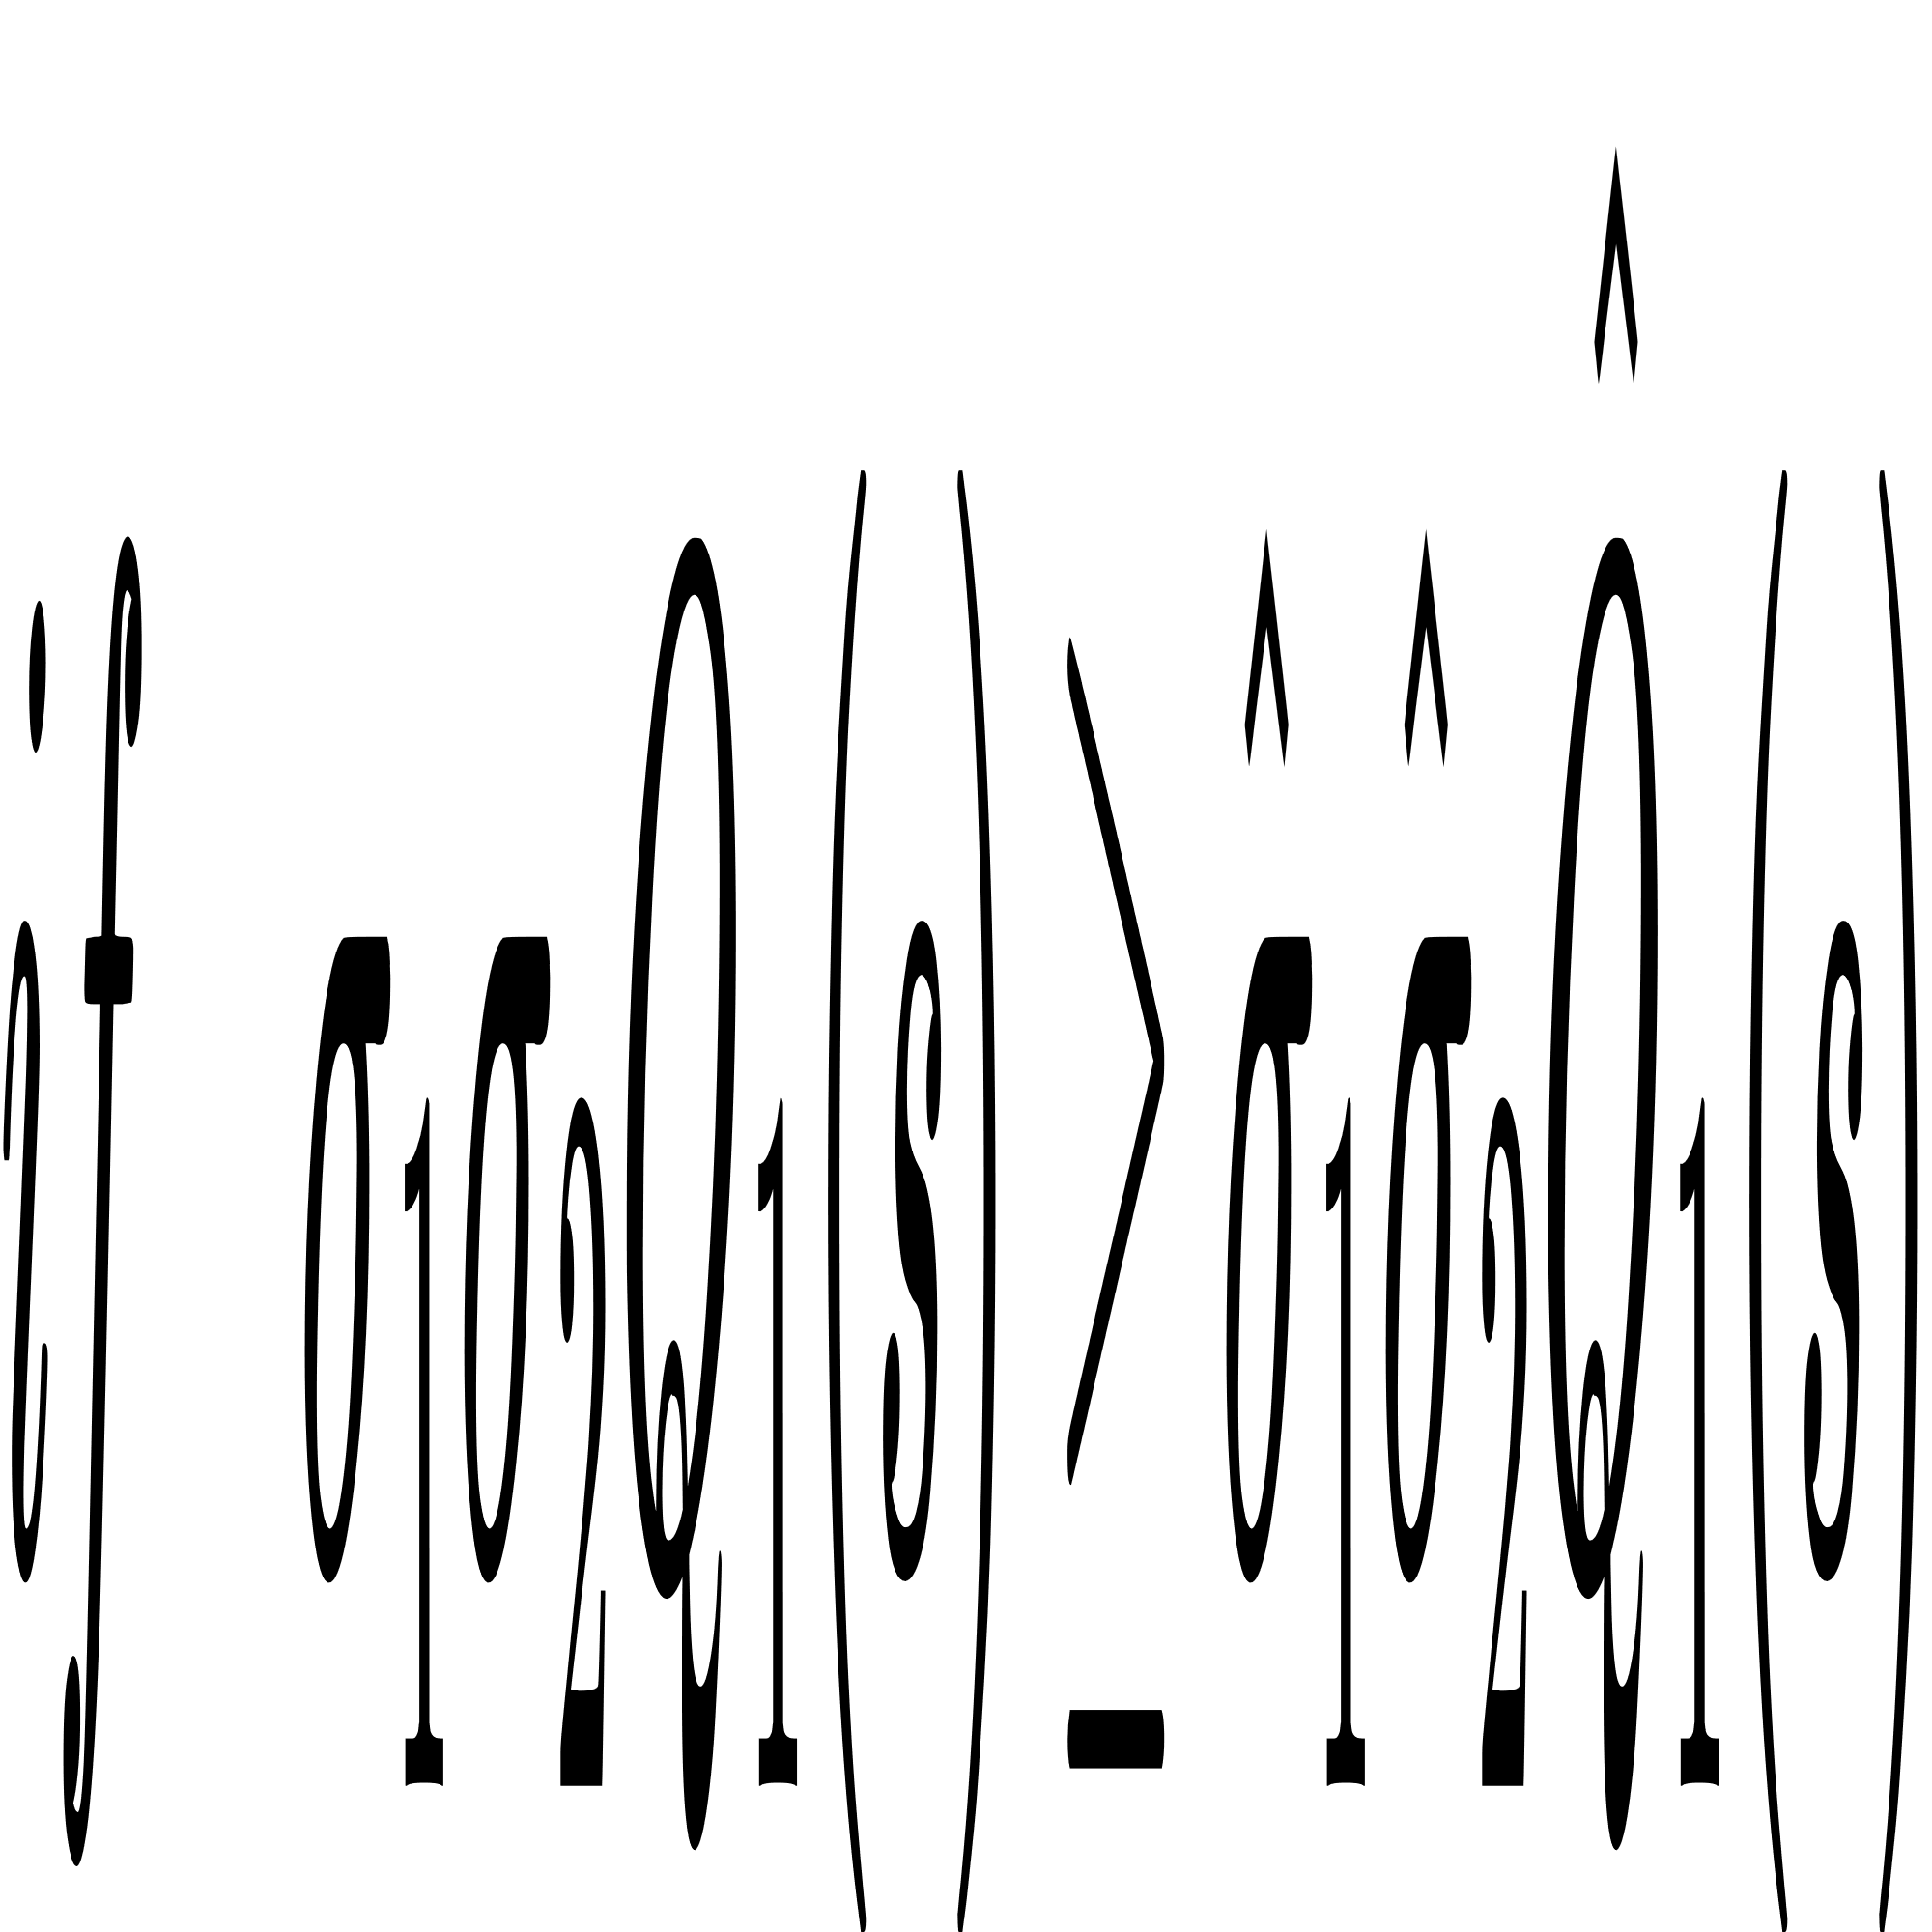
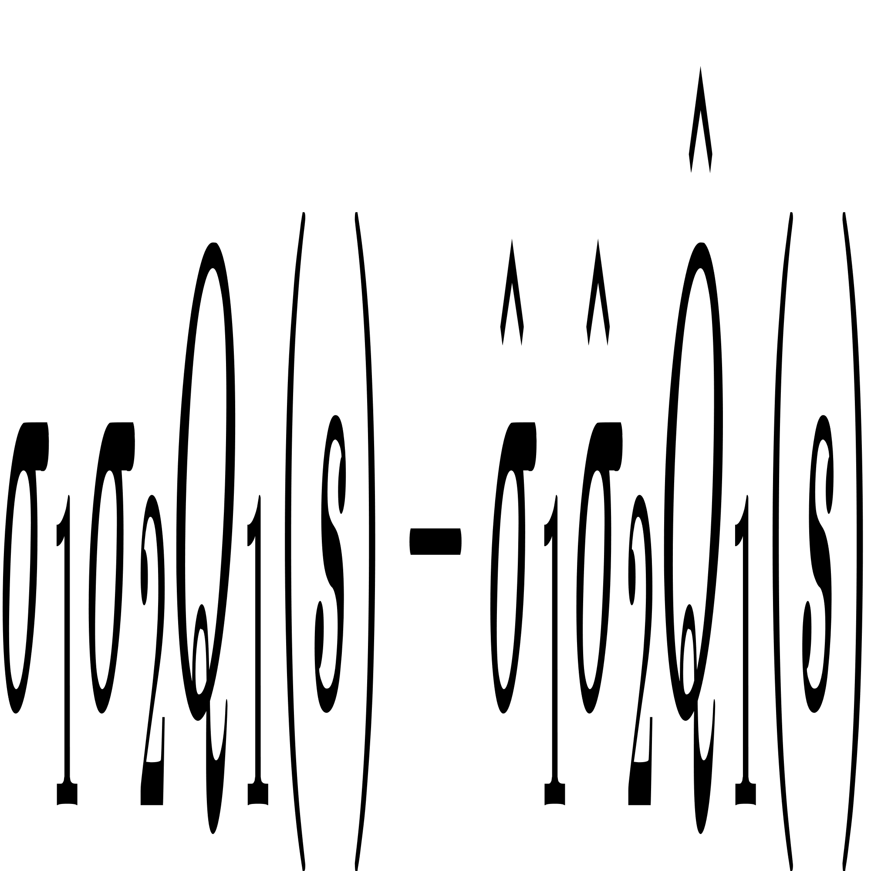
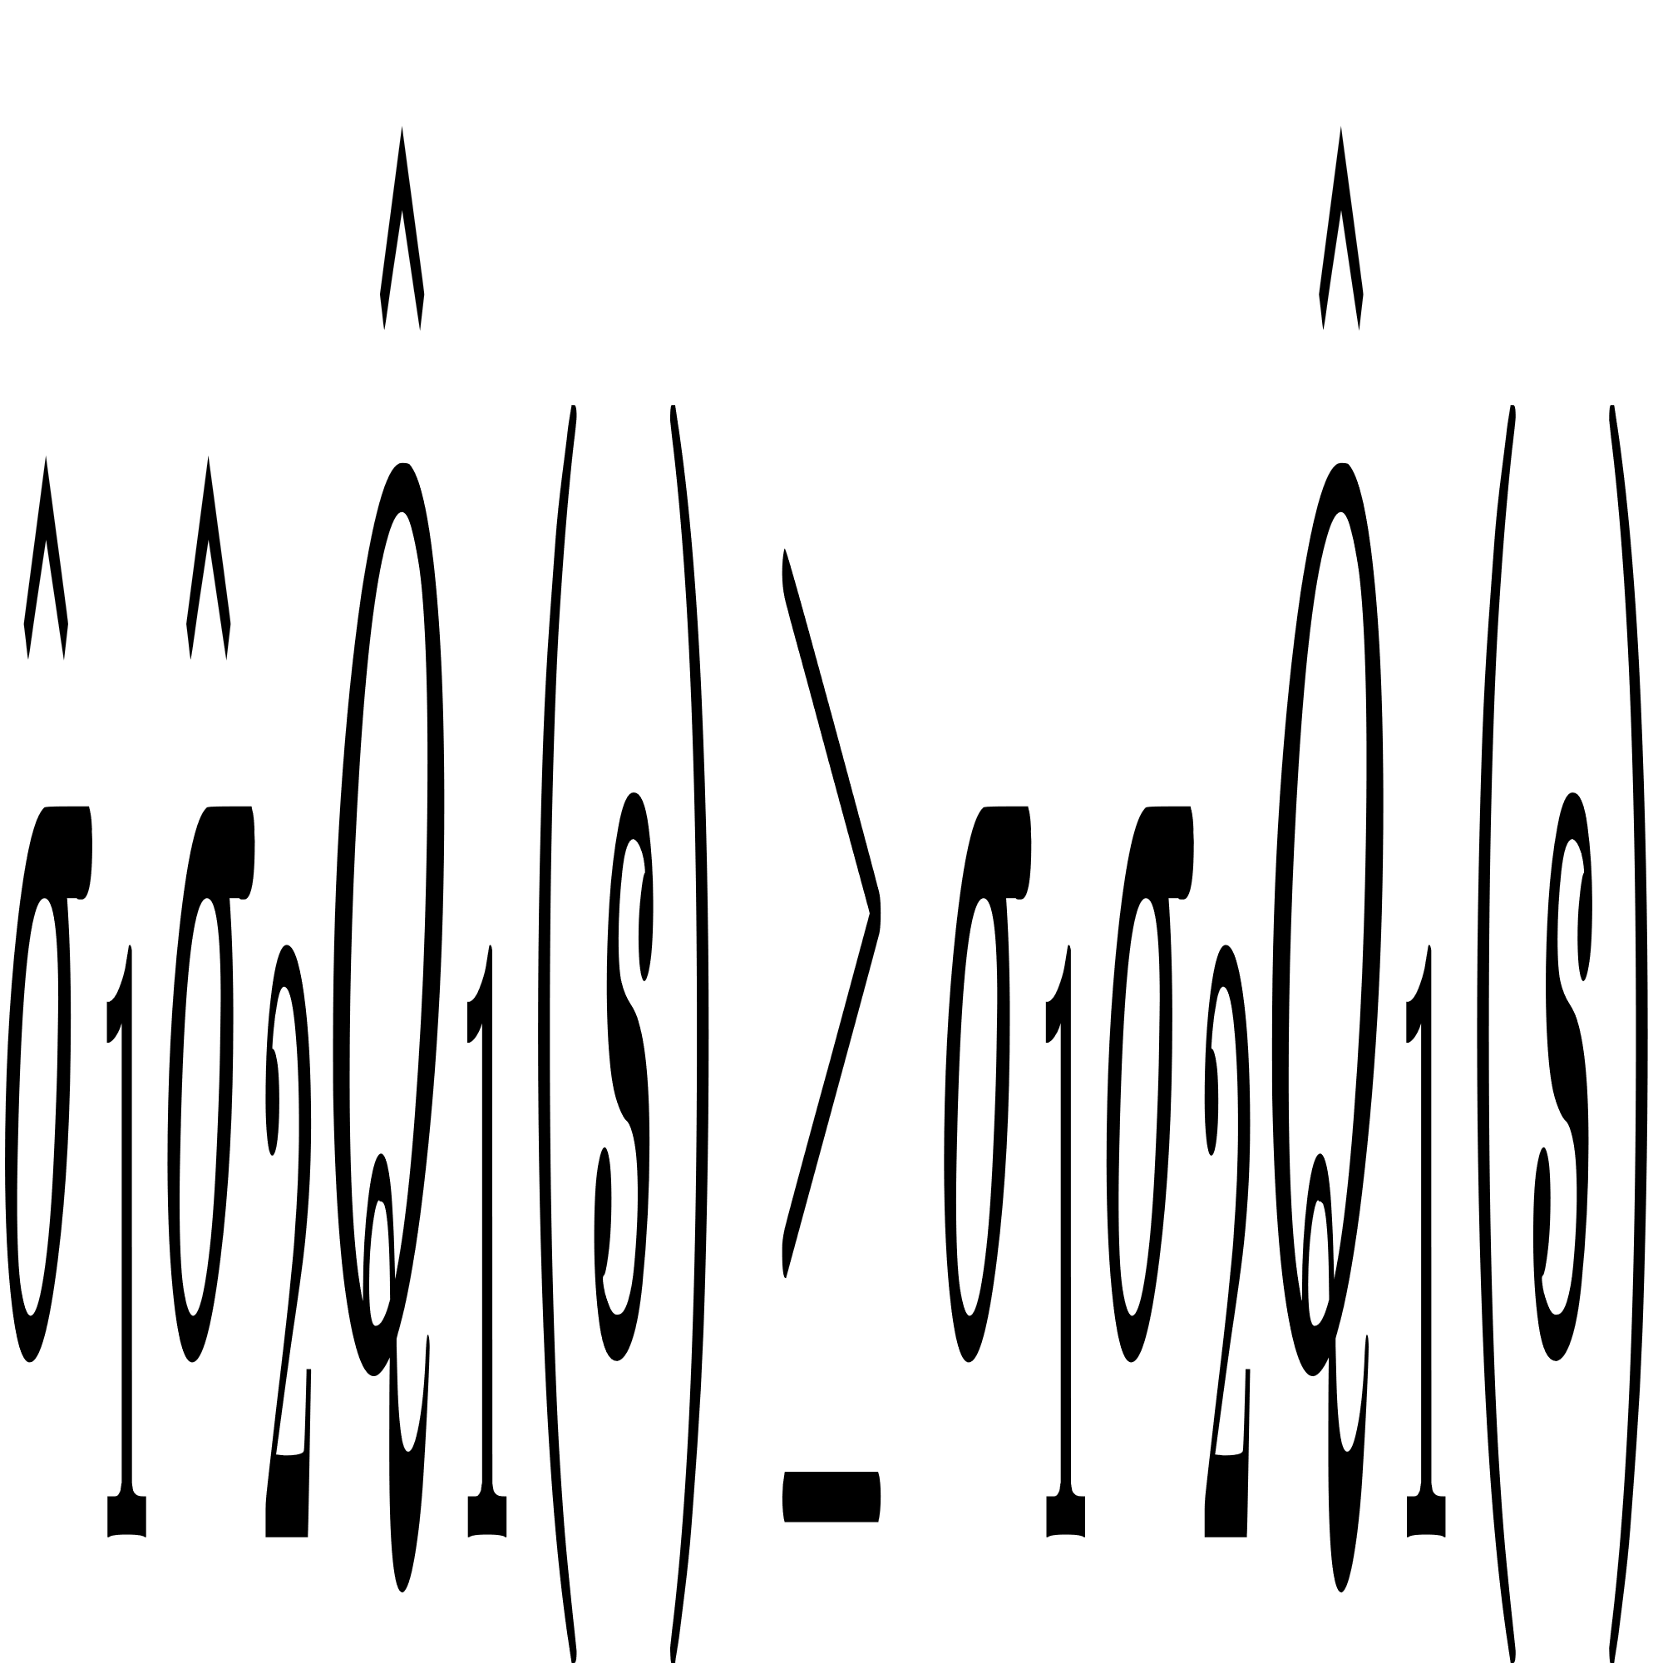
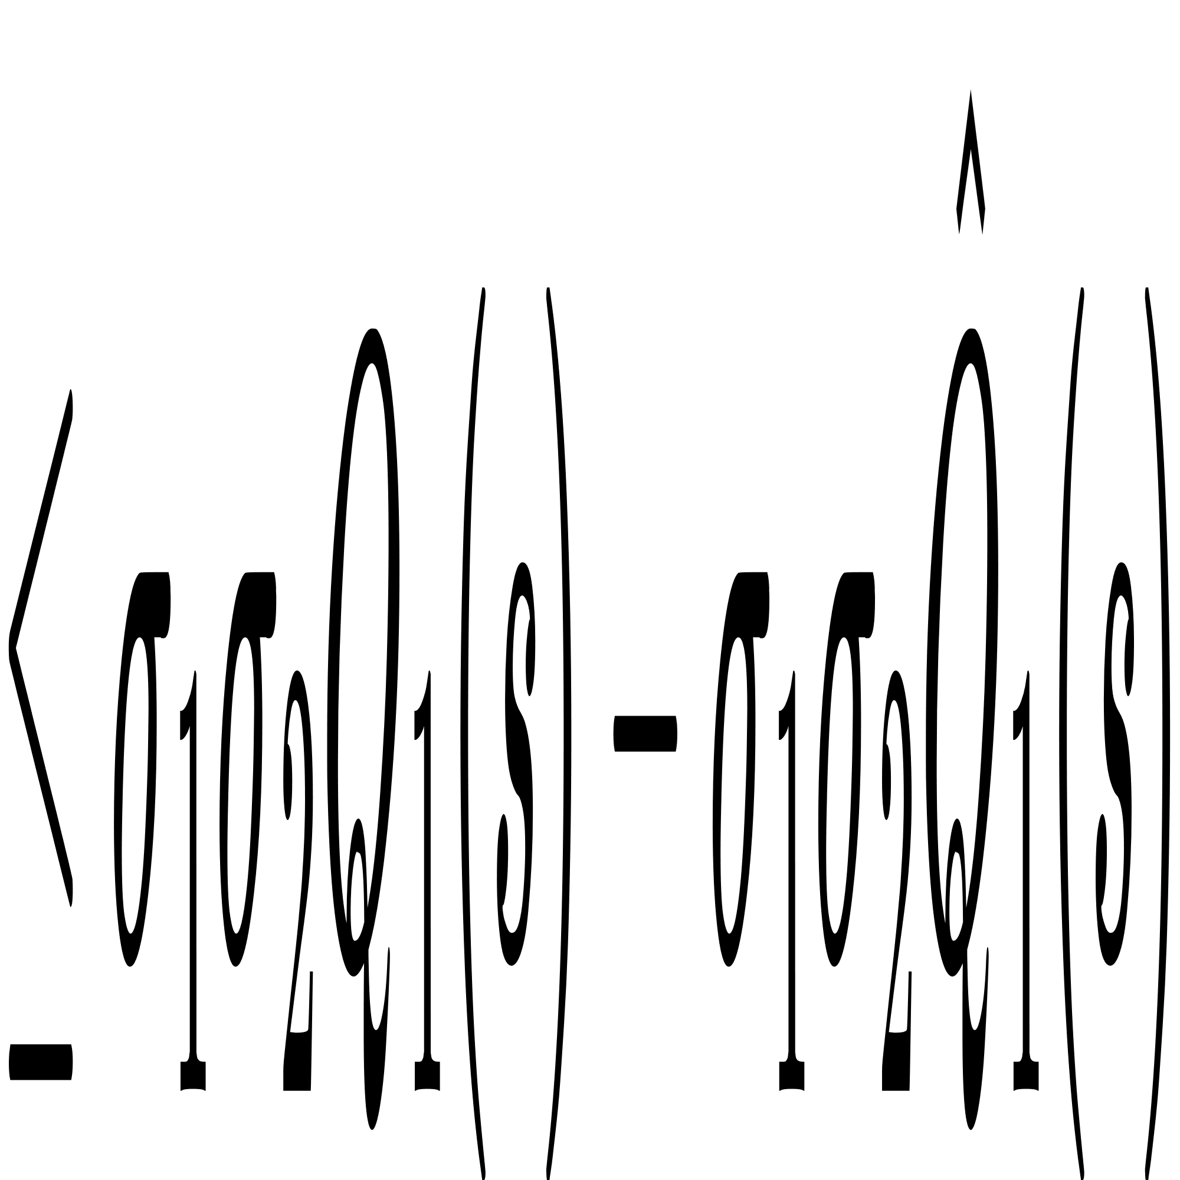
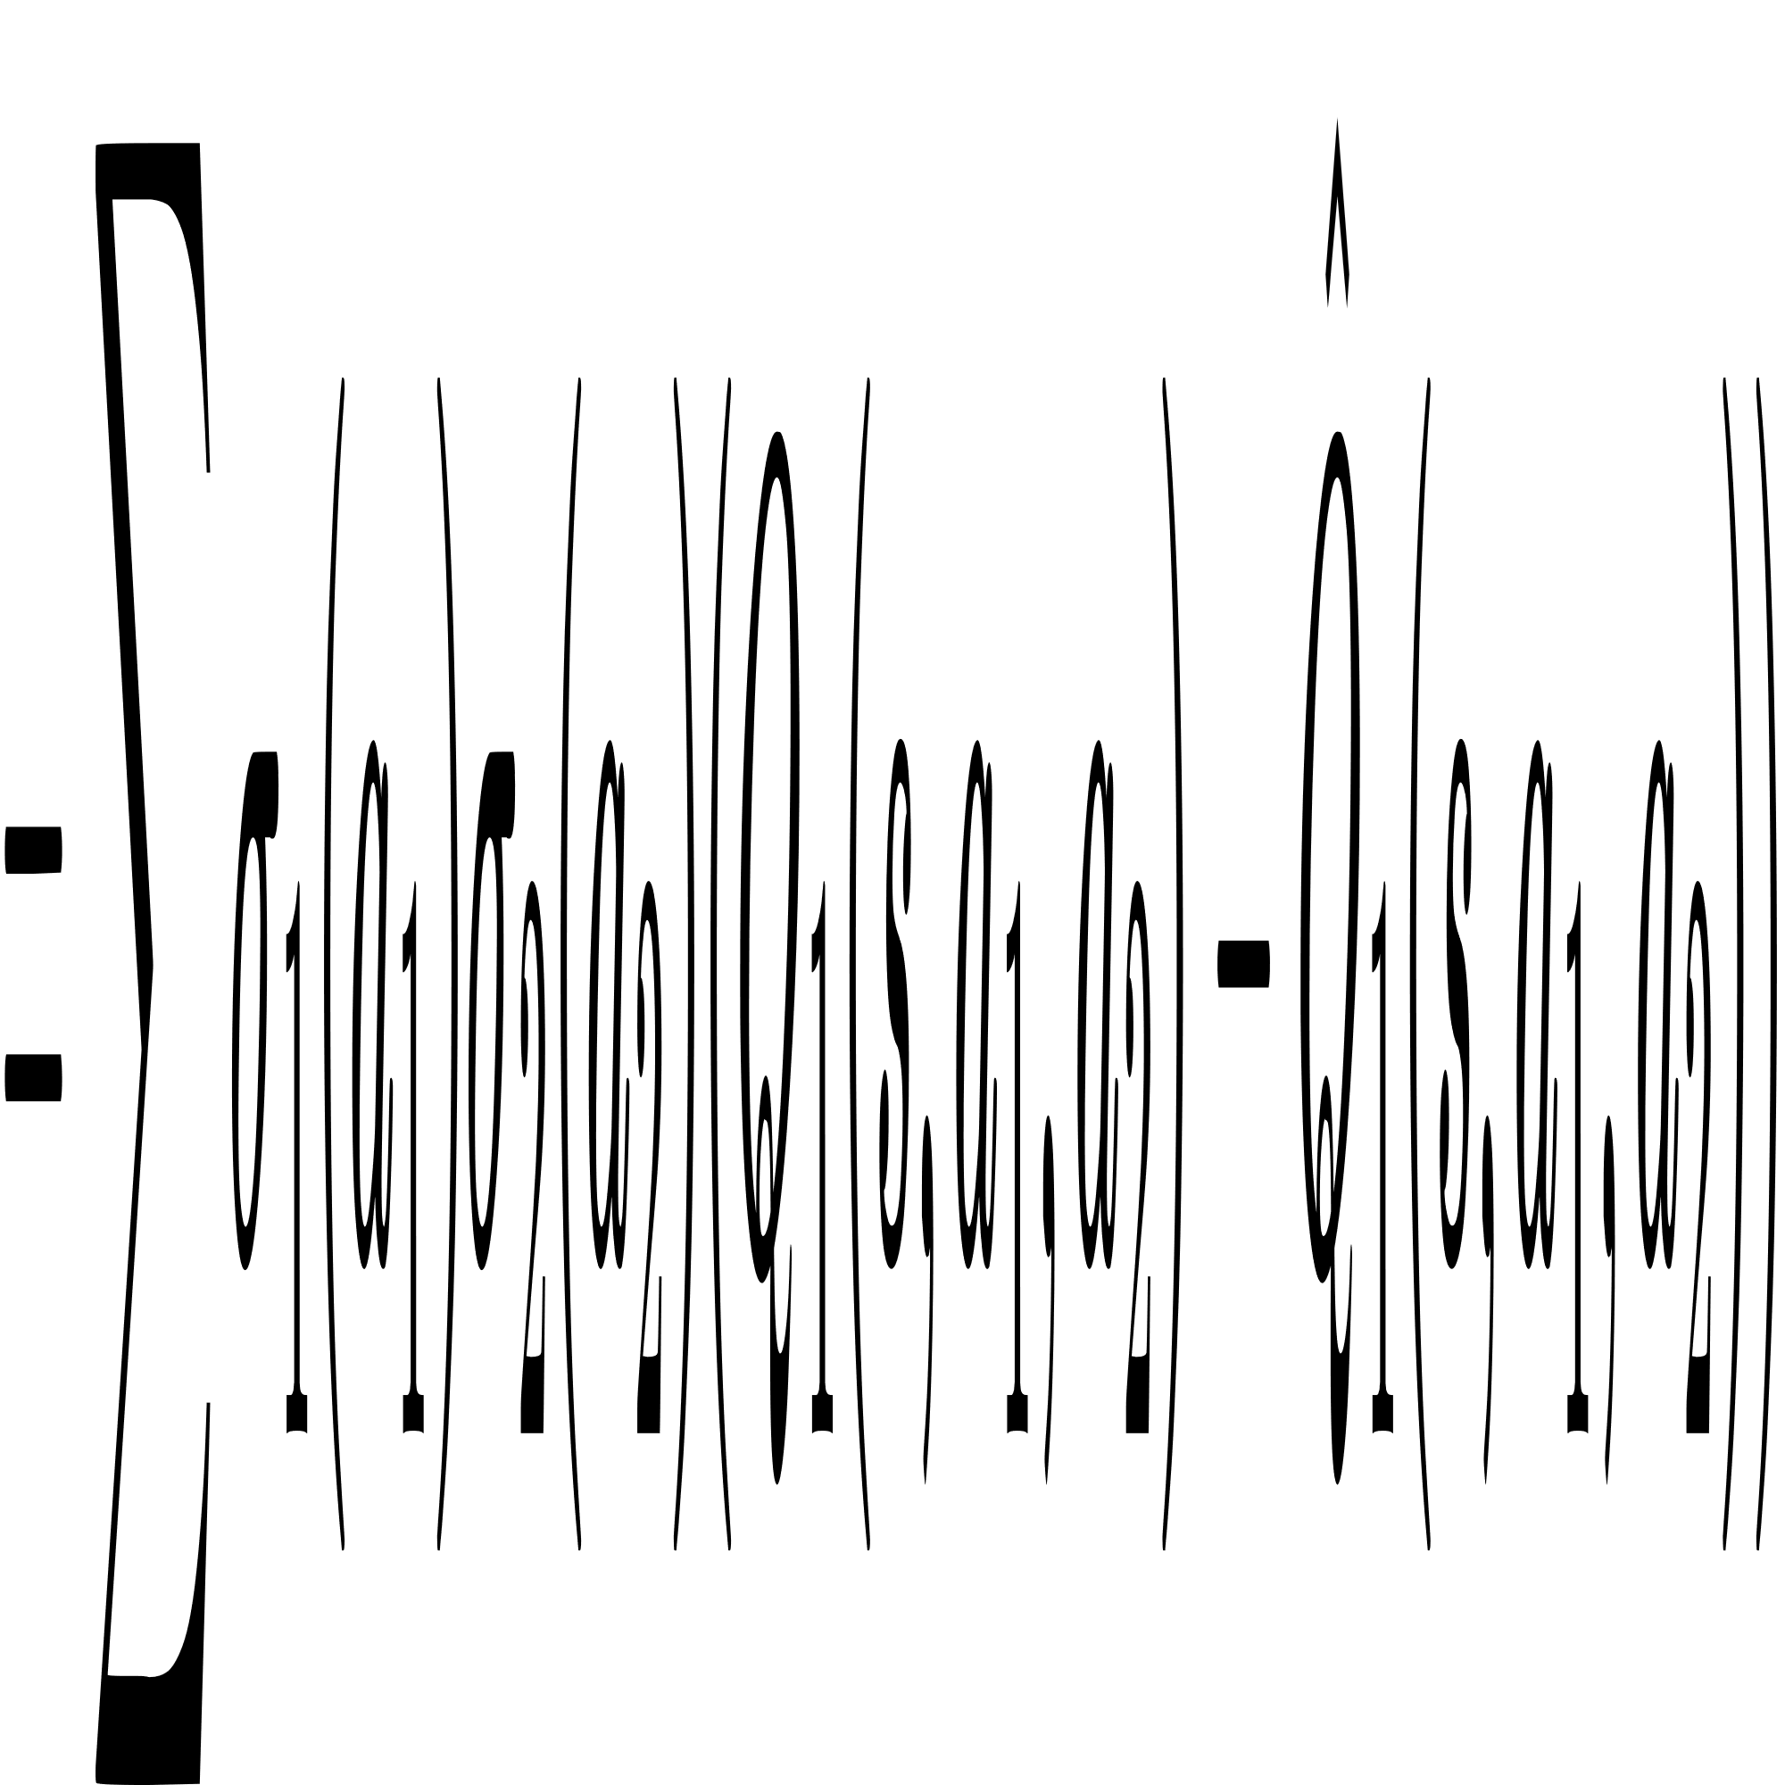
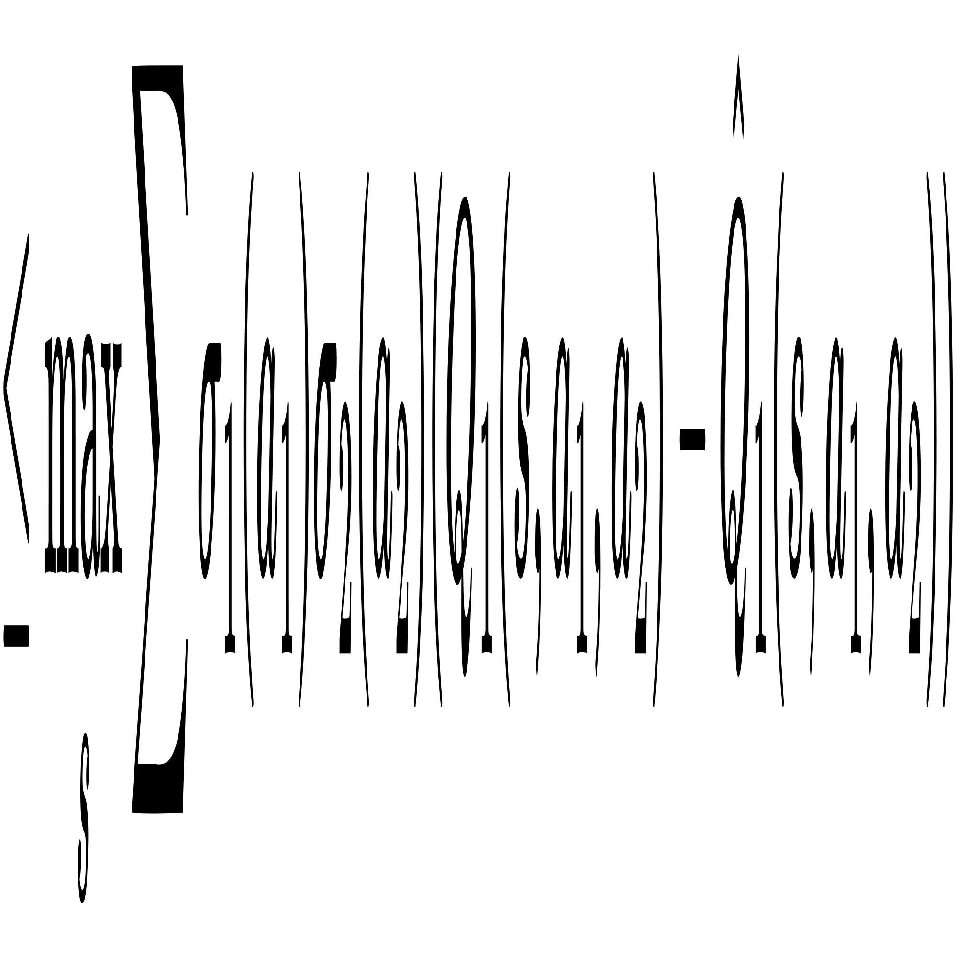
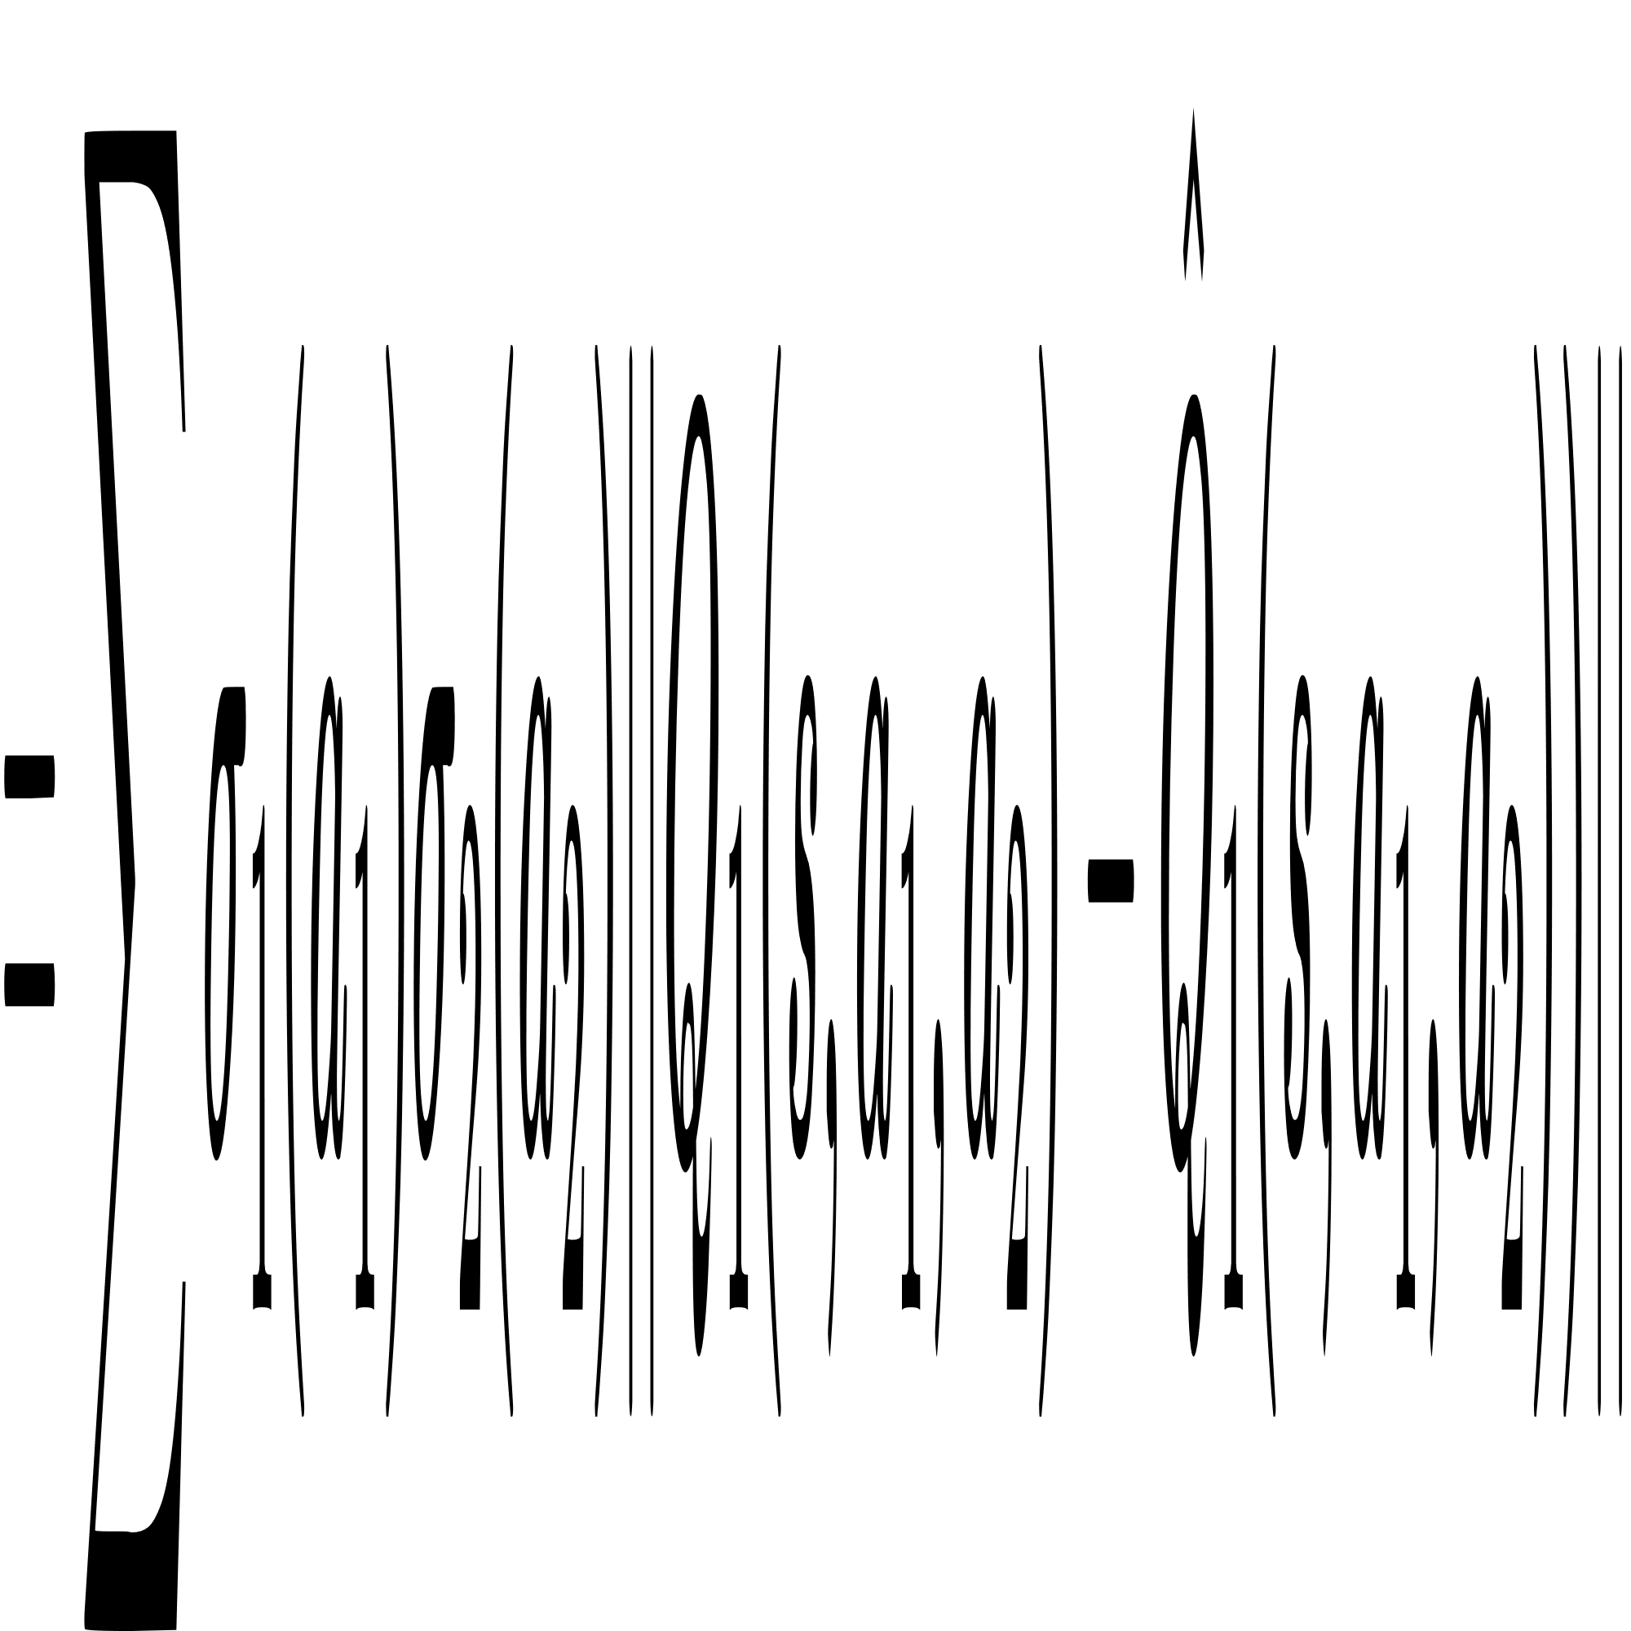
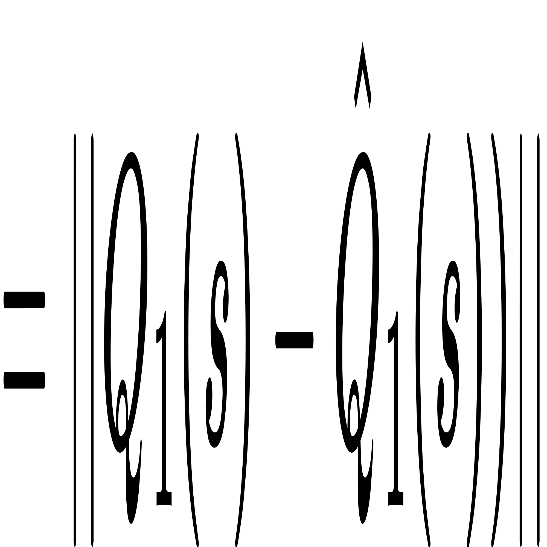
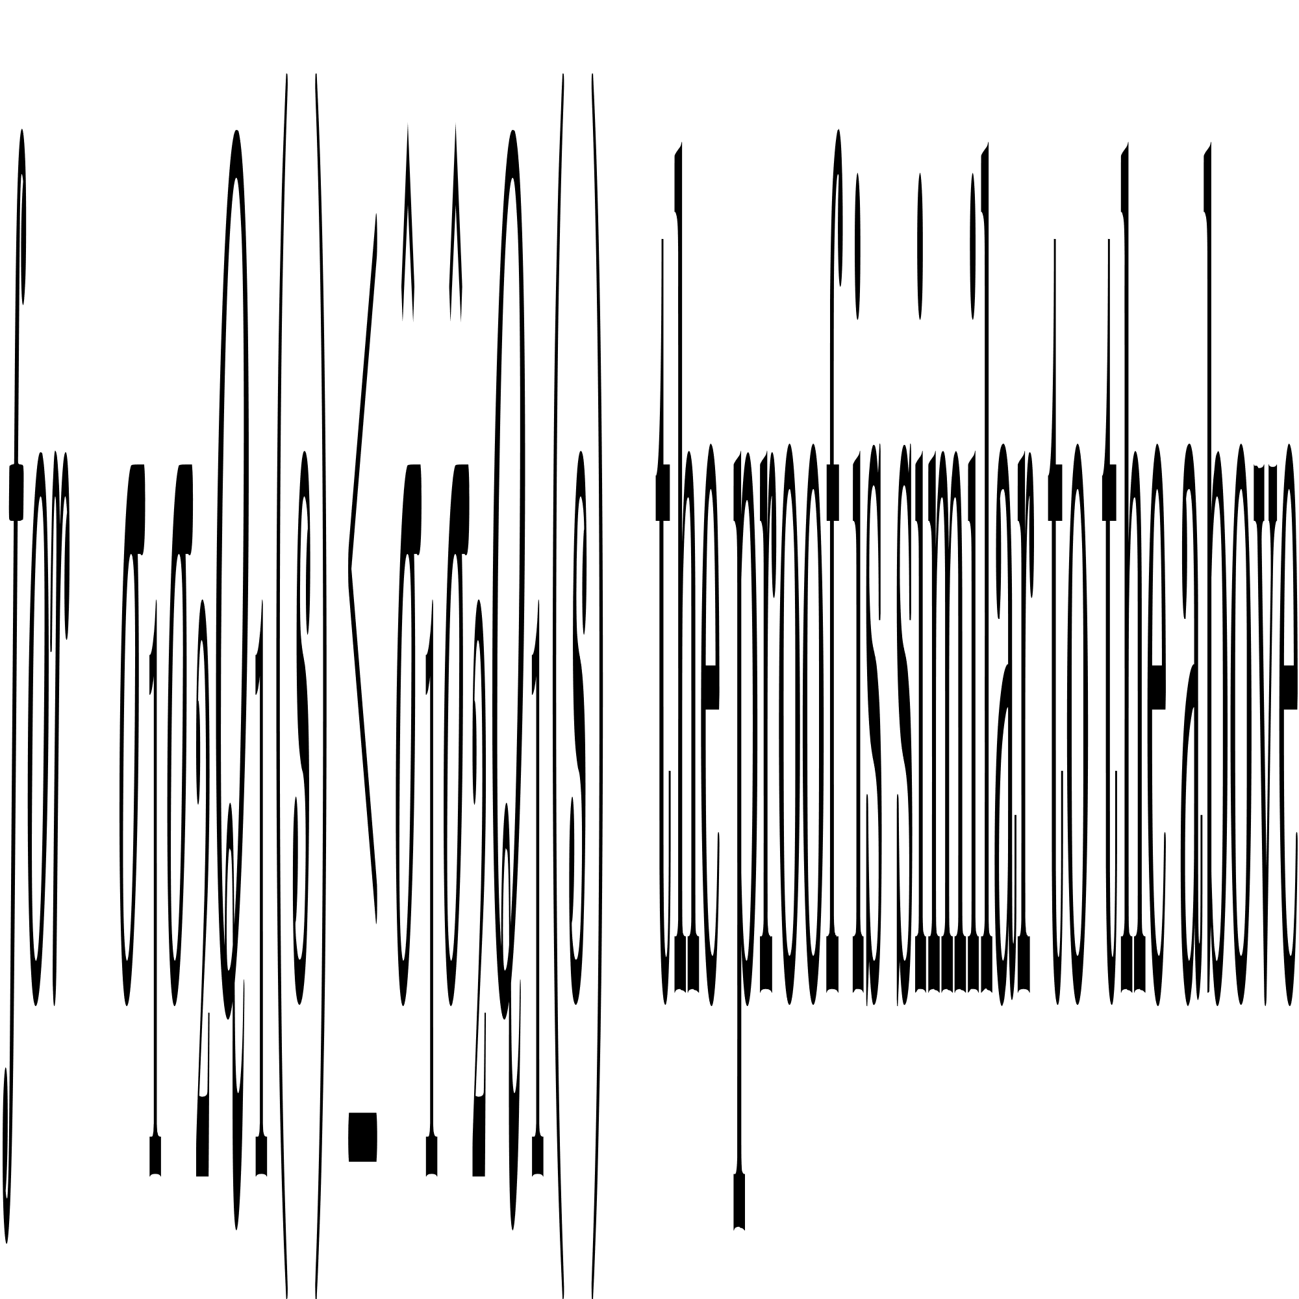
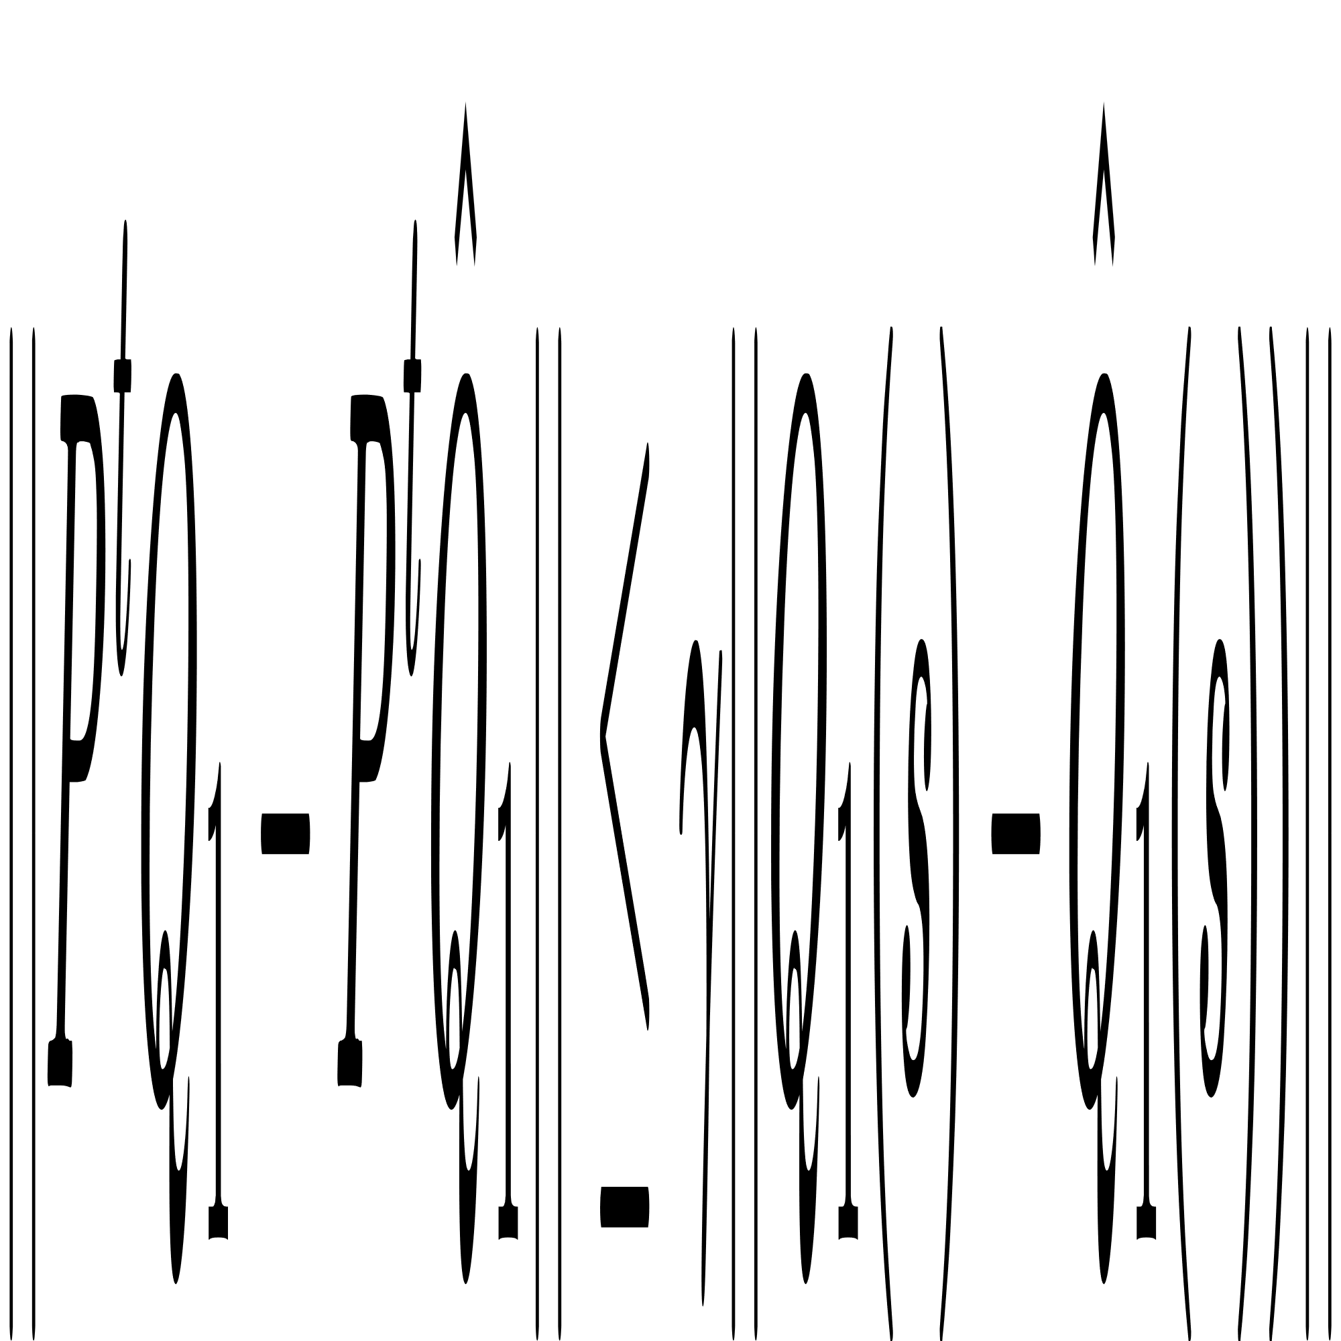
for j = 1,2
Leader

Slide 22
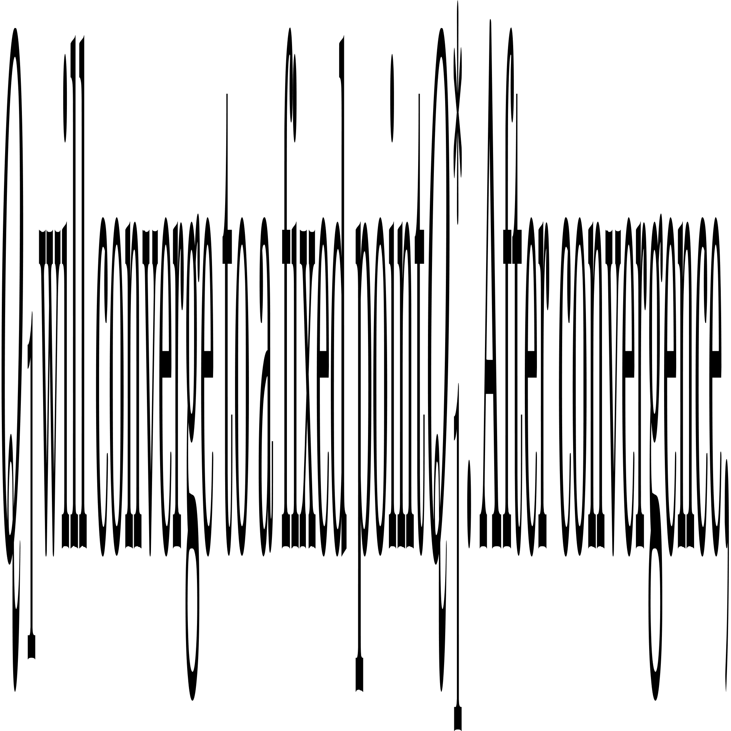
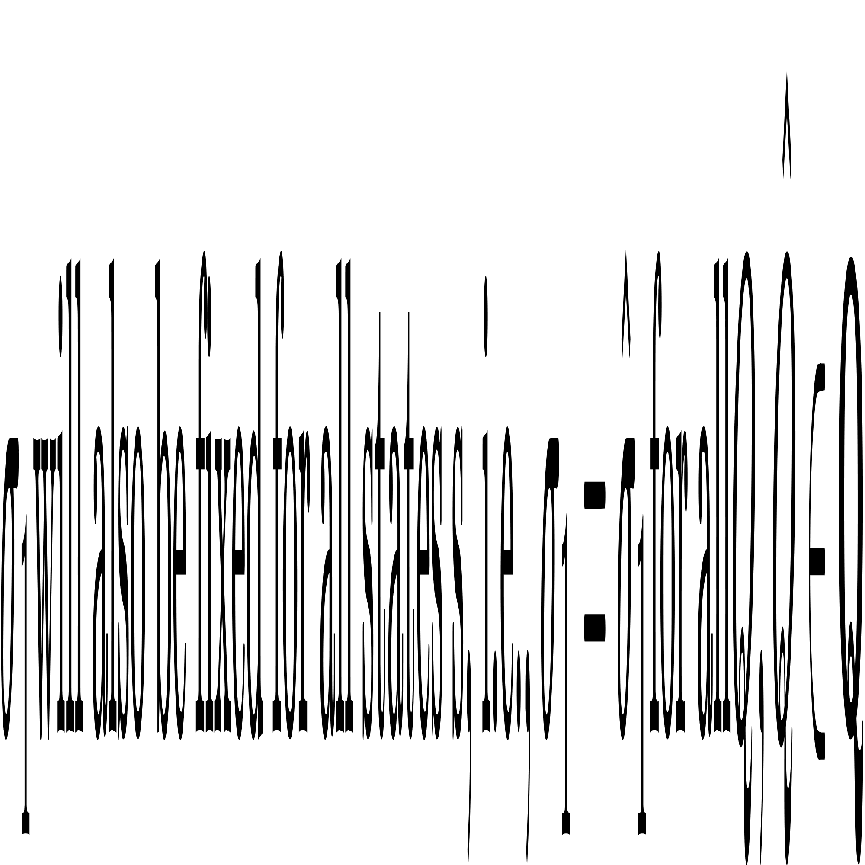
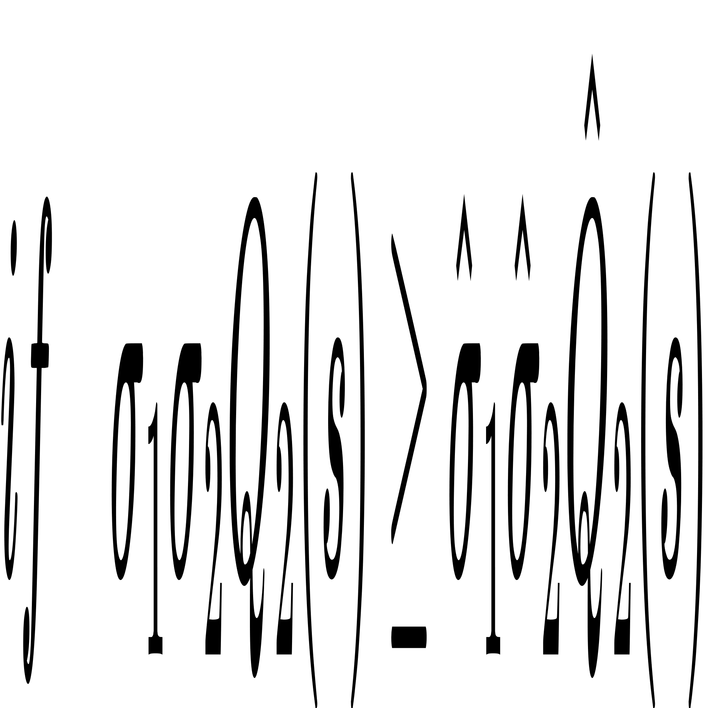











Follower

Slide 23


Experiments and Results
Merge Env(discrete action)
Bi-AC
C_SQ(ours)

Slide 24



Slide 25

Roundabout Env(discrete action)
Bi-AC
C_SQ(ours)

Slide 26



Slide 27


Intersection Env(continuous action)
Bi-AC, MACPO, C_SMADDPG(ours)
MAPPO_L

Slide 28



Slide 29


Racetrack Env(continuous action)
Bi-AC
C_SMADDPG(ours)

Slide 30


Racetrack Env
MACPO
MAPPO_L

Slide 31



Slide 32
Q & A

